Slide 1
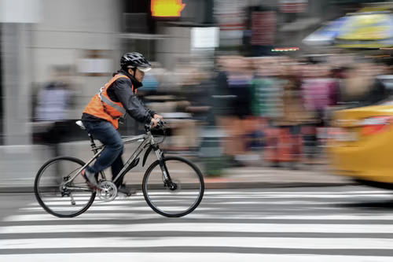

WORLD BANK ACADEMY
Leaders in Road Safety Management
Session 1:
The Road Safety Crisis

Slide 2

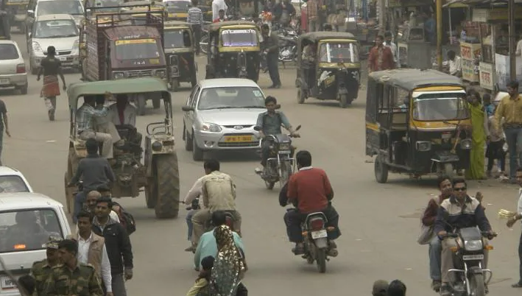
Road Safety: a Continuing Global Crisis
Road transport is responsible for 97% of deaths from all modes of transport
1.19 million die from road traffic crashes and up to 50 million people injured every year
Road traffic fatality is the leading cause of death for children and young adults 5–29 years of age
More than half of the fatalities are vulnerable road users: pedestrians, cyclists, and motorcyclists
92% of traffic fatalities occur in LMICs
75% of FSIs globally are men

Slide 3
Trends of Road Traffic Fatalities and Serious Injuries
More people die in road traffic crashes than by HIV/AIDS, malaria or tuberculosis.
Middle-Income countries have the largest share of the global health burden.
The rise of road traffic deaths and serious injuries are projected to continue in LMICs with their fast-growing number of vehicle fleets.
Benchmarking tuberculosis, HIV/AIDS, malaria and road traffic injuries.

Slide 4
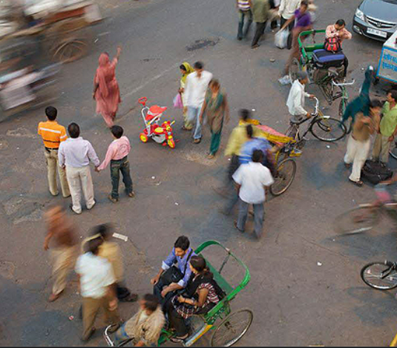
Costs of Road Traffic Fatalities and Serious Injuries
Road traffic crashes cost the economies of LMICs the equivalent of 2-6 % of their GDP every year.
Country wealth is deprived due to loss of human capital, largely impacting the poor and productive ages.
Missed opportunity for economic growth and ending poverty.
Health cost per casualty can reach up to 300% of current health expenditure per capita and 20% of per capita GDP.

Slide 5
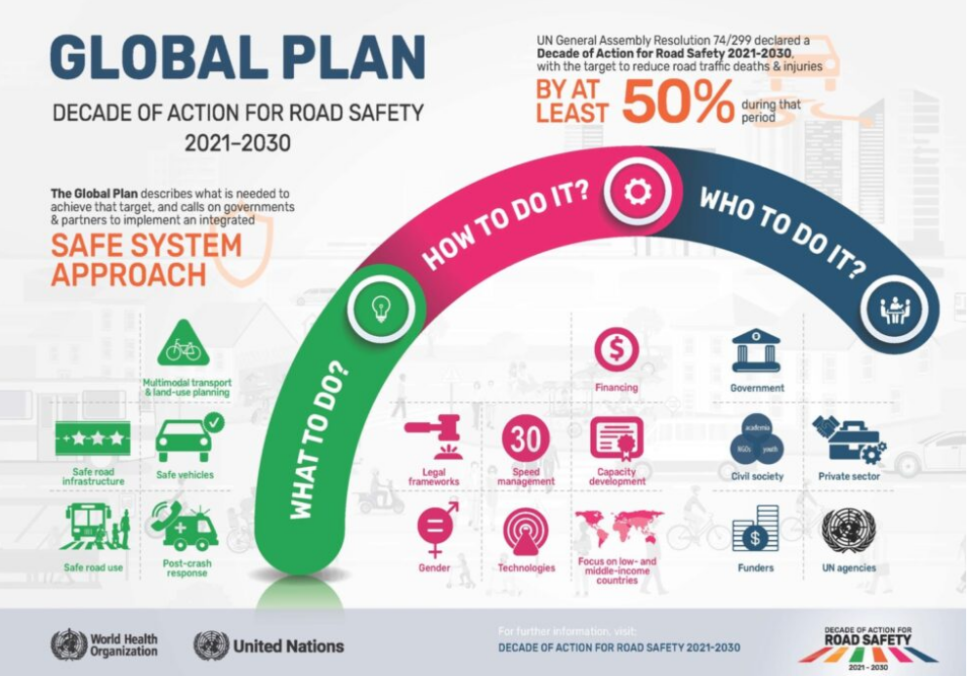
Challenges Ahead
The second Decade of Action for Road Safety 2021-2030
Reducing road traffic deaths and injuries by at least 50 percent
“The Global Plan goal foresees a further 13 million traffic deaths and 500 million injuries on the world's roads and streets over the coming decade, unless bold and decisive measures are taken.”

Slide 6
Shift of Road Safety Financing
Country demand is growing and evolving: the challenges of road safety project complexity must not be viewed as a barrier to action.
A third generation of projects is emerging, which take a more programmatic approach to meeting country demand for road safety financing support, on an even larger investment scale.

Slide 7
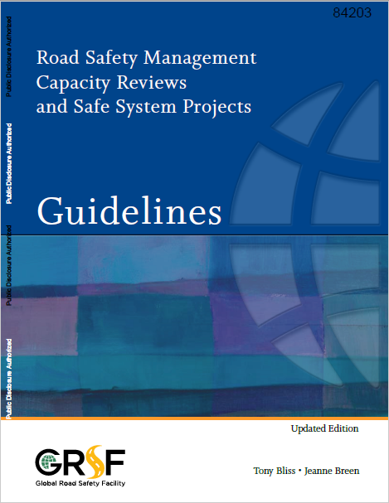
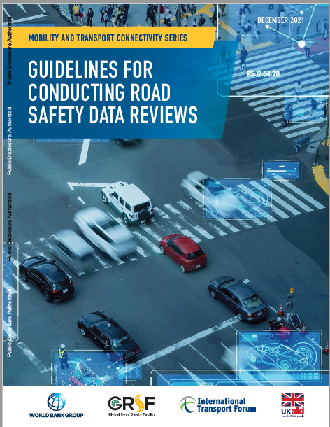
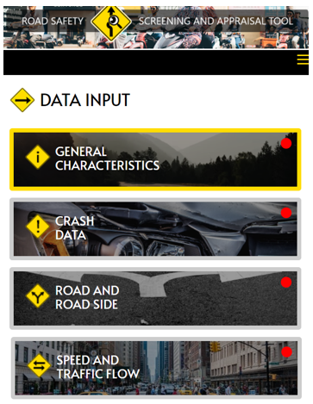
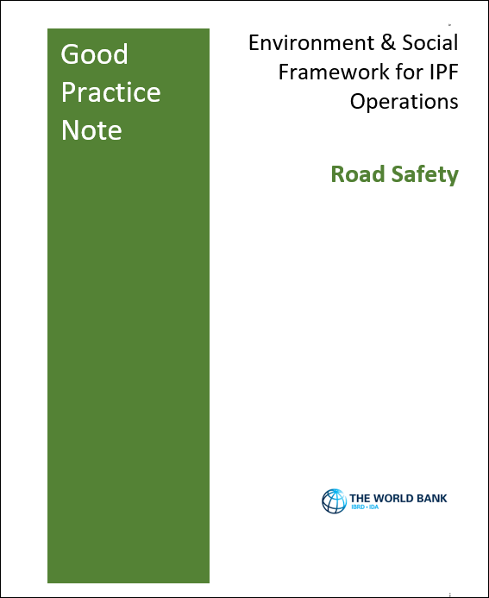
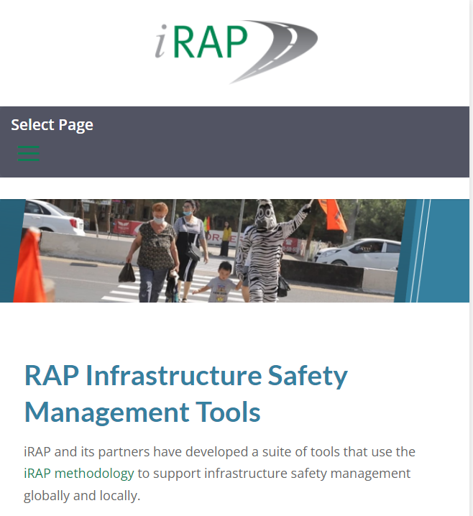
Road Safety Available Tools
Road Safety Management Capacity Reviews
Guidelines for Conducting Road Safety Data Reviews
Road Safety Screening and Appraisal Tool (RSSAT)
Good Practice Note
for Road Safety
Road Assessment Program
Notes:
1.5 minutes

Slide 8
THANK YOU
www.roadsafetyfacility.org
WORLD BANK ACADEMY
Leaders in Road Safety Management

