Slide 1


WORLD BANK ACADEMY
Leaders in Road Safety Management
Session 3:
Road Infrastructure
Safety Management Tools
and their Applications

Slide 2

Road infrastructure safety management tools
What we will cover in this session:
  Why should we do Infrastructure Safety Management?
  What is Infrastructure Safety Management?
  How do we do Infrastructure Safety Management? “Tools” that are available
  When should we do Infrastructure Safety Management?
  Which ones should be used, and when?
  Examples and key issues to consider with some of the more common tools

Slide 3
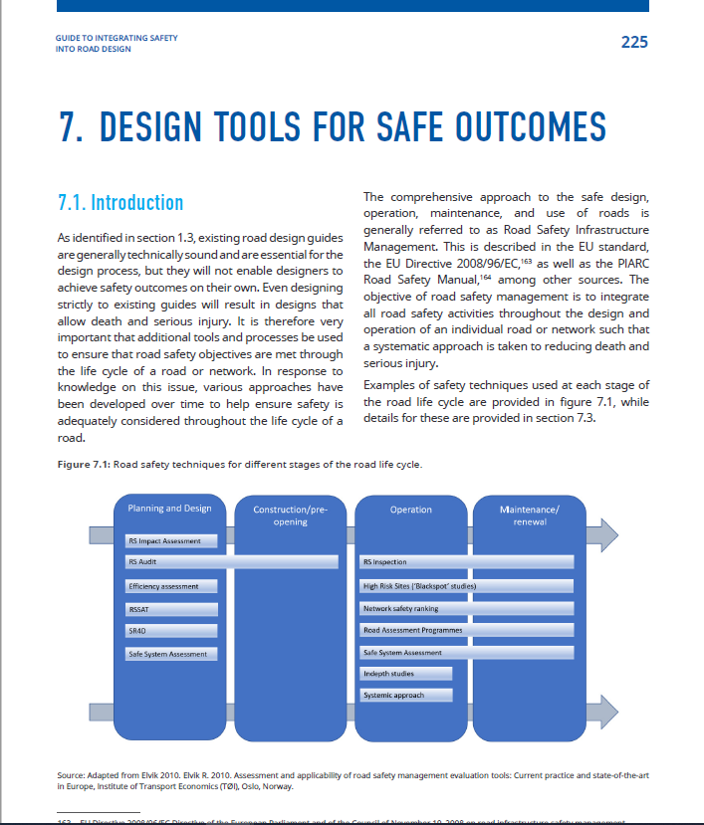
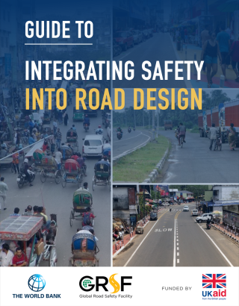
A new guide…
https://www.roadsafetyfacility.org/publications/integrating-safety-road-design

Slide 4
Why should we do infrastructure safety management?
Road infrastructure has the most significant influence on the severity of the crash outcome
Eliminate death and serious injury through safe design
Highly cost-effective and we can control this in projects
What about the Guidelines and Standards?
  Not enough- as they will NOT enable designers to achieve safety outcomes on their own. We need tools.

Slide 5
What is Infrastructure safety management?
A systematic approach to improve road infrastructure safety by applying strategies and tools to all phases of planning, design, construction and operation of road infrastructure

Slide 6
What is Infrastructure safety management
A systematic approach to improve road infrastructure safety by applying strategies and tools to all phases of planning, design, construction, and operation of road infrastructure
Systematic – must be planned, embedded as part of policy
Can introduce at the project level, but try to develop a strategy

Slide 7
How do we do infrastructure safety management?
A systematic approach to improve road infrastructure safety by applying strategies and tools to all phases of planning, design, construction and operation of road infrastructure
Strategies and tools – there are many!
Importance of metrics- what gets measured gets done!
Requirement for road safety data
Reactive vs proactive

Slide 8
When should we do infrastructure safety management?
A systematic approach to improve road infrastructure safety by applying strategies and tools to all phases of planning, design, construction and operation of road infrastructure
All phases
Earlier means easier to influence design; cheaper
Most crashes will occur during operation

Slide 9
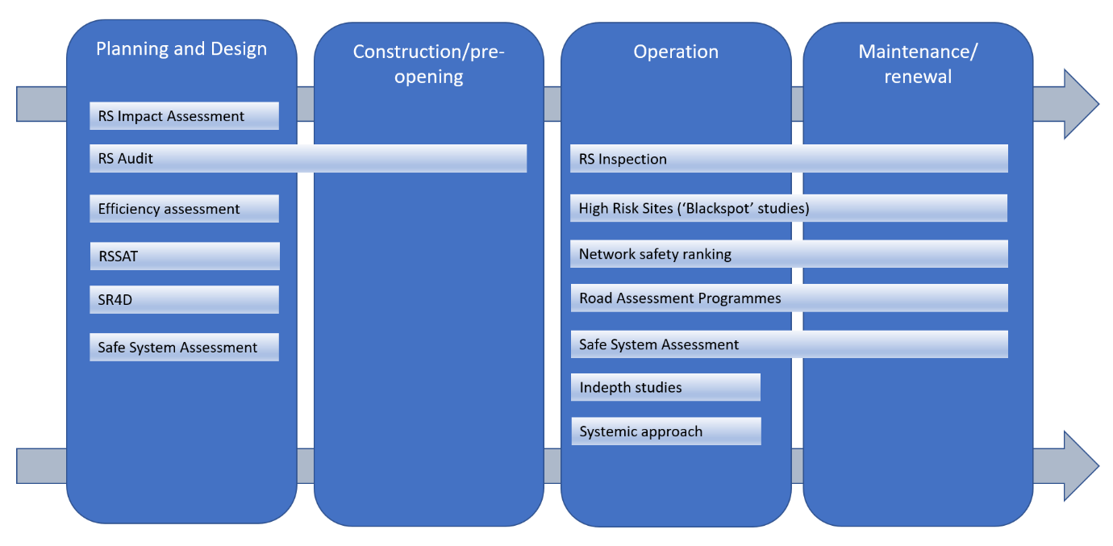
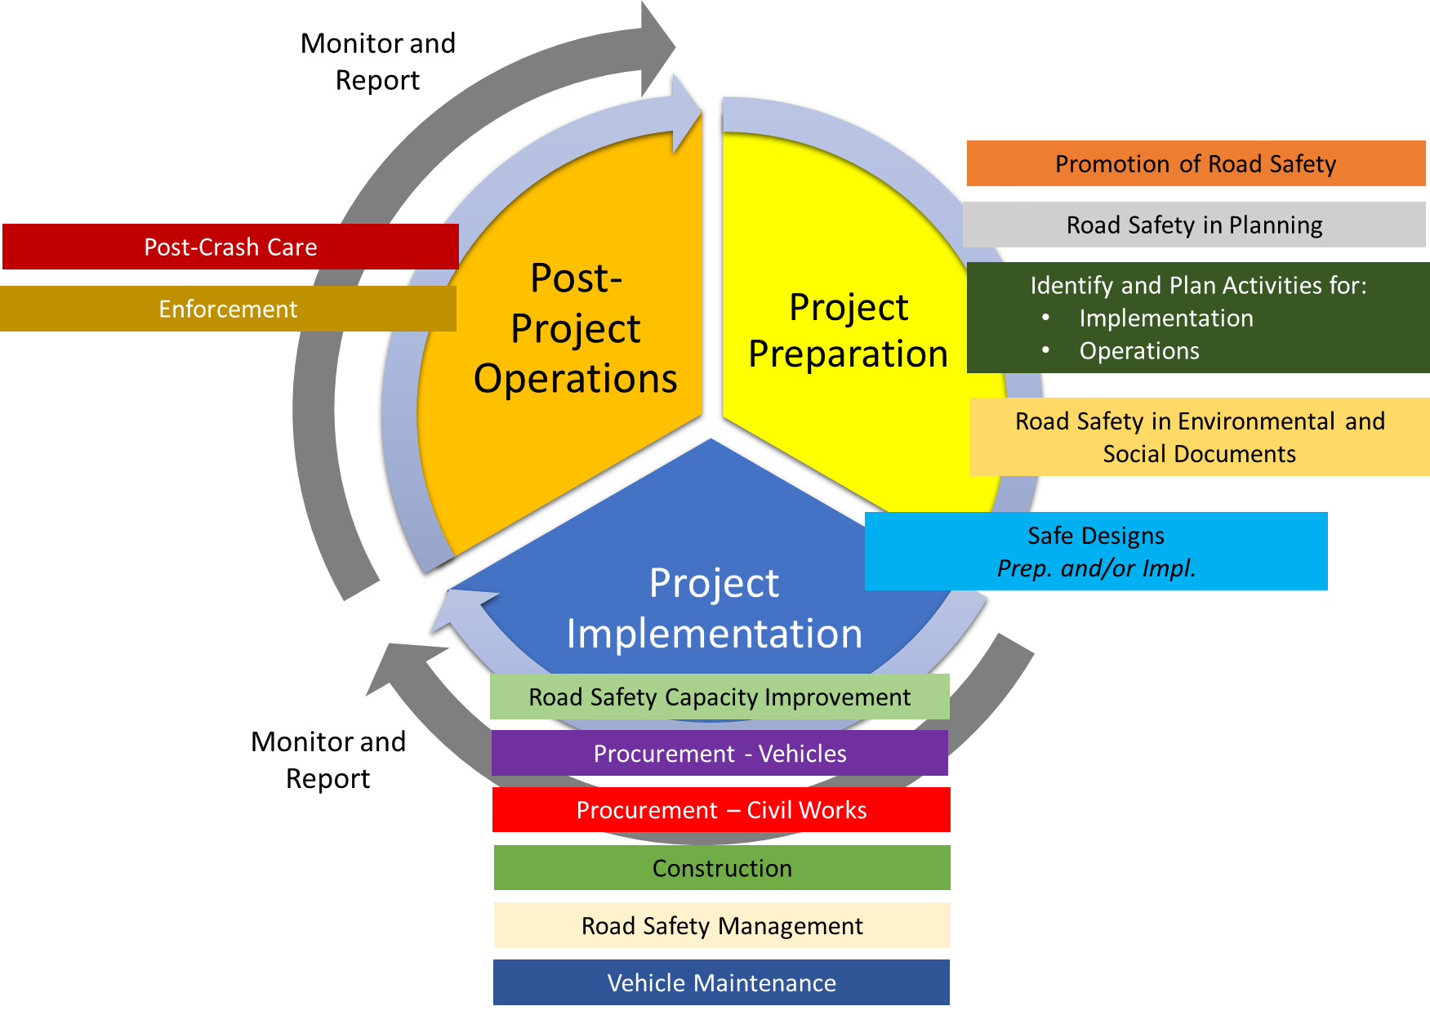
The tools
Project Preparation
Implementation
Post-project Operations

Slide 10
Reactive approaches
The tools
Proactive approaches
Project Preparation
Implementation
Post-project Operations

Slide 11

The importance of the tools
Paint a warning line?
Put up a warning sign?
Teach people not to cross the line
      Sensitization programs?
      School education programs?
Or …..

Slide 12
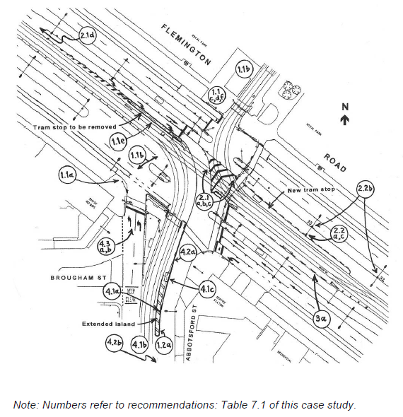
Planning and design
Road Safety Audit (RSA)
Most commonly applied tool in road safety
“a formal examination of a future road or traffic project, or an existing road, in which an independent, qualified team looks at the project’s crash potential and safety performance.”
Usually in 4 stages:
Concept designs
Detailed design
Preopening of the road
Post Opening Monitoring

Slide 13
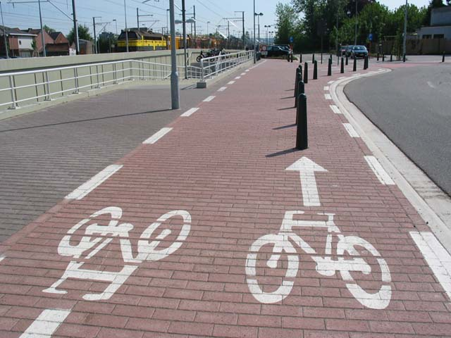
Planning and design
Road Safety Audit (RSA)
Not a check against standards and guidelines
Need adequately trained experts (teams) and capacity at country level
Need a robust process for audits – especially when addressing recommendations
Learn from audits – a training opportunity for designers; a chance to update guidance
Think Safe System – may need more than simple changes to lines and signs

Slide 14
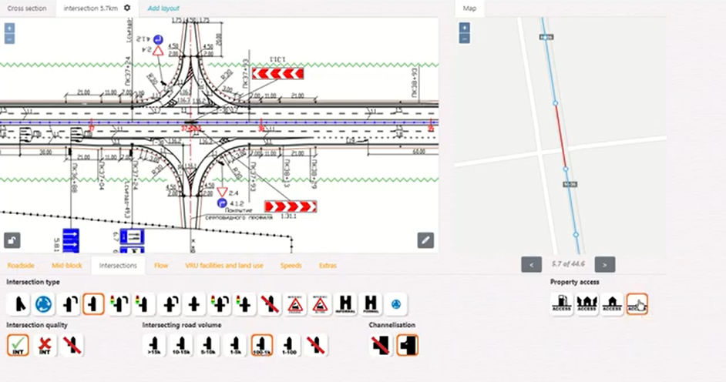
Planning and design
Other assessment methods
  Road Safety Impact assessment (RSIA) – introduces economic assessment for differing options
  Star Rating for Designs – estimate safety impact based on star rating
  Safe System Assessment – estimate potential for fatal and serious crash outcomes

Slide 15

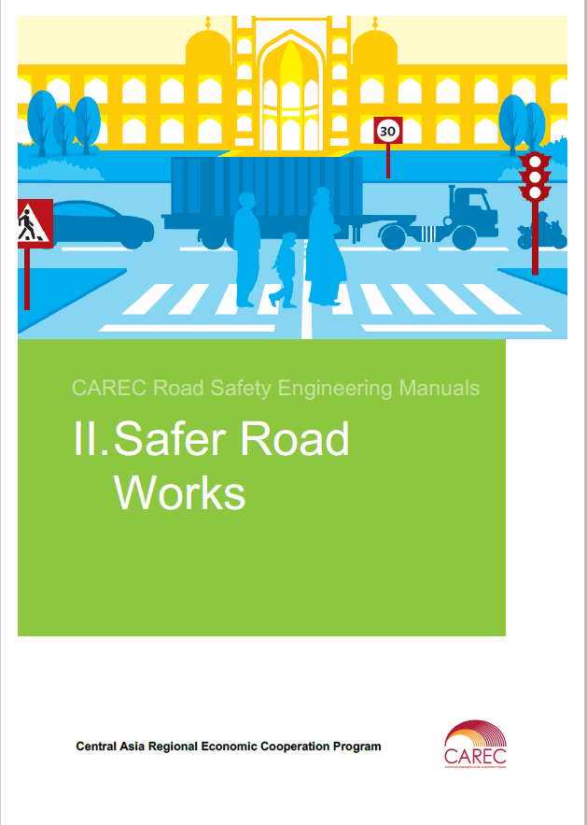
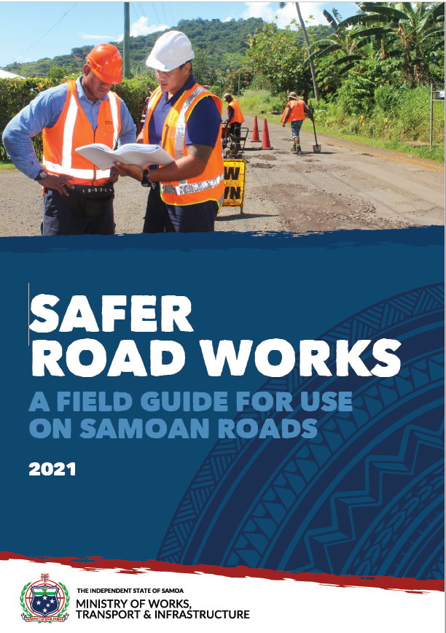
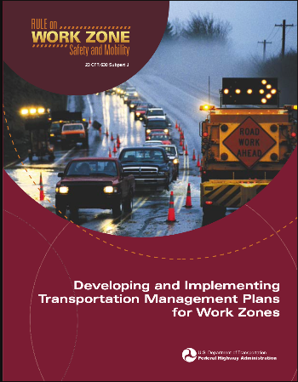
Construction
Road Works Safety Audit

Slide 16
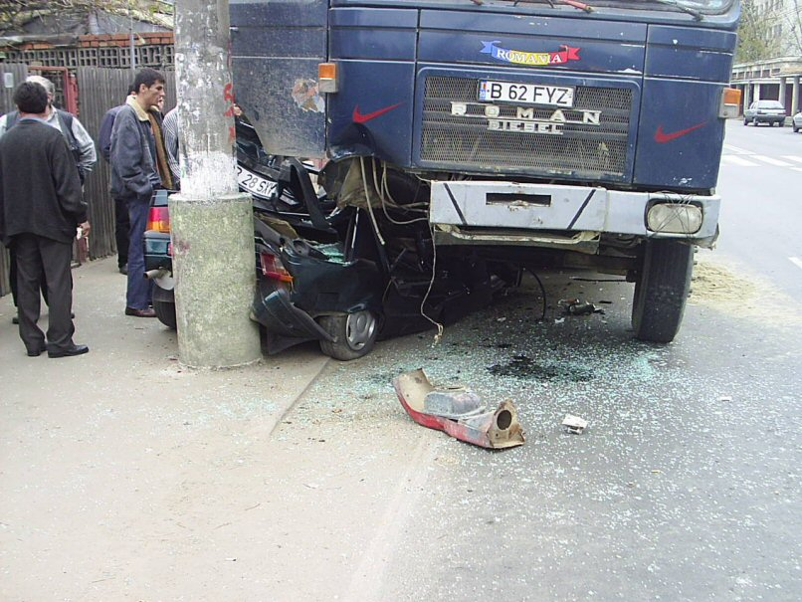
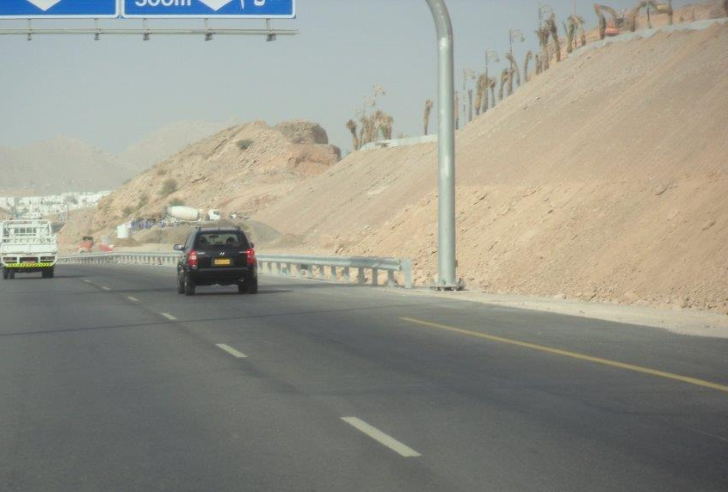
Operation / renewal
Road Safety Inspection (RSI)

Slide 17
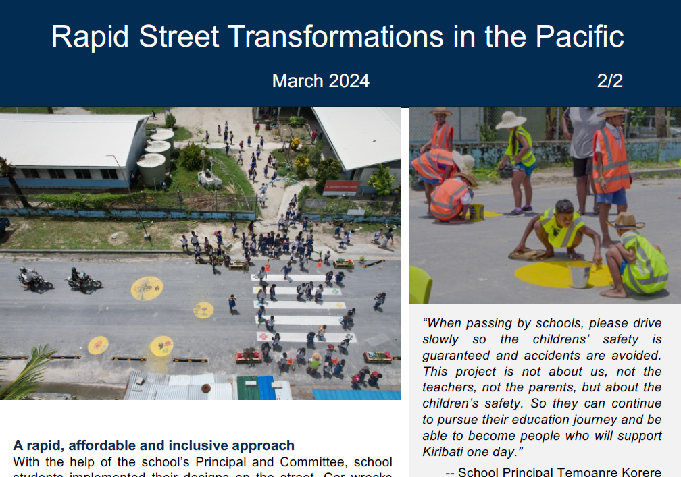
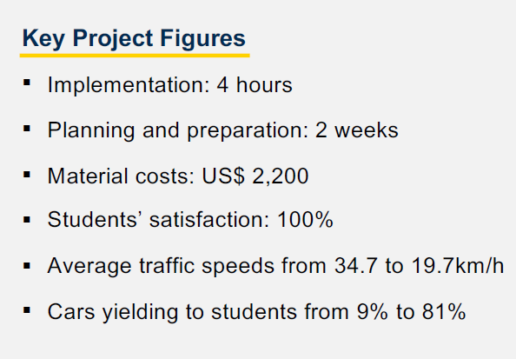
Operation / renewal
In-depth studies – i.e. tactical urbanism

Slide 18
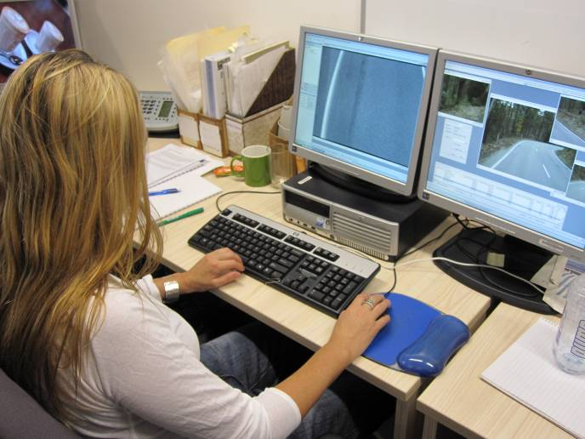
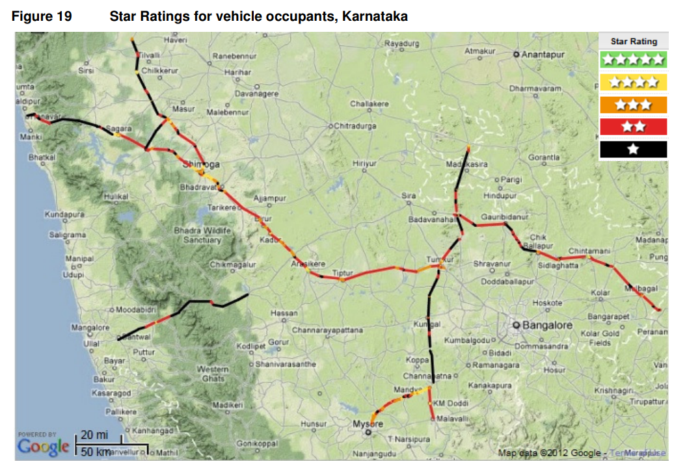
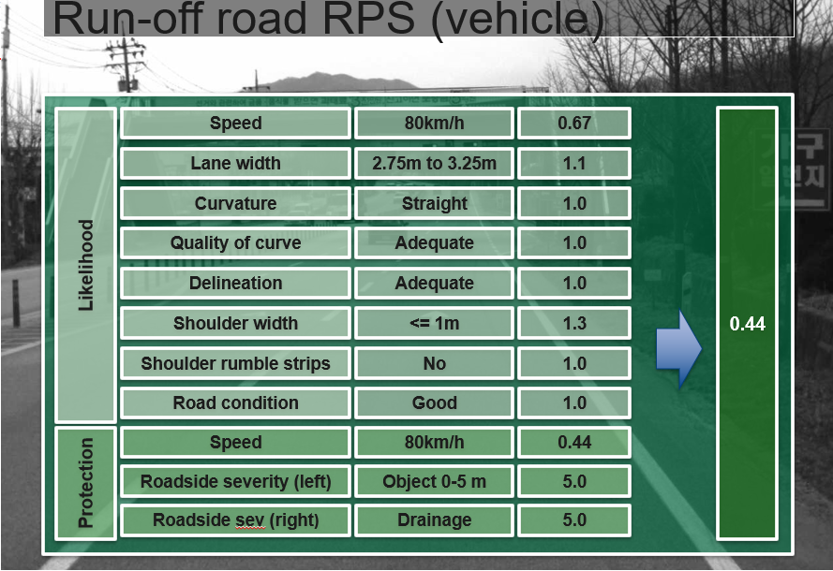
Operation / renewal
Road safety assessment programmes
  iRAP
  Quantifies risk for different road users at network level; applies a star rating; develop safety plans

Slide 19
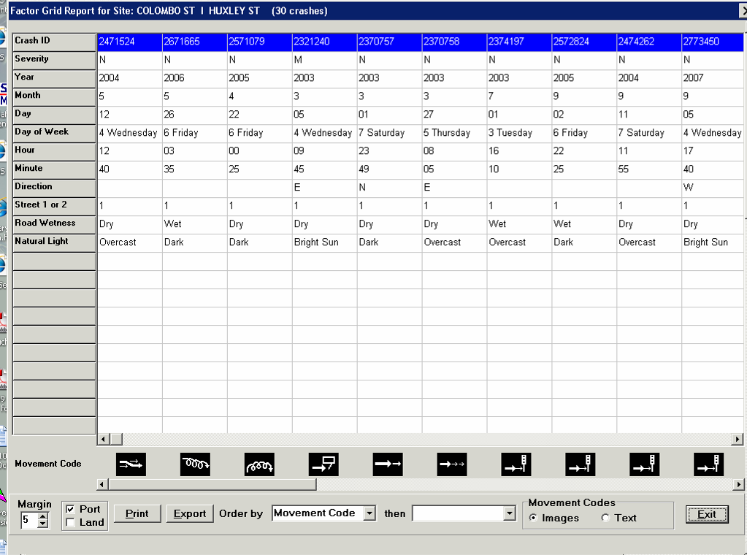
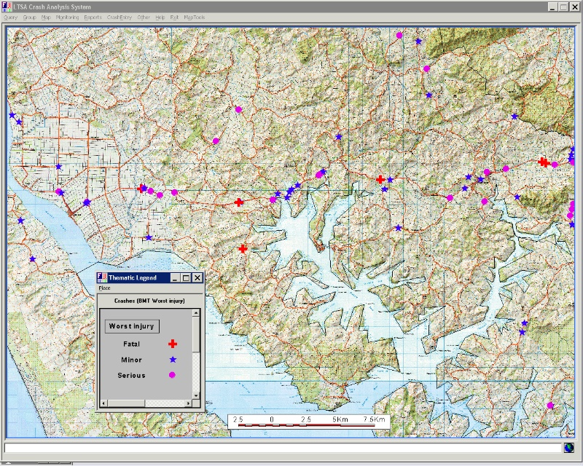
Operation / renewal
Blackspot studies
  A reactive approach – a ‘dated’ approach?
  Routes, areas or themes
  Most cost effective fatal and serious injury reduction

Slide 20
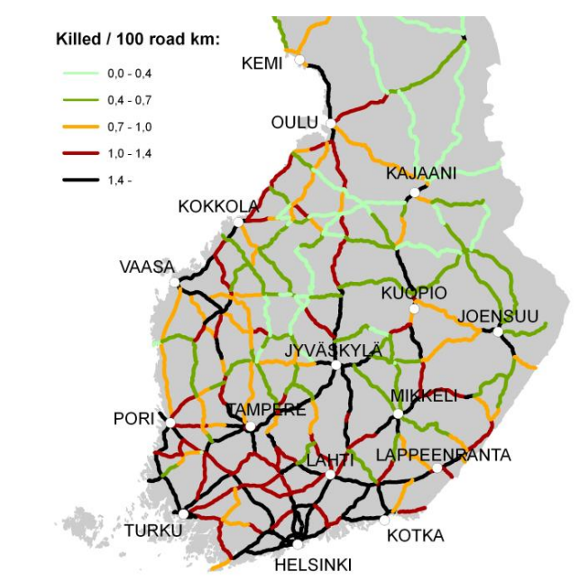
Operation / renewal
Network level studies / safety rankings
  High risk sections – usually homogenous
  Based on crash data / crash rates
  Compare to an average for that road type
  Can apply sophisticated models (e.g. Empirical Bayes) to predict rates and compare
  Assessing potential for improvement (crash reduction / cost saving)

Slide 21
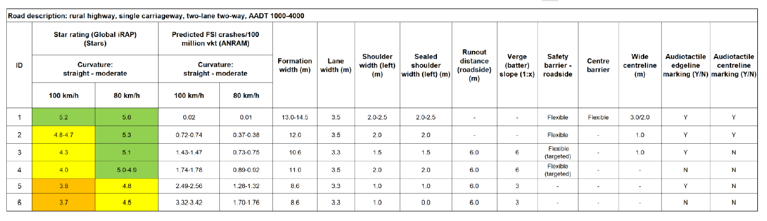
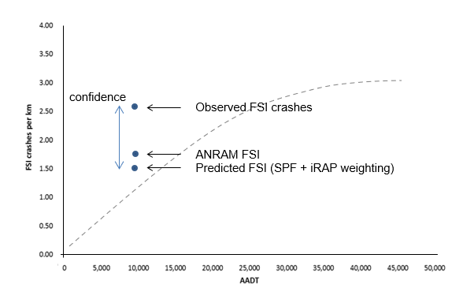
Operation / renewal
Hybrid and new approaches
  Crash data and predictive models
  Road safety inspection and iRAP
  Star ratings for designs
  Road stereotypes

Slide 22

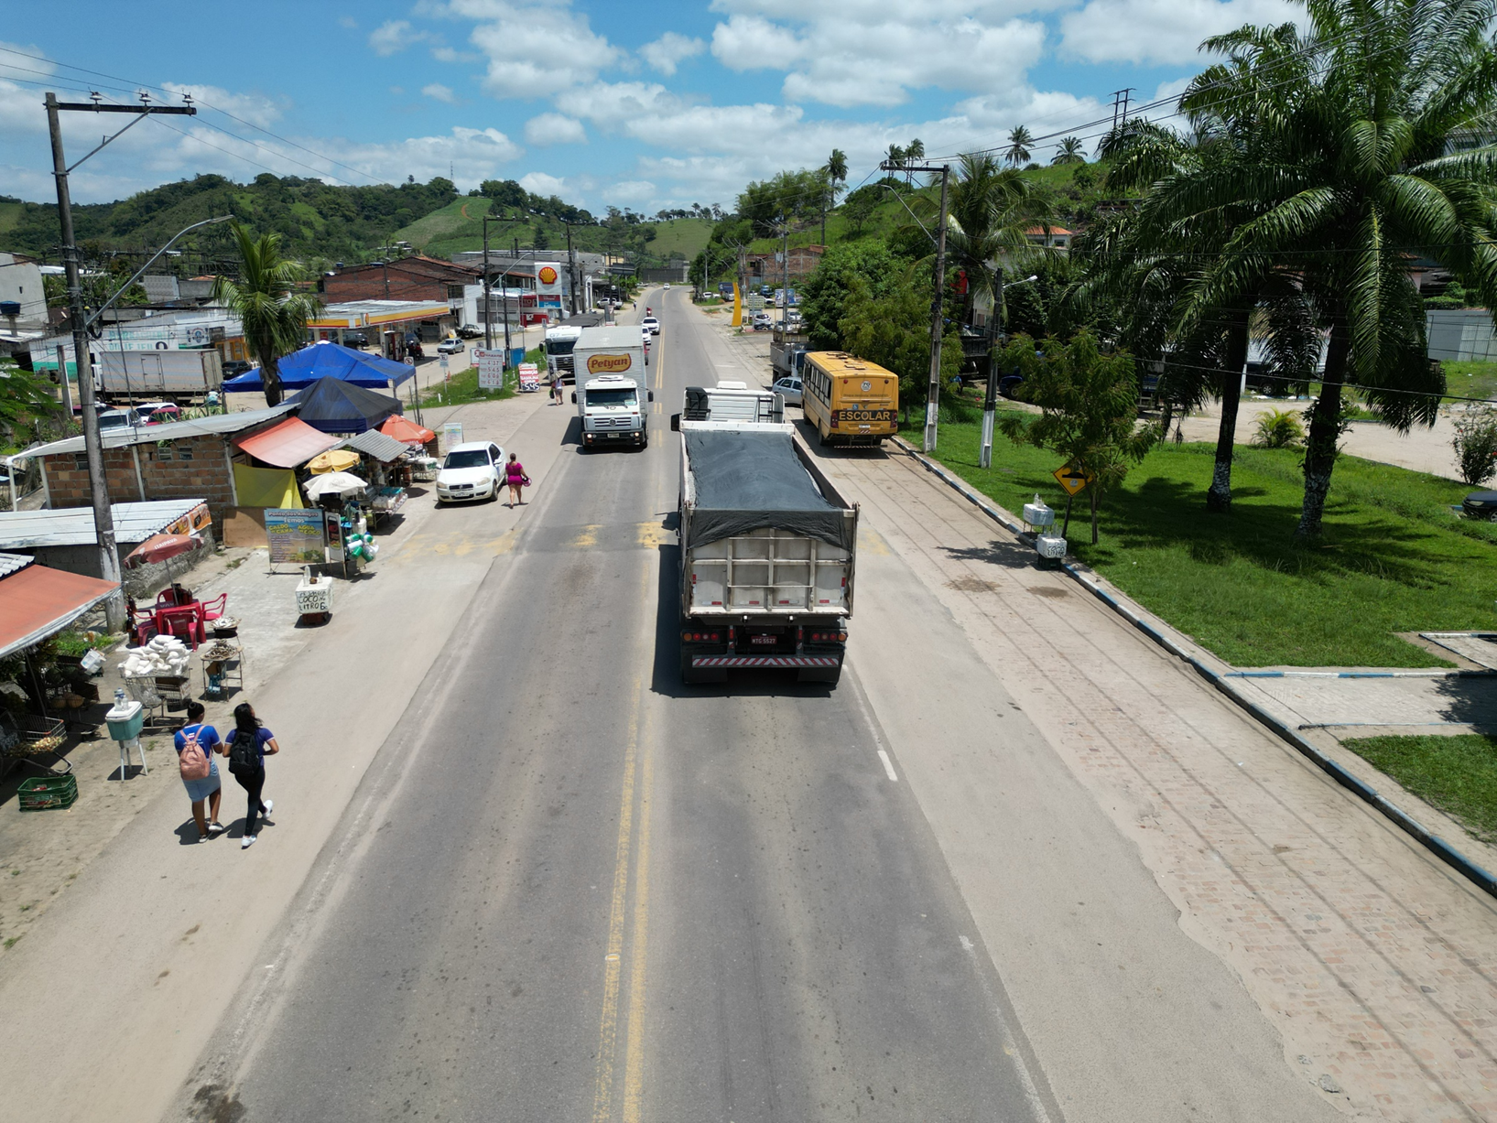
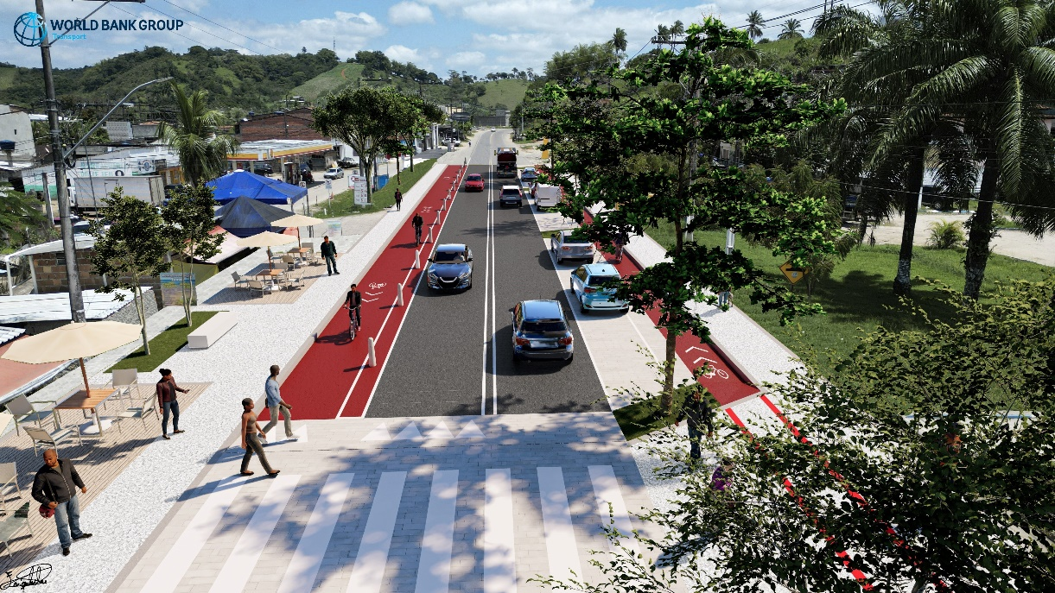
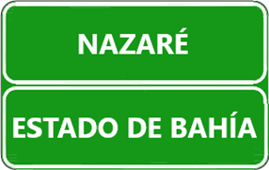
Visualizing the Results - Renderings
Brazil
Current situation
Planned investments
Source: Enrique Juan Urcola Telleria, Marta Rodrigues Obelheiro, Carlos Bellas Lamas

Slide 23
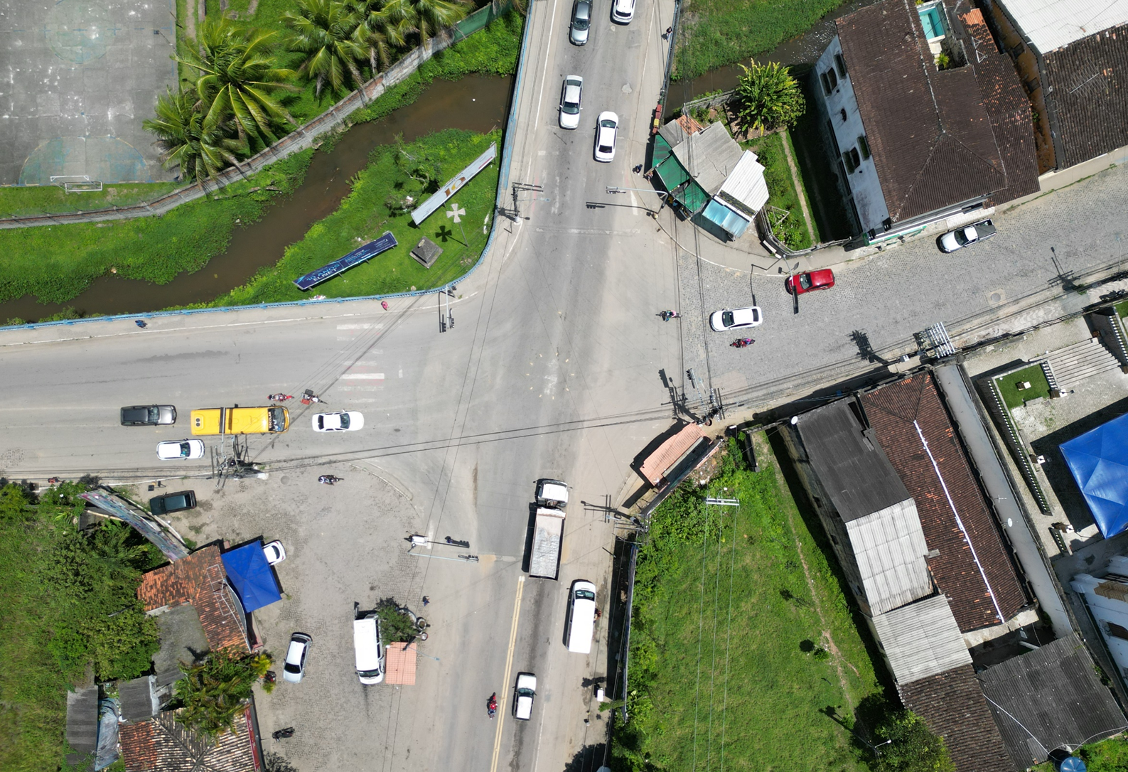
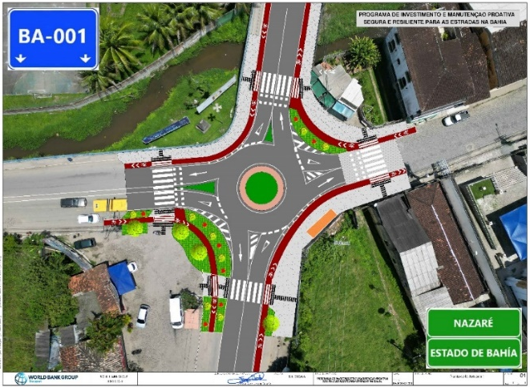
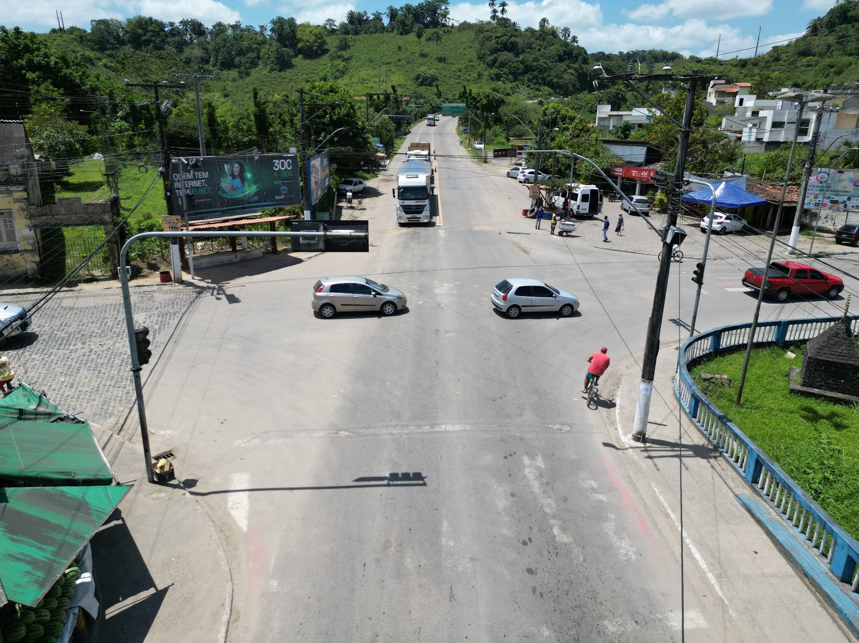
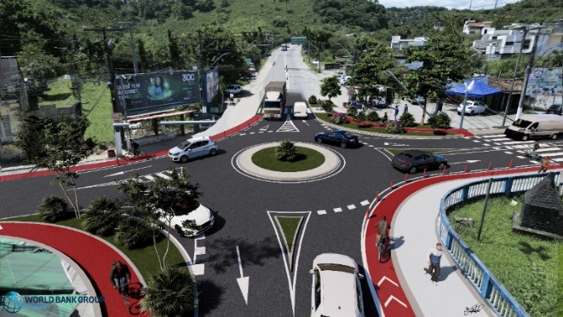
Visualizing the Results - Renderings
Brazil
Current situation
Planned investments
Source: Enrique Juan Urcola Telleria, Marta Rodrigues Obelheiro, Carlos Bellas Lamas

Slide 24
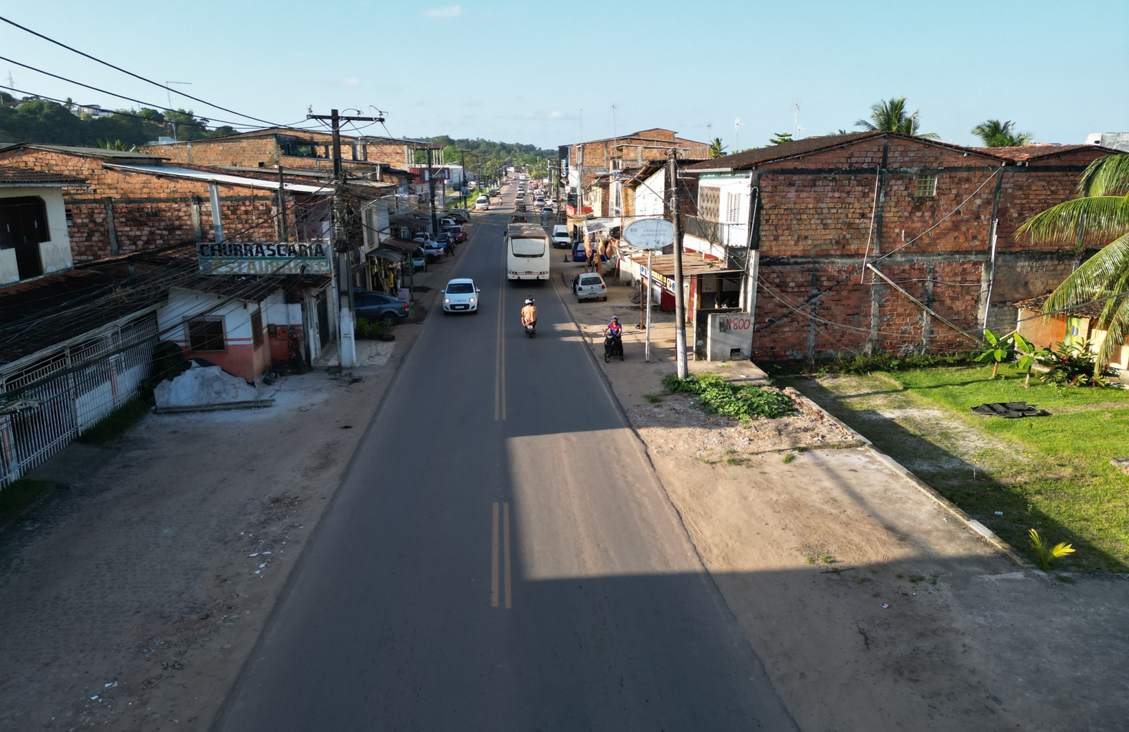
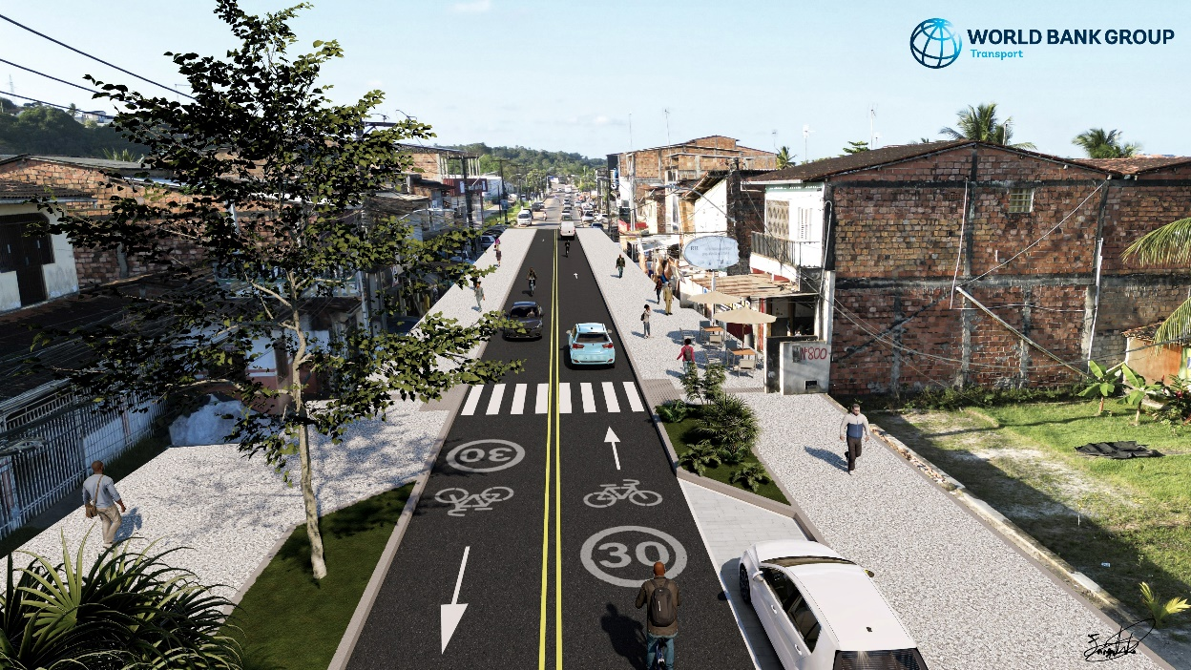
Visualizing the Results - Renderings
Brazil
Current situation
Planned investments
Source: Enrique Juan Urcola Telleria, Marta Rodrigues Obelheiro, Carlos Bellas Lamas

Slide 25
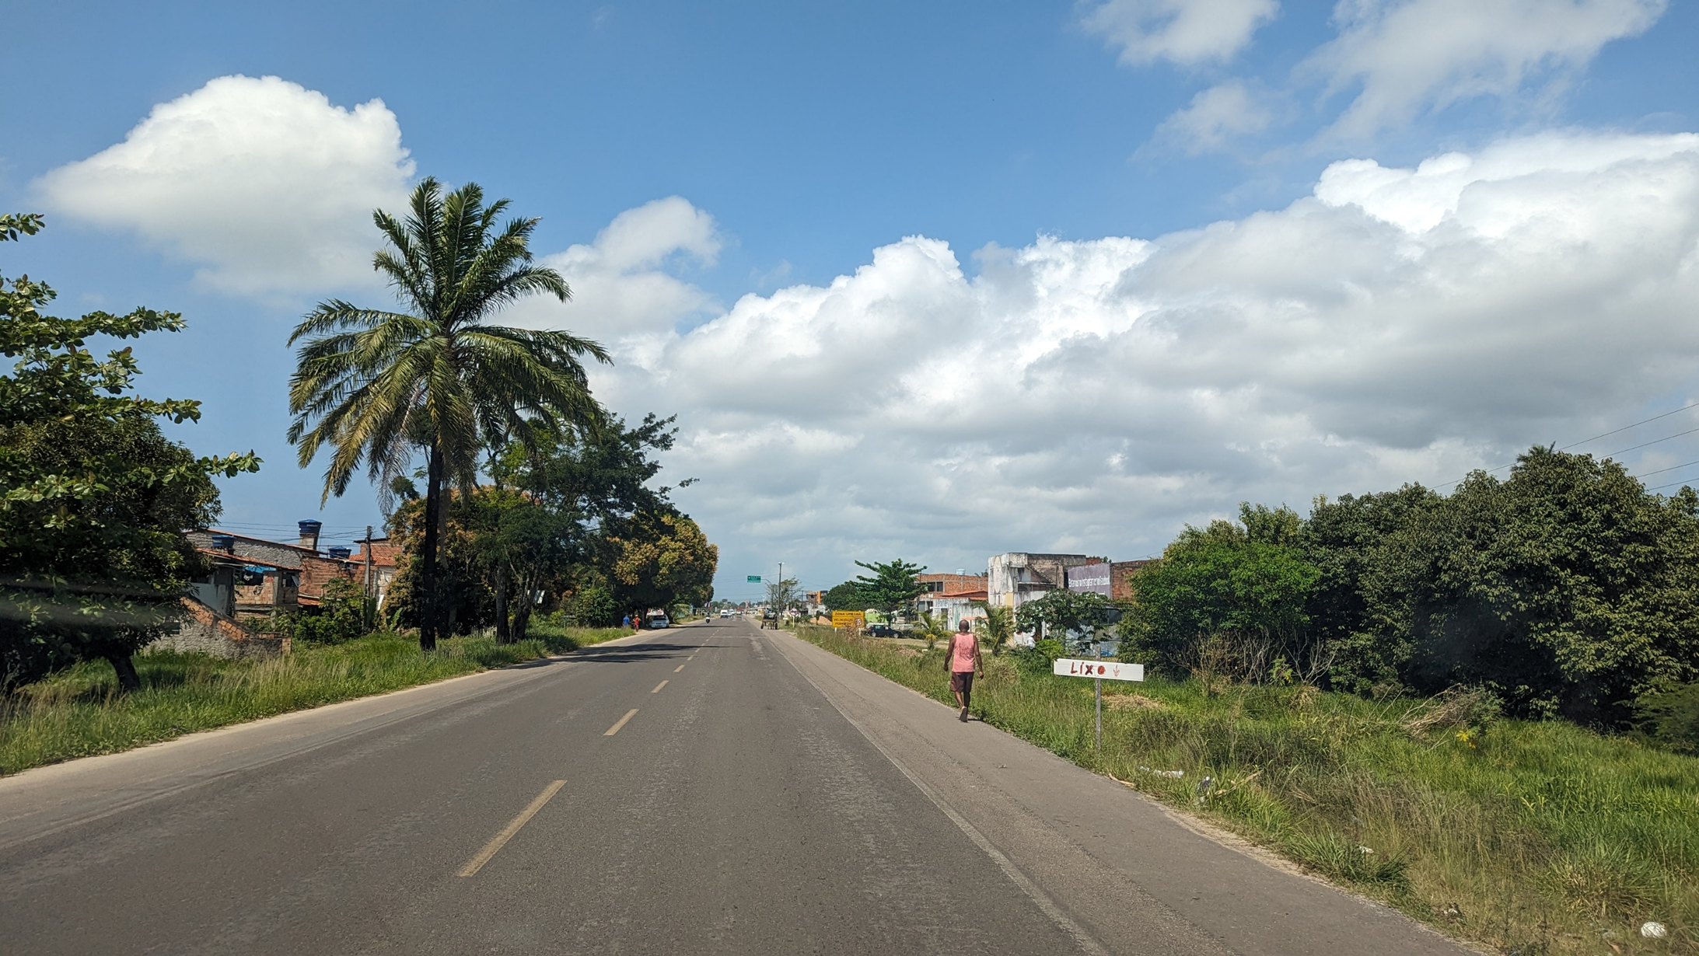
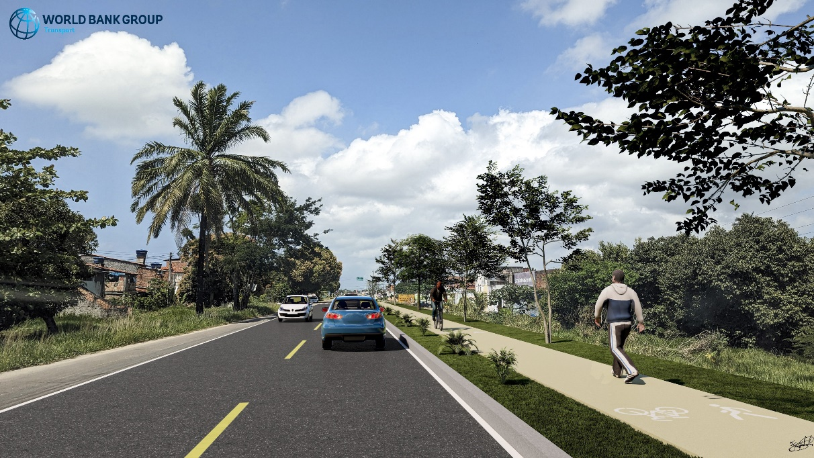
Visualizing the Results - Renderings
Brazil
Current situation
Planned investments
Source: Enrique Juan Urcola Telleria, Marta Rodrigues Obelheiro, Carlos Bellas Lamas

Slide 26
Question
How do we select the most appropriate tool (or tools) to assess and treat road infrastructure risk for projects?

Slide 27
The tools - summary
  Use tools in combination and as at many stages as you can
  Should use road infrastructure safety assessment – road safety audit is most common; crash data if available
  No right answer on tools – World Bank- GRSF can support!
  Should improve data quality and use crash data
  Use projects to develop capacity and build infrastructure safety management policy and procedures

Slide 28
THANK YOU
www.roadsafetyfacility.org
WORLD BANK ACADEMY
Leaders in Road Safety Management

