Slide 1
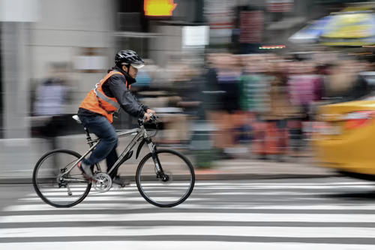

WORLD BANK ACADEMY
Leaders in Road Safety Management
Session 4:
Designing Road Safety Activities
and Associated Results

Slide 2

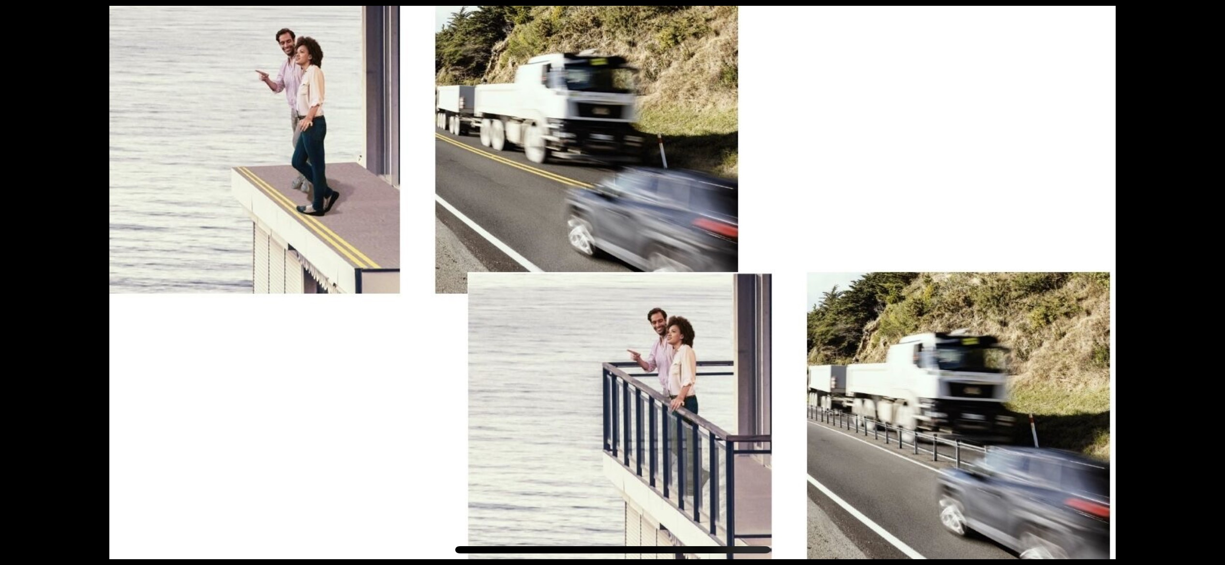
Increasing RS Impacts
The Safe System Approach
Paint a warning line?
Put up a warning sign?
Teach people not to cross the line
      Sensitization programs?
      School education programs?
Or …..

Slide 3
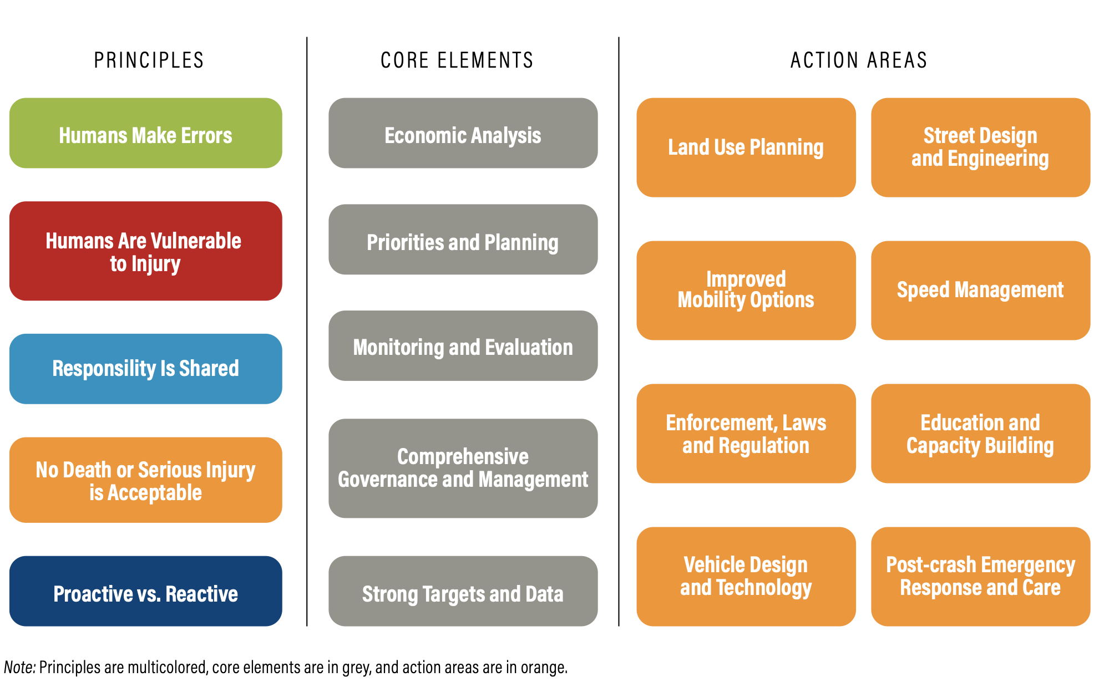
Increasing RS Impacts
The Safe System Approach
People make mistakes
Limited human tolerance to crash forces
Shared responsibility
Zero deaths and serious injury
Solutions can be found across all pillars
Other elements
  Proactive approach
  Focus on fatal and serious injuries
  A vision – directs interim strategies
Notes:
This approach is a radical departure from how we have traditionally approached road safety.
Key differences:
Safe system focus is on fatalities and serious injuries (FSI) not crashes. Under a safe system we are happy to have more minor crashes if it reduces FSI
Users are not the problem, it is a system failure instead. We need to allow for users making mistakes
The responsibility for safety is with the system designers and operators
Focus is on interventions which reduce the energy from a crash

Slide 4
World Bank Road Safety Investments
The GRSF has guided a shift from the financing of first-generation road safety projects to the next generational level; i.e. a shift from small road safety components of road infrastructure projects to larger standalone, multisectoral road safety projects. A third generation of projects is emerging, which takes a more programmatic approach to meeting country demand for road safety financing support, on an even larger investment scale.

Slide 5
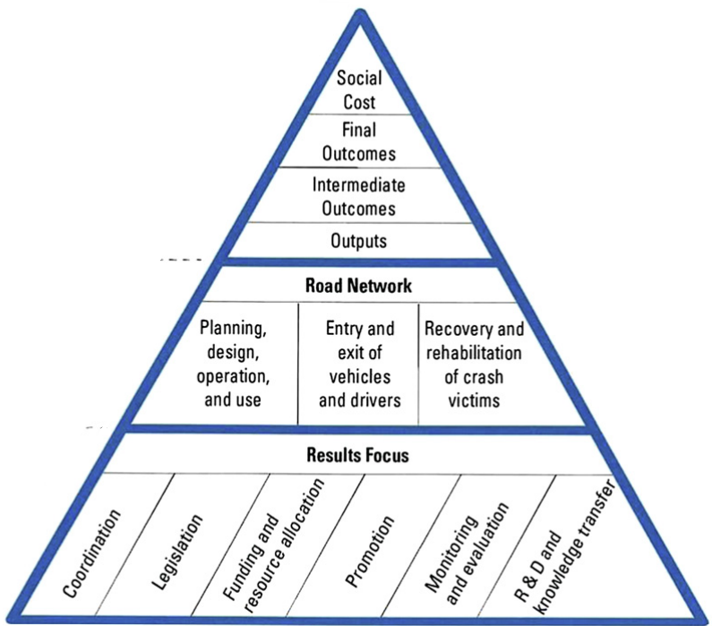
Designing Road Safety Component
Prioritize Road Safety Management Functions in your Projects.
Projects should consider 'second generation' characteristics, with a large-scale, multisectoral focus.
Address all elements of the road safety management system.
Crucial to embed lead agency coordination arrangements
Priority should be given to targeting high concentrations of network road trauma to ensure rapid results.
Even, first generation component can help!
The road safety management system
Source- Bliss and Breen

Slide 6
Designing Road Safety Component
Be a storyteller!
Sector/Country Context
Look at current situation using WHO Global Status Reports, GRSF Country profiles, government crash data (police, hospital), project studies, VRU conditions, GDP impact, lead agency presence, and progress with the National Action Plan.
Highlight the UN Decade of Action and SDGs.
Review lessons learned from previous engagements and successful interventions in your or other countries .

Slide 7
Designing Road Safety Component
Consider both Project and National Levels.
Build on successful past initiatives to continue investments from MDBs.
Align with other development partners and identify synergies.
Prioritize data collection and capacity building.
Involve key stakeholders: Lead Agency, Police, Hospital, Academia, City Road Authorities etc and engage other champions from across the government.
Assess before investing in Action Plans, databases, speed cameras, etc.

Slide 8
Designing Road Safety Component
Consider both Project Corridor and National Levels.
Demonstrate in the project corridor before national rollout.
Consider a National Accreditation Scheme for RSA and initiatives like Safe Route to School and Speed limit reviews.
Involve policymakers in project activities and ensure alignment with national policies and regulations.
Recognize that Road Safety Awareness Campaigns alone are not sufficient; focus on What Works.

Slide 9
Designing Road Safety Component
Indicators
Project Development Objective Indicator should aim for fatality reduction.
Intermediate indicators could reflect road safety component outputs/intermediate outcome:
  Percentage of project roads designed with a minimum 3-star IRAP rating.
  Establishment of a Lead Agency with adequate staffing, plans, procedures, and finance.
  Adoption and preparation of a national road safety strategy with SMART targets.
  Commissioning and utilization of a crash data recording and analysis system for informed decision-making.
  Increased Helmet /seatbelt wearing rate
Choose indicators and targets wisely.

Slide 10
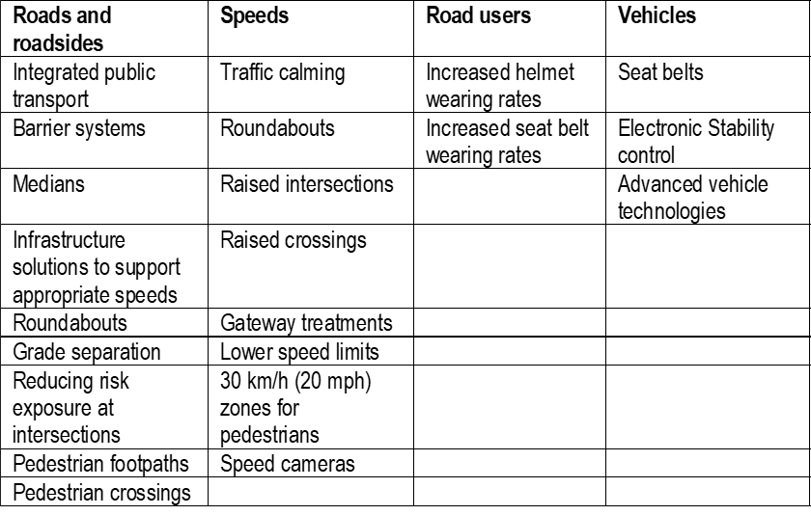
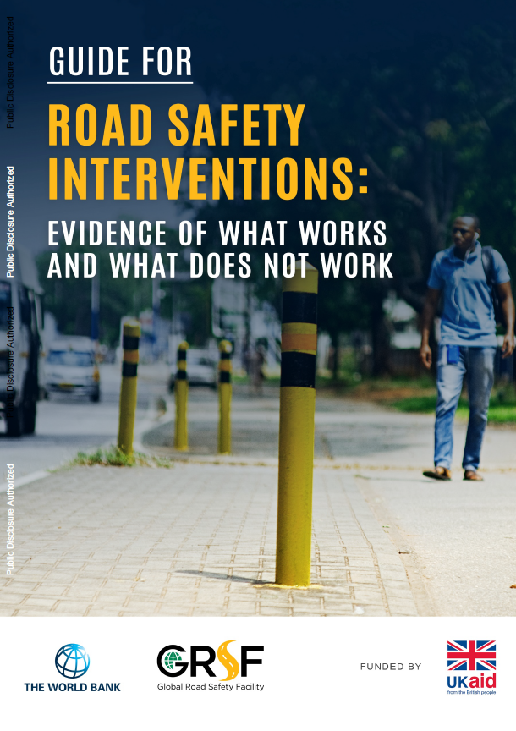
What Works in Road Safety
Road Safety “Superstars”
*30%+ improvement

Slide 11
What Works in Road Safety
A set of integrated and impactful activities could be considered for designing road safety activities in World Bank projects as well as in projects financed by other MDBs and development partners:
Safe roads and roadsides for all road users
Enforcement legislation or equipment
Emergency Medical Services
Safe vehicles procurement or legislation, including for BRTs and fleets
Capacity building
Data collection and management
Road Safety management and leadership
Speed management
Road user safety (i.e. helmet use, seatbelts)

Slide 12

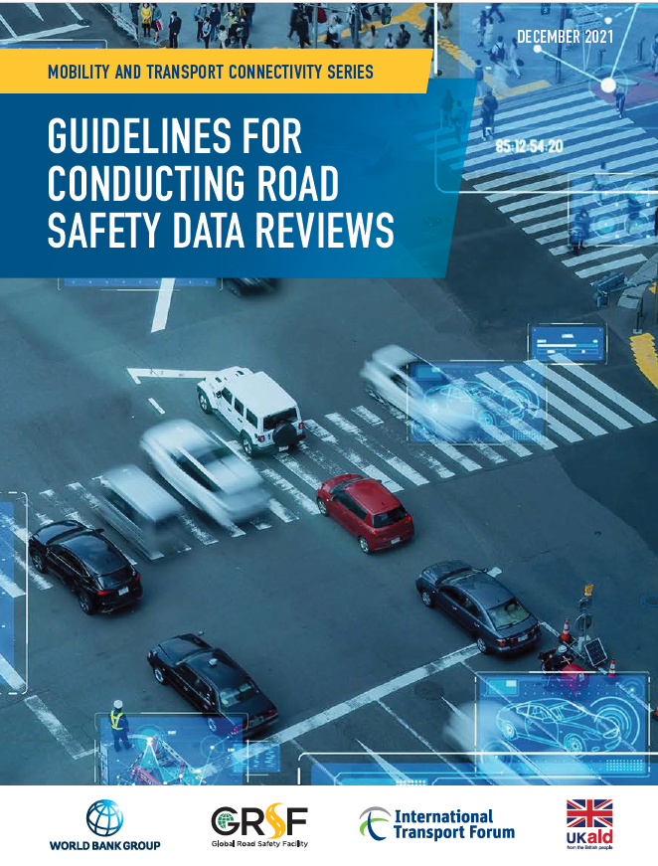
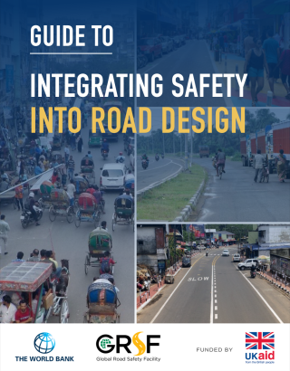
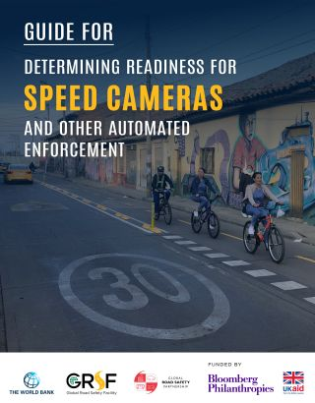
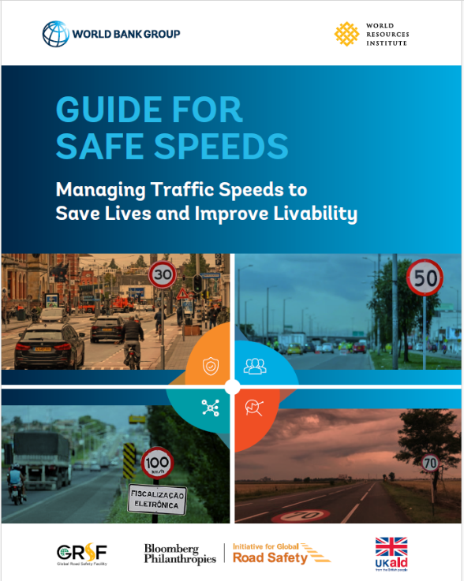

Guidelines to Shape Road Safety Components

Slide 13
THANK YOU
www.roadsafetyfacility.org
WORLD BANK ACADEMY
Leaders in Road Safety Management

