Slide 1
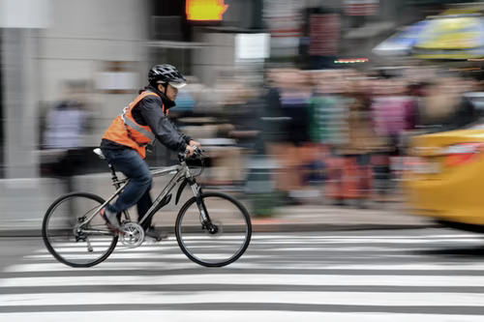

WORLD BANK ACADEMY
Leaders in Road Safety Management
Session 5:
Speed Management

Slide 2

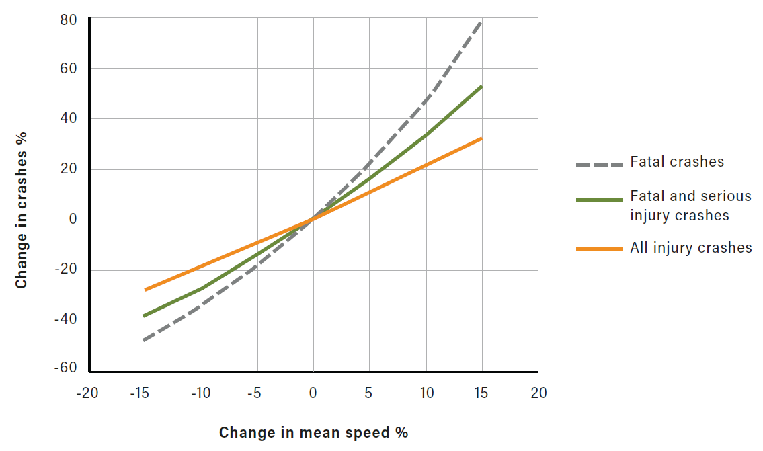
Why speed management matters
  Speed is the single biggest contribution to road deaths and serious injury
  Higher involvement in road traffic deaths than previously thought: 60-70% of road deaths linked to speed – this is true for LMICs and HICs
  Reducing speed can bring significant road safety benefits as well as benefits for environment, health, livability and travel time
  Interventions needed are often highly cost-beneficial

Slide 3
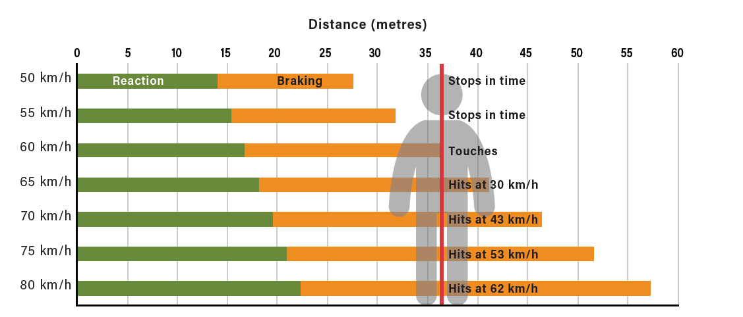
Why speed management matters
Speed and stopping distance

Slide 4
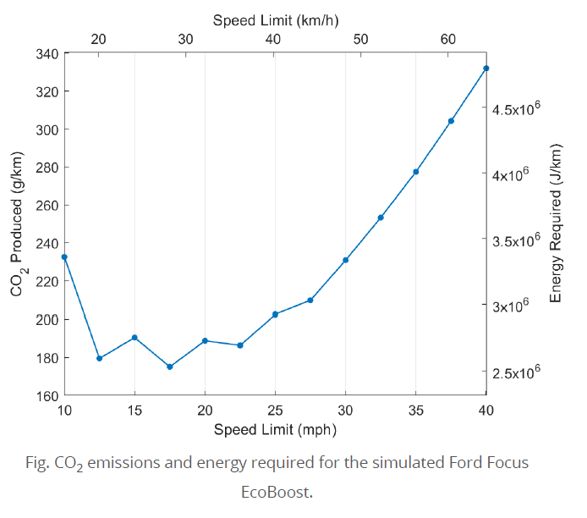
Broader benefits of speed management
Road safety improvements
Decarbonization
Mode shift to walking and cycling with subsequent health and environmental benefits
Noise reduction
Vehicle operating costs reduced (reduced fuel costs; wear and tear on tyres, brakes)
Increased social interaction / social capital
Smoother traffic flow and less congestion
Source: https://futuretransport.info/urban-traffic-research/

Slide 5
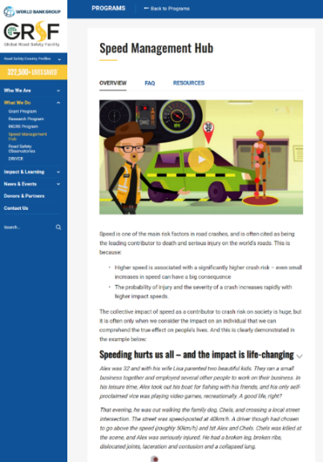
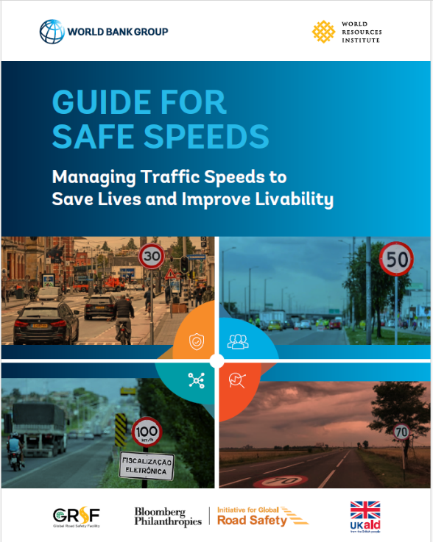
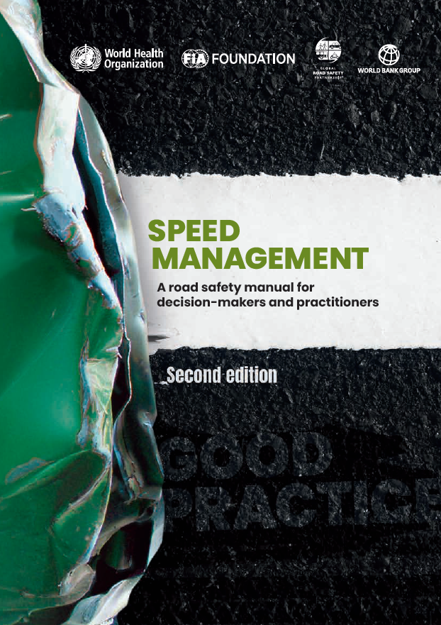
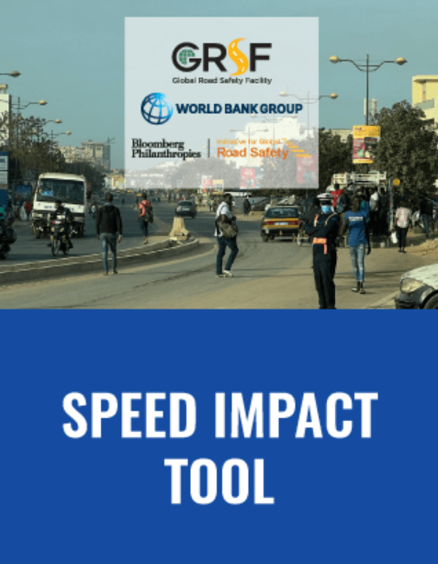
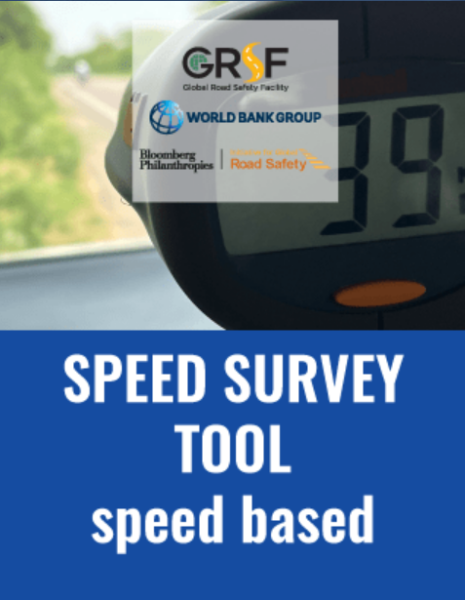
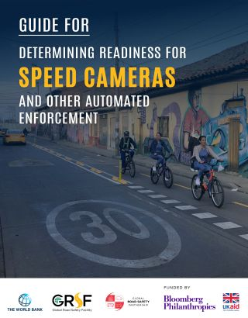
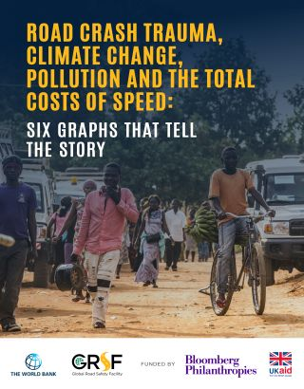
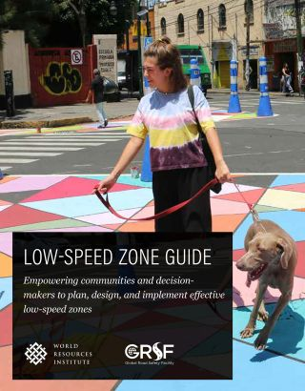
GRSF Speed Management Hub
🔥 74,000+ page views and 5,000 downloads since launch
📢 130+ FAQs and myths on speed management
📢 Speed tools and videos
40+ global resources related to speed, with more to be added!
https://www.roadsafetyfacility.org/speed-management-hub

Slide 6
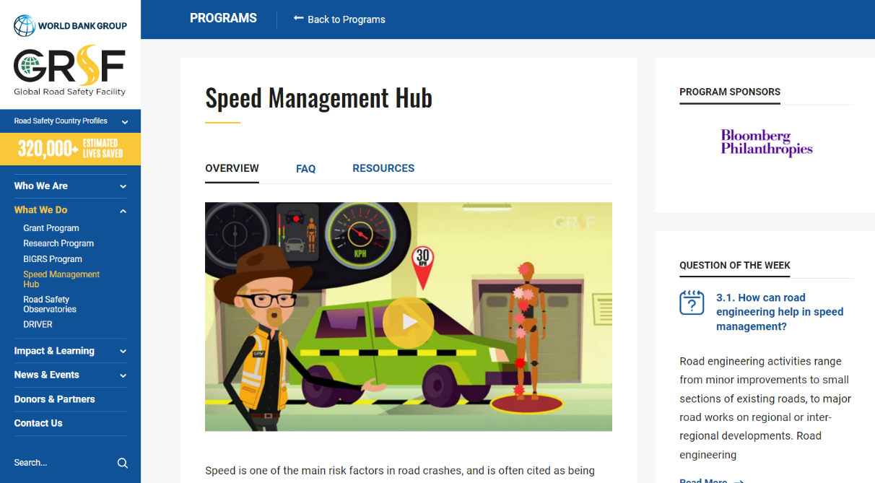
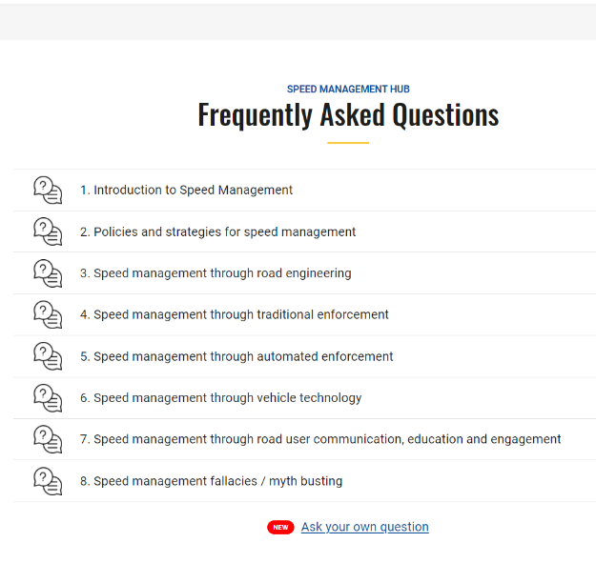
Speed Management Hub

Slide 7
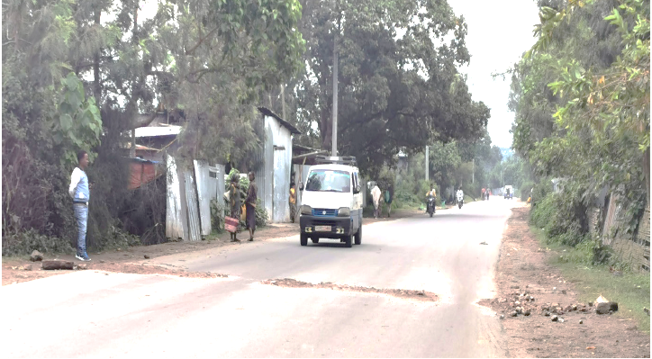
Popular speed myths busted
Popular speed myths are busted
MYTH: THE PUBLIC / COMMUNITIES WANT HIGHER SPEEDS
  ESRA survey – 35,000 respondents across 32 countries (see www.esranet.eu)
  Less than 20% find it acceptable to drive faster than the speed limit; less than 10% in built up areas
  Most people believe that speed is a cause of road crashes (up to 80%)
  Up to 90% suggested traffic rules should be stricter
  Do a local survey to help convince!
Figure: Speed bumps made by local people on Wendogenet Road, Ethiopia (Source: WRI, Ethiopia)

Slide 8
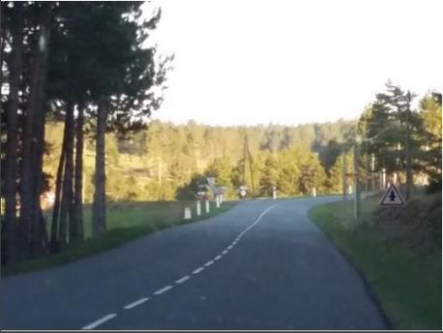
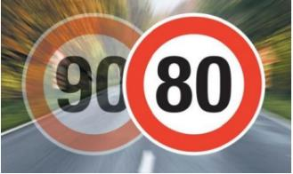
Popular speed myths are busted
MYTH: LOWER SPEEDS HAVE A NEGATIVE ECONOMIC IMPACT
Or …. Reduced speed limit increase journey times
Or …. Reduced speed limit result in congestion
  Economic benefits likely to improve in many situations:
      Reduced cost of injury and death
      Reduced fuel costs at lower speed
      Reduced emissions and noise
      Other health and societal benefits (inclusion, placemaking)
  Journey time – less impact than most people think – especially for urban roads, and low-quality rural highways
  Can have a positive effect on congestion – more regular flow
France – rural single lane roads speed limit reduction:
On average, a travel delay of only one second per km
34% of journeys had a time saving
37% of itineraries noticed a travel delay under 1 second per kilometer
12% have a travel delay higher than 2s/km.
Source: Manuelle Salthe, French Road Safety Observatory

Slide 9
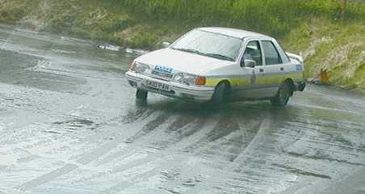
Popular speed myths are busted
MYTH: EDUCATION AND TRAINING WILL SOLVE THE SPEED PROBLEM
  Often not effective – situations where risk can increase (over-confidence)!
  Education best done as part of a campaign
  Training for specific groups can be useful, but mixed results otherwise
  Often need infrastructure support
  Enforcement as a support is also effective

Slide 10
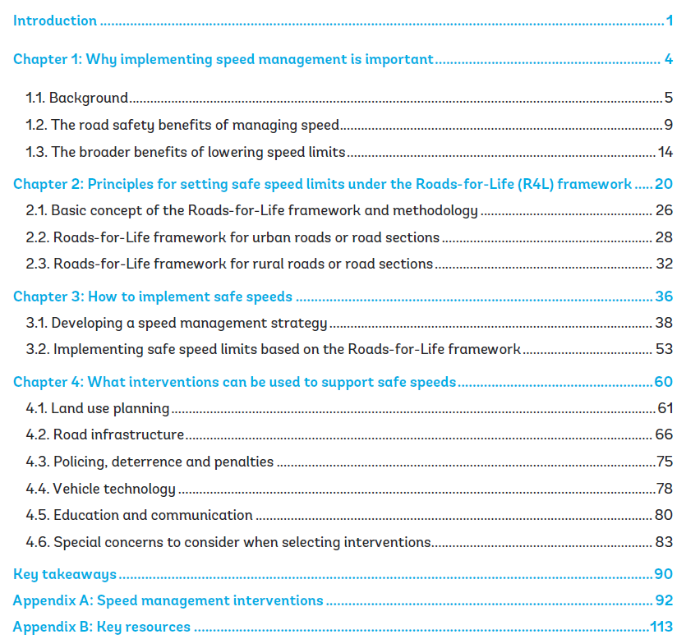
A new World Bank guide

Slide 11
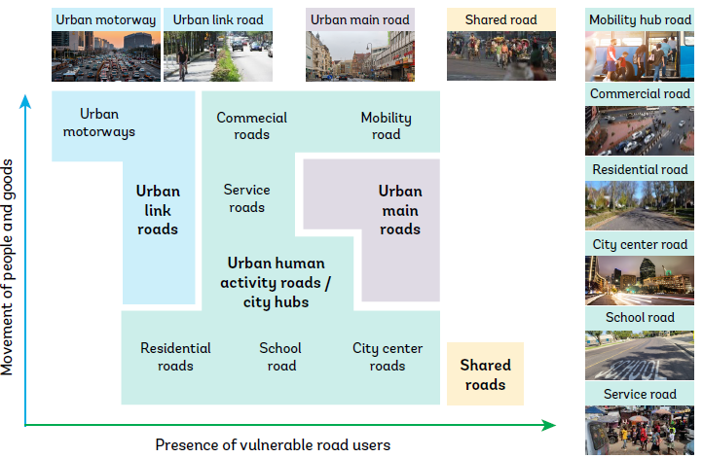
Selecting safe speed limits: Framework
The Roads for Life framework –
Speed limits for urban roads
max. 10 km/h on shared roads
max. 30 km/h on urban human activity roads
max. 30-50 km/h on urban main roads
max. 50 km/h on urban link roads
max. 80 km/h on urban motorways

Slide 12
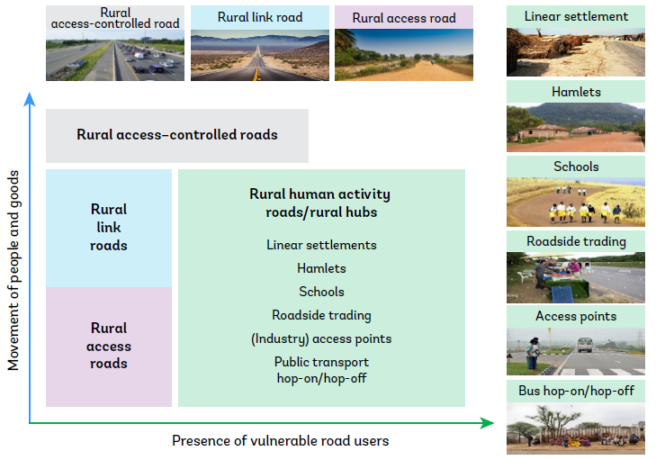
Selecting safe speed limits: Framework
The Roads for Life framework –
Speed limits for rural roads
max. 30 km/h on rural human activity roads
max. 50-70 km/h on rural access roads
max. 70-80 km/h on rural link roads
max. 100 km/h on rural access-controlled roads

Slide 13
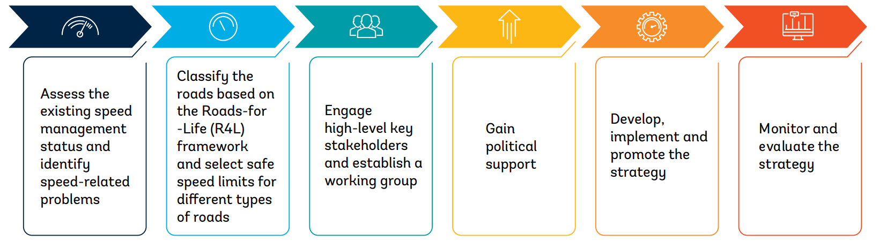
Implementing speed strategy
Develop and implement a speed management strategy to systematically tackle the speed problem in your country

Slide 14
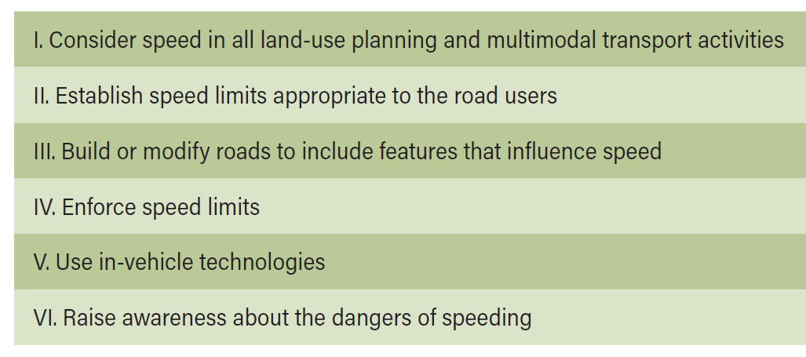
Supporting speed limits: Effective interventions
This is often the real game changer

Slide 15
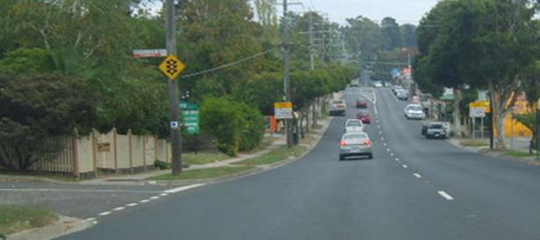
Supporting speed limits: Effective interventions
Source: C. Jurewicz

Slide 16
Supporting speed limits: Effective interventions
Source: C. Jurewicz

Slide 17
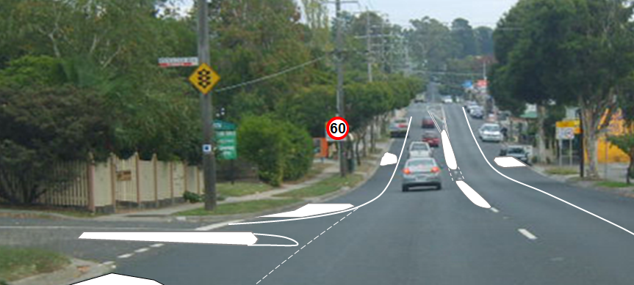

Supporting speed limits: Effective interventions
Source: C. Jurewicz

Slide 18
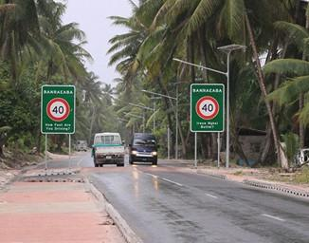
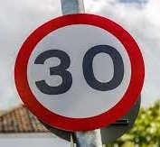
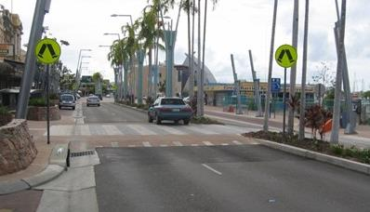
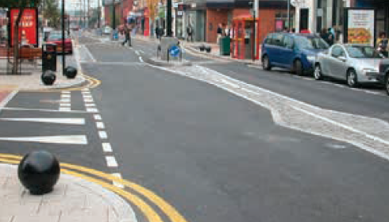
Supporting speed limits: Effective interventions
Our top infrastructure interventions:
Speed limit signs
Gateway treatments
Raised pedestrian crossings
Road narrowing – including intersections
Traffic calming - humps

Slide 19
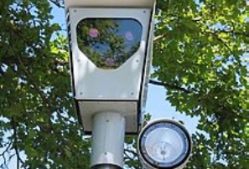
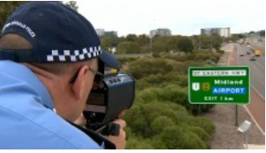
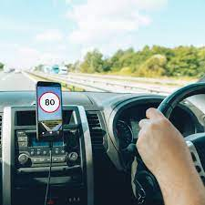
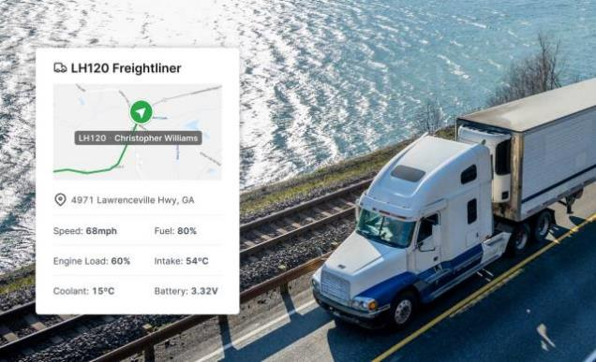
Supporting speed limits: Effective interventions
Enforcement
Manual enforcement
Automated enforcement
Vehicle technology – focus on public/commercial fleets:
Intelligent speed adaptation
Monitoring for trucks / buses

Slide 20
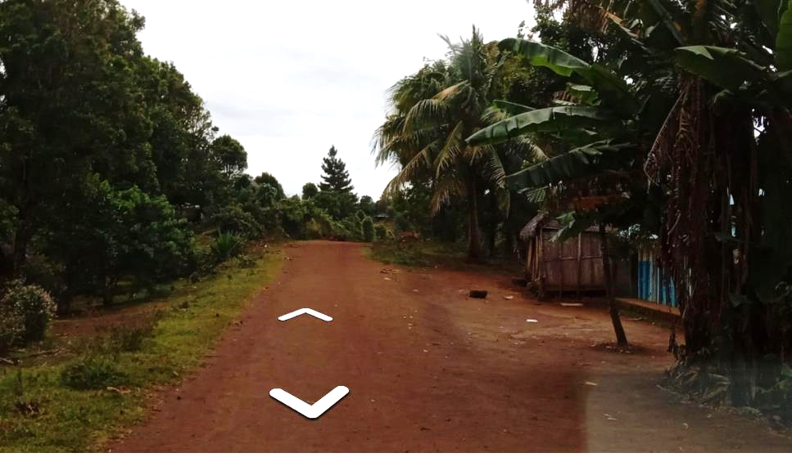
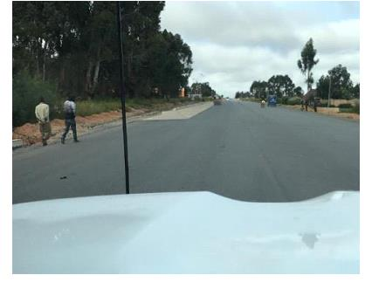
Investing in road projects
  Improving the road surface will increase speed – that is the point for many projects!
  Need to mitigate the risks – villages, curves, intersections, narrow sections.

Slide 21
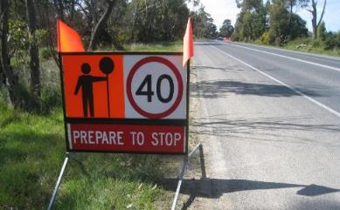
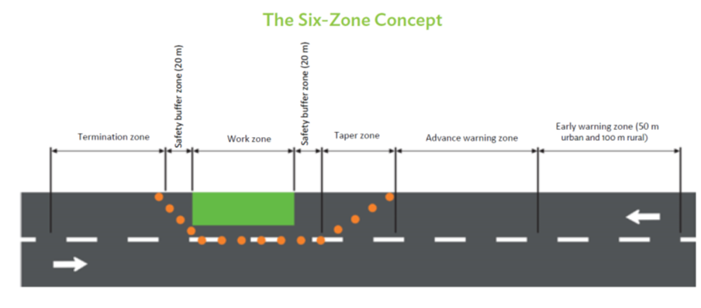
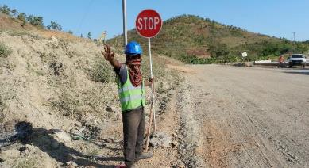

Investing in road projects
  During construction

Slide 22
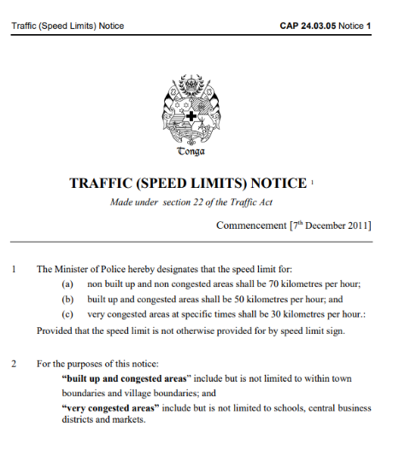
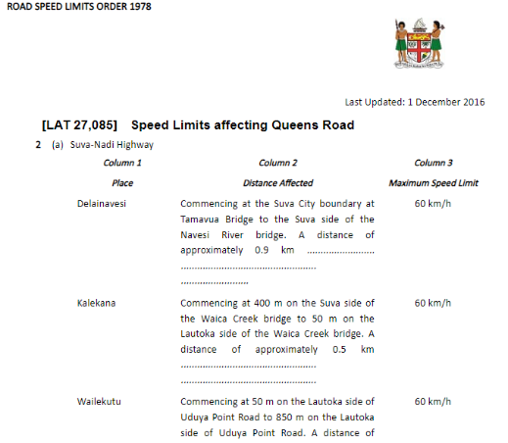
Investing in road projects
  Legislative reviews of speed limit setting process – legislation/regulations to facilitate change
  Tonga and Fiji illustrate the massive contrast in approach
  One country – legal change occurs from erection of speed sign following consultation; allows 30, 40, 50 and 70 km/h
  The other – every change needs parliamentary approval, and no provision for 30 km/h

Slide 23
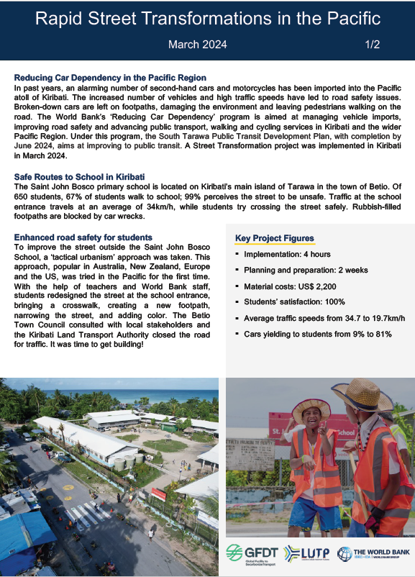
Investing in road projects
  Strategy and action plan development
    Starting small: Reducing car dependency – Pacific Islands
    Laos speed management manual

Slide 24
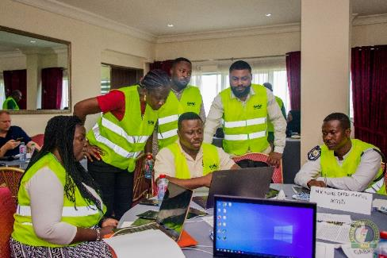
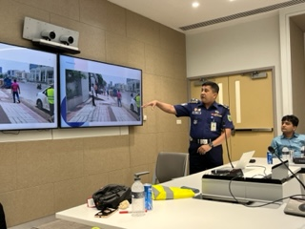
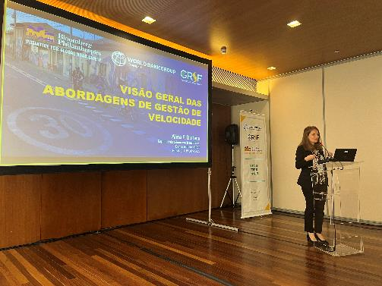
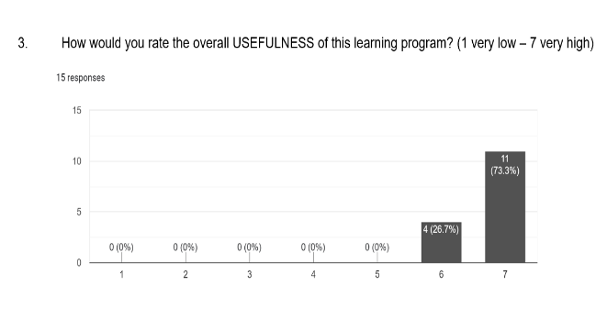
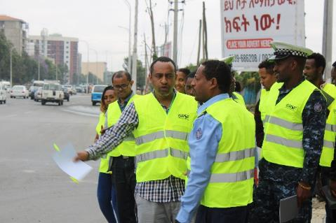
Investing in road projects
  Capacity building on speed and safety – Action plan focus

Slide 25
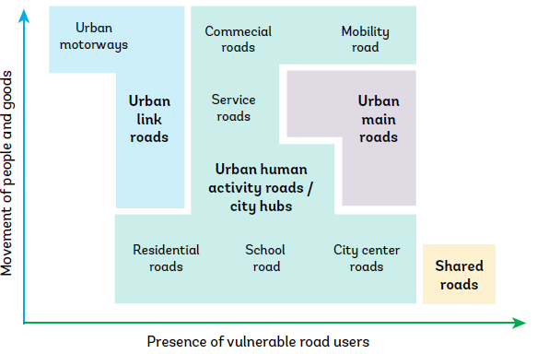
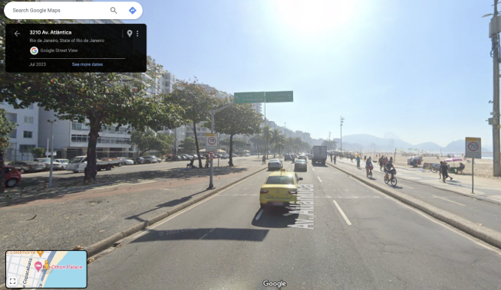
Investing in road projects
  Speed limit review – R4L speeds
  Rio:
    Use of road classification system based on motorized traffic
    Need to overlay safety for vulnerable road users

Slide 26
Investing in road projects
  Supporting measures we should put focus on::
    Infrastructure – low cost / high impact
    enforcement and penalty regimes
    in-vehicle monitoring systems
  Especially when we know that speeds will increase and at high risk locations
    Schools, markets, villages etc.

Slide 27
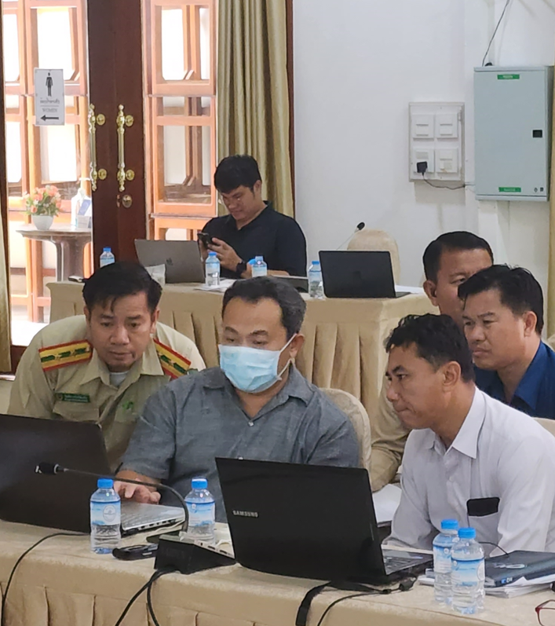
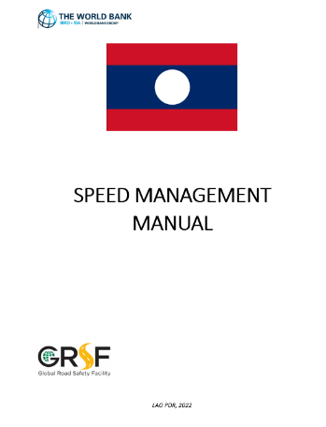

Case study: Laos Speed Activity
  2019 Road safety capacity review identified speed as a major issue
  2021 - GRSF $150,000 grant for a study to eliminate systemic risks of severe road trauma involving speed; additional $100,000 from MPWT.
    Diagnostics
    Speed manual including speed limit regime
    Pilot (raised platform)
    Capacity building and awareness raising – decision makers, practitioners, public
  Government is adopting the Speed Management Manual and has already begun the implementation process. The Ministry of Public Works & Transport (MPWT) has allocated funds for this task.

Slide 28

Case study: Laos Speed Activity
  Pilot of raised platform on National Highway
    Raised pedestrian crossing platform
    Pedestrian-operated signal
    Speed sign of 40kph
  Prior to project, no chance of installing such a treatment
  2022 – assessment undertaken
  Speeds reduced to 30 km/h
  Seen as a significant safety improvement amongst local community

Slide 29
Download the Guide
Key points
  Speed management is critical in road safety, but also brings other benefits
  GRSF has produced a new guide as well as the Speed Management Hub. Can be a useful tool when planning for your country.
  Speed activity can be embedded into projects, and produce significant benefits
  Speed is a complex topic – be aware of the myths, and where to find evidence to counter these

Slide 30


Download the Guide
Download the guide
…or visit the Speed Management Hub: https://www.roadsafetyfacility.org/speed-management-hub

Slide 31
THANK YOU
www.roadsafetyfacility.org
2024 ROAD SAFETY ACADEMY
Delivered by the Global Road Safety Facility (GRSF)

