Slide 1
WORLD BANK ACADEMY
Leaders in Road Safety Management
Session 6:
Safe and Clean Vehicles

Slide 2
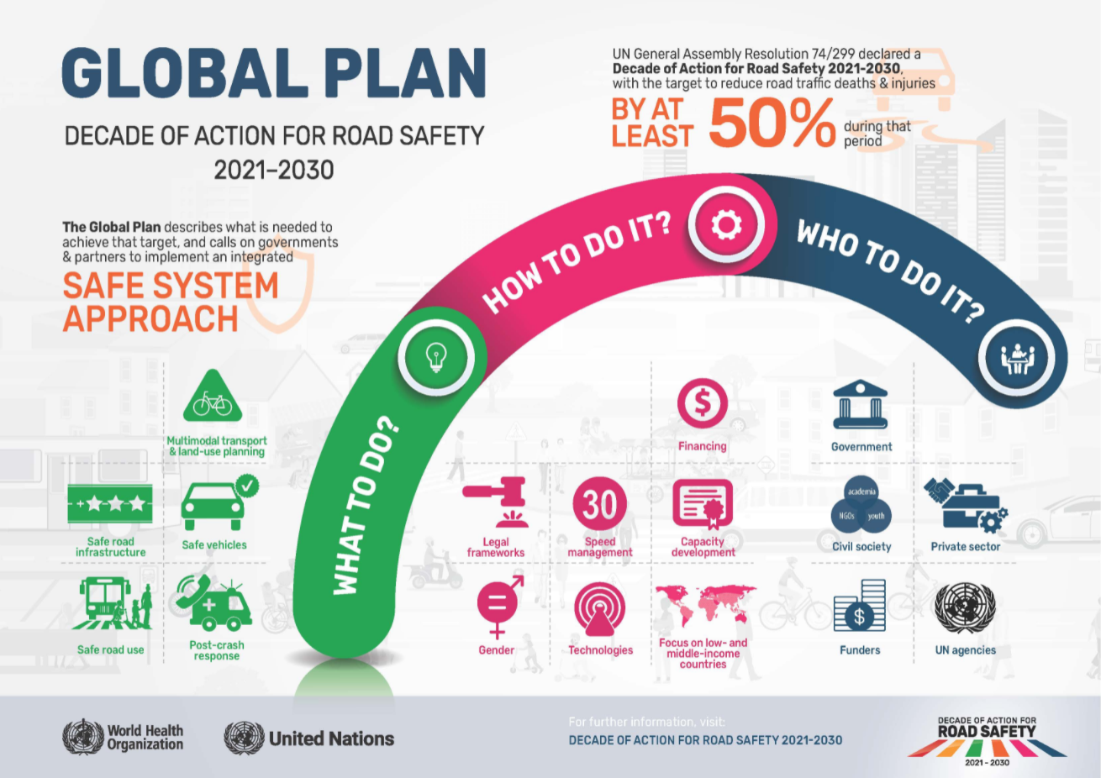
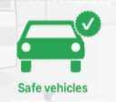
Vehicle: one of the key pillars

Slide 3
Fatalities vs Vehicles

Slide 4
Rapid rate of motorization globally

Slide 5
Snapshot of Motor Vehicles in LMICs
Limited domestic manufacturing capacity
Demand met through importation of vehicles
70% of LMICs imported more used vehicles than new ones in 2018
58% imported more than three times as many used vehicles as new ones
Large share of the used vehicles traded do not meet globally accepted road safety and air quality standards
Sub-standard vehicle technology, weak markets and lack of comprehensive motorization policies are key contributory factors.

Slide 6
Laws on “Core” vehicle safety standards

Slide 7
Road safety vehicle pillar as part of motorization management approach
Road safety
Ensure vehicle fitness (roadworthiness)
Improve vehicle configuration (crash-worthiness)
Air quality
Address motor vehicle contribution to air pollution
Presence of pollutant emissions control systems and compatible fuels
Decarbonization
Reduce fossil fuel consumption of road vehicles
Encourage electrification
Vehicle pillar of safe systems approach
Ensure proper maintenance
Encourage fuel efficiency – vehicle & engine technology, size, weight

Slide 8
What is Motorization Management
Framework comprising policies and measures aimed at managing vehicle stock.
Proactive, phased, and systematic approach to improving vehicle and fuel quality
Deliberate, diligent, and coordinated process involving key stakeholders
MM contributes to a broader sustainable transport policy
Combined with policies like travel demand management, public transport, and active mobility, traffic management and land-use planning
Key part of Avoid-Shift-Improve (ASI) framework
MM also involves building institutions for policy analysis, compliance, and communications

Slide 9
Core elements of motorization
management

Slide 10
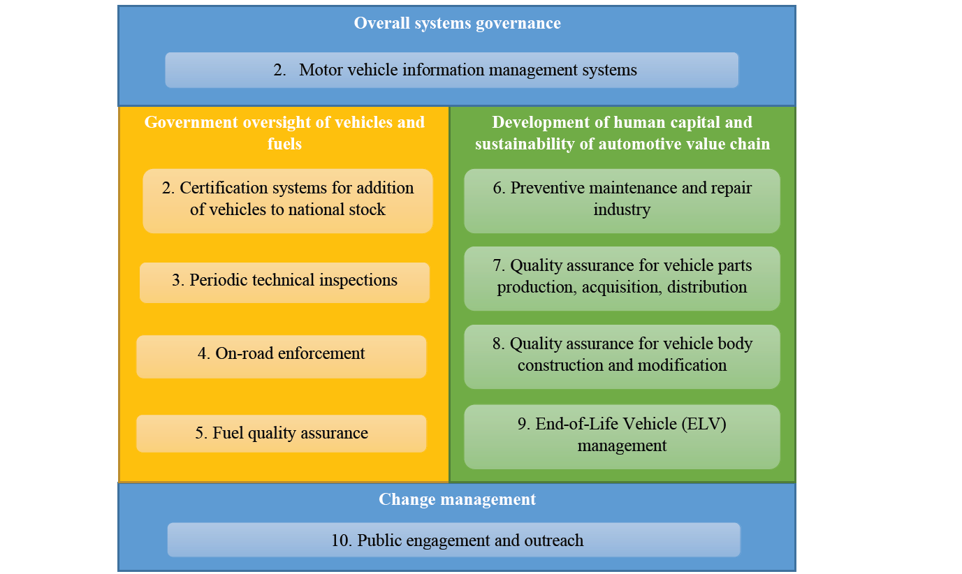
Effective governance of vehicle stocks

Slide 11
Vehicles’ life cycle
Change of ownership
Repairs
New vehicles
Modifications
Breakdowns
End of life
Life of the vehicle
Imported used vehicles
Export to a 3rd country
Change of use
Maintenance
Crashes
Miscelanea

Slide 12
Ensuring that safe vehicles are plying roads
Configuration of vehicles when they enter
Frontal crash
Side crash
Pedestrian protection
Electronic Stability Control
Anti-lock Braking System for motorcycles
Fitness of vehicles while used
Brakes, lights, safety systems
Tire treads / condition
Track structural integrity
Presence of key components

Slide 13
Ensuring the entry of safe vehicles
Clear definition of standards, enforcement and roles
Coherent import regime
The role of UN WP Vehicle Regulations and adoption
Vehicle-level data sharing with country of export
Effective border inspection

Slide 14
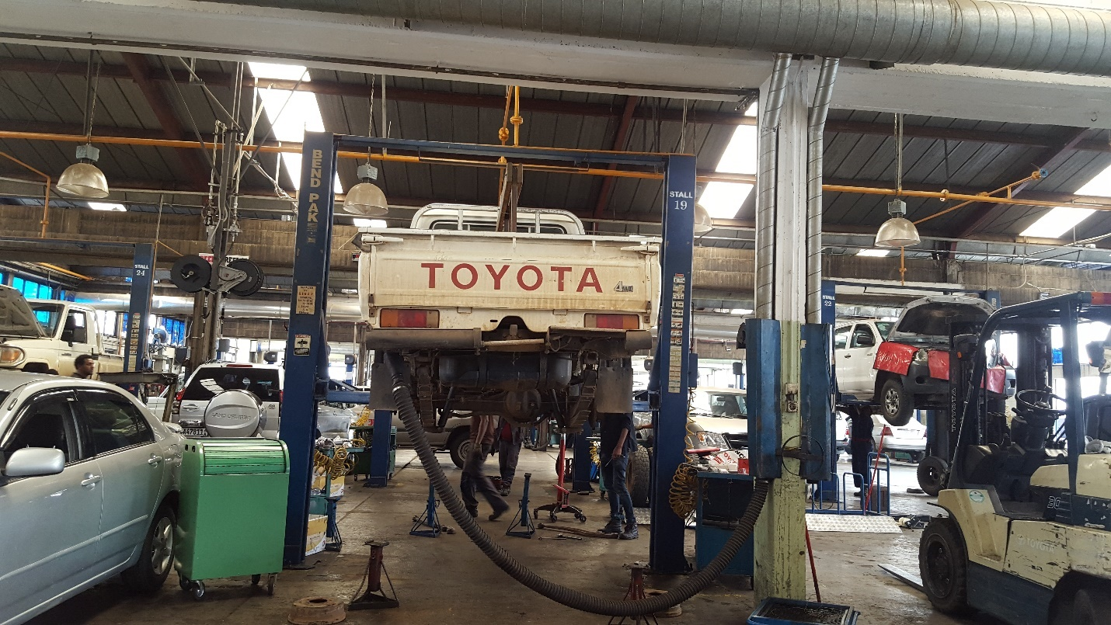
Ensuring the continued fitness of safe vehicles
Periodic technical inspection
Improved oversight of vehicle modification
Strengthening of automotive aftermarket service industry
Improve information management systems to keep track of motor vehicles

Slide 15
Benefits of well-performing vehicles throughout their lifetime
Costa Rica:
Inspection reduced crashes by a 40%
Turkey:
Inspection reduced fatalities by a 15%
Spain:
Mopeds’ inspection reduced fatalities by a 18%
Spain:
Emissions control prevents 400+ premature deaths per year
USA:
5,6% fewer fatalities in states with safety inspection

Slide 16
Compliance schemes
Technicalities
Governance

Slide 17
Compliance schemes
Governance:
Authorities shall be able to design, implement and operate^{(*)} the vehicle compliance scheme
Governance
^{(*)} Operations or control of operations may be outsourced. The responsibility of authorities cannot be.

Slide 18
Examples of compliance schemes

Slide 19
Assessment of Vehicle Inspection Systems
Assessment of Vehicle Inspection Systems
The common denominator of AVIS projects findings is the need to reinforce authorities' skills and capabilities to ensure the scheme governance.
Country | Governance of vehicle compliance
Togo | Single provider until 2019 and government service (state monopoly) thereafter
Cameroon | Liberalized market. Service provided by several middle-size private operators authorized by government
Armenia | Liberalized market. Service provided by many small-size private operators authorized by government
Bangladesh | Hybrid system. Government service for emission test. Private service for safety test
Ecuador | Liberalised and decentralized. Private operators authorized by regional authorities
Philippines | Liberalized and non-integrated. Separate networks and authorization bodies for emission and safety test
Mozambique | Limited providers. Limited number of private operators are authorized by the government

Slide 20
Ongoing Work
i. E-learning (OLC) on Motorization Management
ii. ASA on Improving Vehicle Safety and Air Quality in Low-and-Middle Income Countries (P181329):
PDO: estimate impact of transport policies on vehicle crash safety and local air pollution in LMICs

Slide 21
Sources:
Motorization management for development: an integrated approach to improving vehicles for sustainable mobility. World Bank 2022
Vehicle Killing Potential: project SaferAfrica, 2018.
Reducing the death toll of road accidents in Costa Rica through the introduction of roadworthiness inspections by the government. W. H. Schulz and S. Scheler
Impact study to estimate the economic effects of the introduction of PTI in Turkey. W. H. Schulz and S. Scheler
Study on the inclusion of light trailers and two- or three-wheel vehicles in the scope of the periodic roadworthiness testing, European Commission
Roadworthiness testing contribution to vehicle safety and environment, V. Díaz López, J.L. San Román García, A.M. Gómez Amador, S. Santos Cuadros and E. Olmeda Santamaría
A data-driven assessment of safety inspection programs’ efficacy. P. S. Acharya, L. AitBihiOuali, H. S. Matthews and J. Graham

Slide 22
THANK YOU
www.roadsafetyfacility.org
WORLD BANK ACADEMY
Leaders in Road Safety Management

