Slide 1


WORLD BANK ACADEMY
Leaders in Road Safety Management
Session 7:
Addressing Emergency
Post-Crash Care

Slide 2

Why Focus on Pre-Hospital Emergency Care?
A significant contributor to trauma deaths in LMICs is prehospital deaths that occur following a crash but before the patient can be admitted to hospital
As per the Global Status Report of Road Safety, 2018, the proportion of trauma patients who die before reaching hospital in Low-Income Countries is more than twice as high as in High-Income Countries
A study by Mock et al. compared trauma mortality patterns across regions in USA, Mexico, and Ghana, and found that in Kumasi, Ghana, prehospital deaths occurred in 51% of all seriously injured patients, whereas in Seattle, USA, 21% of patients died before reaching hospital
The study also found prehospital times to increase as country income level decreased: the average prehospital time was 31 minutes in Seattle, 73 minutes in Monterrey, Mexico, and 102 minutes in Kumasi, Ghana
WHO Secretariat: Studies on the effect of improving organization and planning of trauma care in high-income countries have consistently shown survival gains of between 8% and 50%

Slide 3
Why Focus on Pre-Hospital Emergency Care?
Stockholm Declaration 2020
World Health Assembly 2019
Reiterated the importance of Pre-Hospital Emergency Care (PECS) and
Reinforced the link with Universal Health Coverage (UHC)
New Goal: Halve the number of road traffic deaths by 2030
“Emergency care is an essential element of UHC, responding to a range of acute conditions in children and adults […]. It is the first point of contact with the health system for many people […]. Especially when there are barriers to accessing health care, people may seek care only when they are acutely ill or injured.”

Slide 4


The Impact of Road Injuries and Fatalities
Global and Regional Perspectives
WHO Projections
2015
2030
9th leading cause of death
20 deaths per 100.000 population
7th leading cause of death
22 deaths per 100.000 population
World
10th leading cause of death
25 deaths per 100.000 population
6th leading cause of death
38 deaths per 100.000 population
SSA

Slide 5
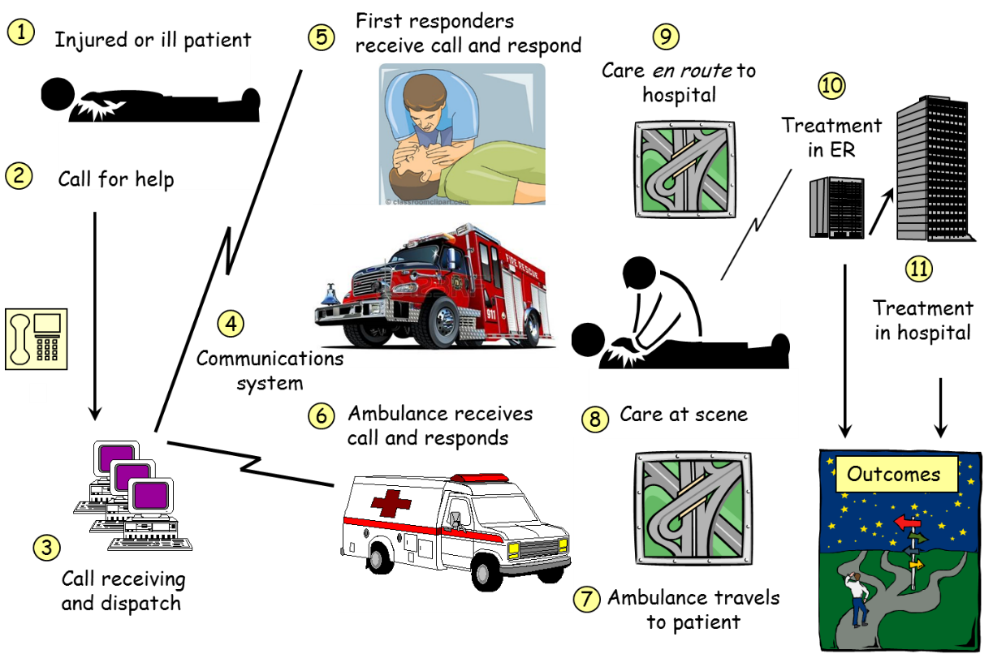
Post-Crash Care Systems, Processes & Challenges
Emergency Medical Services (EMS): refers to an established entity, agency or system, which is appropriately integrated into existing out-of-hospital emergency care and facility-based healthcare system, thereby facilitating the coordinated, timely, and safe provision of emergency care and transportation to the most appropriate healthcare facility.
Proper policy and regulatory frameworks for inter-agency coordination, communications, licensing, and knowledge & skills capacity
Sustainable funding options
Provision of adequate quality fixed & mobile trauma care facilities & equipment
Timely & reliable information, data, analyses & reporting
Scarce human resources & lack of training to manage trauma care

Slide 6

Computer-Aided Dispatch
Measuring Response Times & Communication between the Public and EMS
Response Intervals should be available from call intake to patient’s arrival at the hospital, including:
Assignment Interval - Length of time needed to assign at least 1 responder to the incident
Arrival Interval - Length of time before the first assigned responder confirms arrival on scene
Total Scene Interval – Length of time responder were at the incident scene
Transport Interval – Length of time needed to transport patients from the incident scene to a destination facility
Total Incident Interval - Length of entire incident, from alert to completion
Data Compliance – Rate at which responders reply to messages correctly
Determination of a dispatch priority
Dispatching of first responders & ambulance crews
Ongoing monitoring of calls as they evolve
Management of all available resources
Contact with health facilities
The dispatching of multiple responders and various types/categories of responders
CAD systems should interface with:
Caller ID –verify exact location of an incoming call / incident
automatic vehicle location (AVL) - pinpoints location of response vehicles
geographic information system (GIS) - geospatial data
records management systems (RMS) - data relevant to current service call

Slide 7
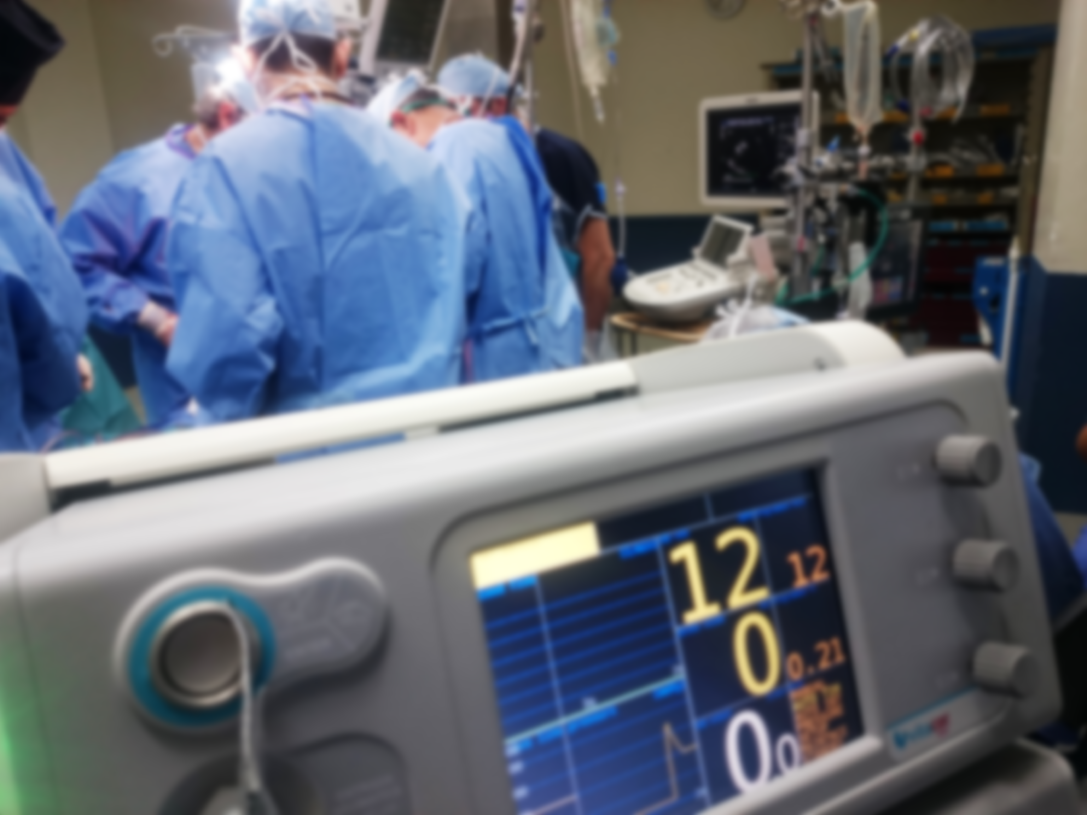
Post Crash Care
Assessment Tools and Pilot Experience

Slide 8




“EMS in Sub-Saharan Africa” – A survey-based assessment
EMS Governance & Standards | Review of current legislative enabling environment, collaboration, and partnership between federal and/or state-level public agencies and private sector stakeholders, as well as technical and regulatory requirements applied to EMS services
EMS Financing Arrangements | Policy principles, funding allocation mechanisms, payment processes and cost recovery approaches
EMS Skills & Human Resources | Higher education system and learning requirements among medical professional specialties, the extent to which EMS training programs are driven by national minimum guidelines and competencies
EMS Communication & Information Management Systems | EMS communication architecture, established standards or protocols, and functional performance and dispatch system verification capabilities in recording incident and response data

Slide 9
Key Findings from “EMS in Sub-Saharan Africa”
Most SSA countries do not have specific EMS policies or regulations in place
A lack of uniformity in a national governance approach; formal EMS systems tend to preserve the characteristics of basic, informal systems
EMS systems are scattered across multiple organizations and models
Minimum standards are not comprehensive and do not reflect international good practice
Mostly funded through central budget, though private sources & user payments are used in some States
Few SSA countries have a designated authority responsible for regulating quality or standards of the EMS education system (course authorization, curricula review, licensing of instructors, accreditation)
Wide recognition of the need to introduce a single emergency number; emergency communication and response systems in place for EMS, police, fire or civil protection accessed through different numbers.

Slide 10
Assessing Corridor Post-Crash Response Readiness
Assessing the capacity of health and emergency systems to respond to road traffic incidents along a regional corridor, with specific attention to:
Corridor catchment
EMS communications
First medical response
Fire & rescue services
Pre-hospital emergency care
In-hospital trauma care

Slide 11
Assessing Corridor Post-Crash Response Readiness – Baseline Data Collection
Where are facilities located and how well equipped are they to treat road trauma?
How are road crash incidence reported and recorded?

Slide 12
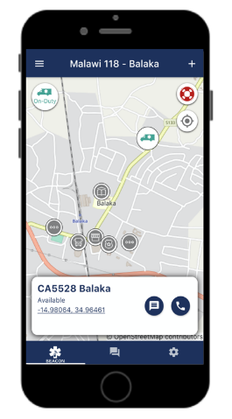
Assessing Corridor Post-Crash Response Readiness – EMS Communications
Public Safety Access Point (PSAP): Is a toll-free emergency (short code) available?
Emergency Medical Dispatch (EMD) standards:
Confirmation of patient location and procedures to dispatch to the scene
Call processing: ascertain the presence of threats to life or limb; or differentiate high acuity from low acuity calls
Provide telephone-based instructions to the caller to assist with basic patient care prior to responders arriving on scene
Dispatch and tracking of EMS vehicles
Optimal route and hospital selection
EMS interoperability: Do communication systems and standards between public safety agencies (police, fire, ambulance, disaster response) allow interoperability?
Global System for Mobile (GSM) services: What is the mobile coverage rate?
Responder channels: Is country-wide two-way (VHF) radio communication available?

Slide 13
Assessing Corridor Post-Crash Response Readiness – First Medical Response
First Responders include community-at-large, police, fire fighters, emergency medical technicians (EMT) and others trained in first aid. In a medical emergency, their role is to provide basic first aid until the ambulance arrives, extricate trapped patients (if safe to do so), and secure the scene in terms of hazardous materials.
“Bystanders contribute by activating the emergency care system and taking simple, potentially life-saving actions until professional help is available” World Health Organization (2018)
Police are likely to be the first “official” responders to the scene (particularly in rural areas) and should be trained to provide first aid to crash victims
Firefighters deployed to post-crash response bring special tools to free trapped victims and manage other hazards
Are there road incident response protocols to which the public at-large adhere?
Is basic first aid training available to public or community?
What capabilities exist for fire-fighting, technical rescue, gas leaks / hazardous materials / arcing electrical wires?
Where are fire and rescue units located or available?
What is the level and frequency of first aid training or certification for police?
How do police communicate with ambulance or hospital centers?
Notes:
What first aid equipment is carried in all police vehicles

Slide 14
Assessing Corridor Post-Crash Response Readiness – Pre-Hospital Emergency Care
Out-of-hospital emergency care (OHEC) includes all aspects prior to arrival at a suitable formal healthcare facility:
Bystander-initiated care
access to emergency care or ambulance services
medical care by trained prehospital practitioners
En-route emergency treatment
Advanced Life Support (ALS): Performed by doctors, nurses and the paramedic staff providing life-saving mechanisms and protocols
Basic Life Support (BLS): A variety of noninvasive emergency procedures performed to assist in immediate patient care typically delivered by trained EMTs, pre-hospital crews, first responders, or by-standers

Slide 15
Assessing Corridor Post-Crash Response Readiness – In-Hospital Trauma Care
Availability, scope and location of trauma care services that can be provided at the nearest hospital or health centre, including necessary facilities and equipment or possibility for inter-facility transport of critical cases to higher levels of care
Emergency Room or Triage near entrance with sufficient theater space?
Imaging facilities available and accessible by gurney?
Laboratory equipment on site and functional?
World Health Organization (WHO) Generic Essential Emergency Equipment List (2012)
Tool for situational analysis to assess emergency and essential care (WHO, 2012)
WHO Trauma Care Checklist (WHO, 2016)

Slide 16
Designing Interventions for Corridor Post-Crash Response Readiness
Experience from a Malawi Pilot Program to Develop a “118” EMS System
Objective: initiate emergency systems that respond to road trauma, with a focus on communication platforms, first responder readiness, pre-hospital and in-hospital emergency trauma care
Establishing an EMS Communication System, including an exclusive toll-free 118 phone number
Recruiting and training EMS and in-hospital trauma care providers, including clinicians and nurses
Training of community first responders by the Malawi Red Cross
Refurbishing and equipping trauma care units in participating health facilities
Delivering 12 fully equipped ambulances
Recruiting and training ambulance drivers
Targeted M1 Road Corridor between Lilongwe and Blantyre
Pilot area served by 118 Call Center; all requests & responses managed & recorded through call center dispatch platform
Upgrade existing District medical facilities to provide adequate theatre space with trauma care equipment & supplies
EMS Pilot System Components | ~ Cost US$ (m)
Trauma Care Centers (TCC) | 2.85
TCC Medical equipment | 0.75
12 BLS Ambulances - 2 per TCC | 1.20
EMS Communication System & Ops Manual | 0.10
Training of staff cadres | 0.30
Call & Dispatch Centre set up | 0.20
Ambulance insurance, maintenance, & fuel | 0.17
Public Awareness Media Campaigns | 0.05
Trauma Registry, development and setup 3 years of data collection (10 hospitals) | 0.20
EMS Management | 0.08
Total Investment | ~6.0

Slide 17








Designing Interventions for Corridor Post-Crash Response Readiness
Malawi EMS Communications System
Establishing an EMS Communication System, including an exclusive toll-free 118 phone number
Recruiting and training EMS and in-hospital trauma care providers, including clinicians and nurses
Training of community first responders by the Malawi Red Cross
Refurbishing and equipping trauma care units in participating health facilities
Delivering 12 fully equipped ambulances
Recruiting and training ambulance drivers
Due to limited distribution, access, and reliability of VHF radio vs. mobile networks coverage, the 118-call center was established through a cloud-based platform
118
High-speed internet for dispatch call center
25 smartphones & data plans for ambulance personnel
Local SMS gateway
500 simple phones to communicate with community first responders via SMS

Slide 18
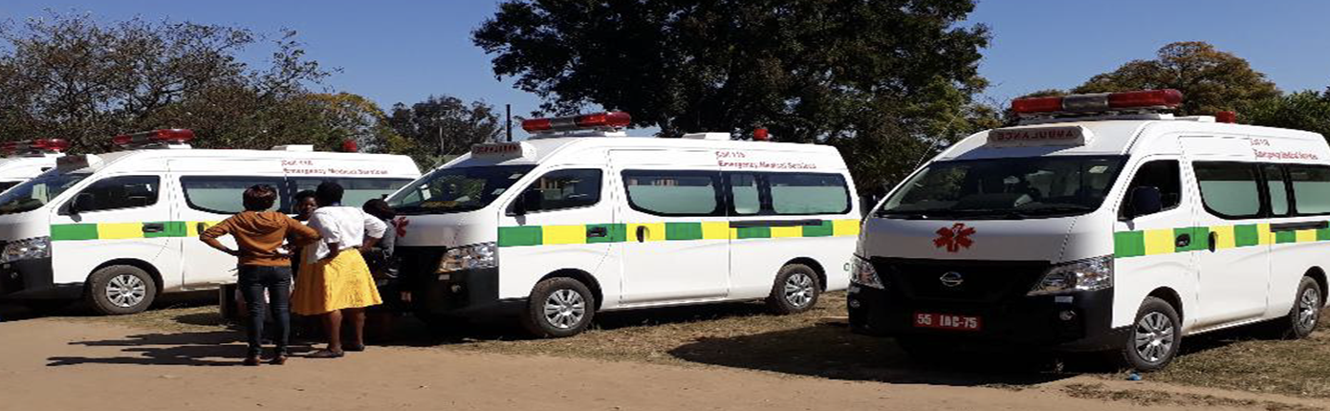
Designing Interventions for Corridor Post-Crash Response Readiness
Malawi Pilot: Ambulance Fleet
Establishing an EMS Communication System, including an exclusive toll-free 118 phone number
Recruiting and training EMS and in-hospital trauma care providers, including clinicians and nurses
Training of community first responders by the Malawi Red Cross
Refurbishing and equipping trauma care units in participating health facilities
Delivering 12 fully equipped ambulances
Recruiting and training ambulance drivers
Fully Equipped Basic Life Support (BLS) Ambulances
Ambulances procured through UNOPS
GPS tracking installed to monitor movements
Locally-branded
Additional equipment & medical kits supplied
Fleet Management Plan developed

Slide 19
Designing Interventions for Corridor Post-Crash Response Readiness
Malawi Pilot: Trauma Care Centers
Establishing an EMS Communication System, including an exclusive toll-free 118 phone number
Recruiting and training EMS and in-hospital trauma care providers, including clinicians and nurses
Training of community first responders by the Malawi Red Cross
Refurbishing and equipping trauma care units in participating health facilities
Delivering 12 fully equipped ambulances
Recruiting and training ambulance drivers
Public health facilities upgraded / constructed
Two central hospitals upgraded, Kamuzu Central Hospital (Lilongwe) & Queen Elizabeth Central Hospital (Blantyre)
Incoming triage space and medical equipment at three district hospitals (Dedza, Ntcheu, and Balaka) one community hospital (Lisungwi)

Slide 20
Designing Interventions for Corridor Post-Crash Response Readiness
Malawi Pilot: Community First Responders
Establishing an EMS Communication System, including an exclusive toll-free 118 phone number
Recruiting and training EMS and in-hospital trauma care providers, including clinicians and nurses
Training of community first responders by the Malawi Red Cross
Refurbishing and equipping trauma care units in participating health facilities
Delivering 12 fully equipped ambulances
Recruiting and training ambulance drivers
Community first responders and police officers effectively operate as independent response units
Approximately 500 first responders provided basic EMS training by Malawi Red Cross Society
Successful trainees received Red Cross certifications
All First Responders were members of the local communities nearest the M1 road
Simple phones to allow 118 calls and to receive SMS from dispatch call center or ambulance teams

Slide 21
Designing Interventions for Corridor Post-Crash Response Readiness
Malawi Pilot: Trauma Care Skills
Establishing an EMS Communication System, including an exclusive toll-free 118 phone number
Recruiting and training EMS providers and in-hospital trauma care providers, including clinicians and nurses
Training of community first responders by the Malawi Red Cross
Refurbishing and equipping trauma care units in participating health facilities
Delivering 12 fully equipped ambulances
Recruiting and training ambulance drivers
All medical training was coordinated through Malawi College of Health Sciences
In-hospital staff provided ALS procedures training and in use of new ALS equipment
Existing clinical staff and nurses were selected for medical/obstetrical emergency management and trauma care training
Trained staff deployed to respond to 118 calls

Slide 22
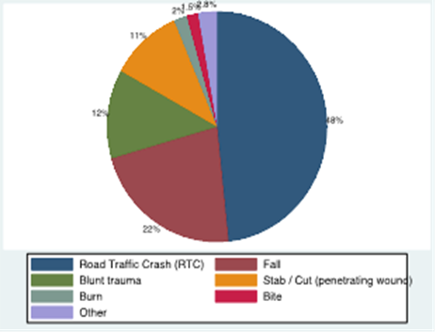
Designing Interventions for Corridor Post-Crash Response Readiness
Malawi Pilot: Lessons Learned
Challenge: Linking Dispatch, EMS Movements and Trauma Registry data chain to evaluate Post-Crash Response ‘Golden Hour’ performance metrics
Challenge: Demonstrating low-cost digital communication solutions to dispatch and monitoring of ambulance and post-trauma care outcomes
118
DIME Trauma Registry
Voice Over Internet Protocol (VOIP) via a SIP Domain was not possible
Telco cable of VOIP
High prank call rate and interconnection fees impacted telecom costs

Slide 23
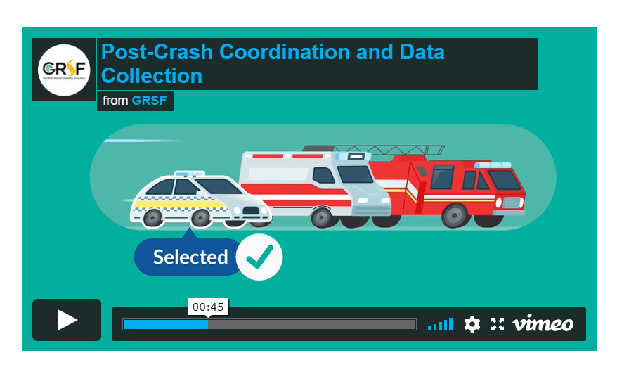
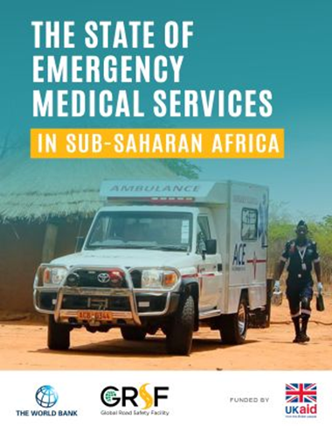
GRSF Resources – Post-Crash Response and Trauma-Care: Products for Different Stakeholders
  Post-Crash Response Toolkit (EASST and EBRD)
Six easy-to-follow video animations covering the key stages of the post-crash response lifecycle: emergency response, communication and dispatch, intervention at the scene, coordination and data collection, equipment and training and victim rehabilitation
  Sub-Saharan Africa EMS Status Report
A survey-based effort to identify current EMS delivery systems and practices
Review of regulatory and policy frameworks related to post-crash response
Potential opportunities for greater coordination and collaboration by noting similarities and differences
Country profiles

Slide 24
THANK YOU
www.roadsafetyfacility.org
WORLD BANK ACADEMY
Leaders in Road Safety Management

