Slide 1
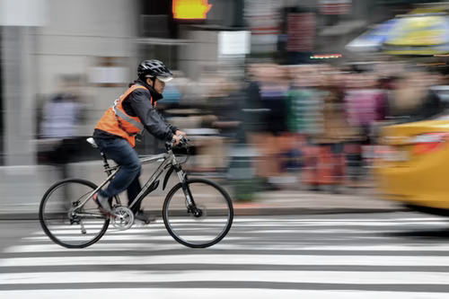

WORLD BANK ACADEMY
Leaders in Road Safety Management
Session 8:
Managing Traffic Safety
During Construction

Slide 2

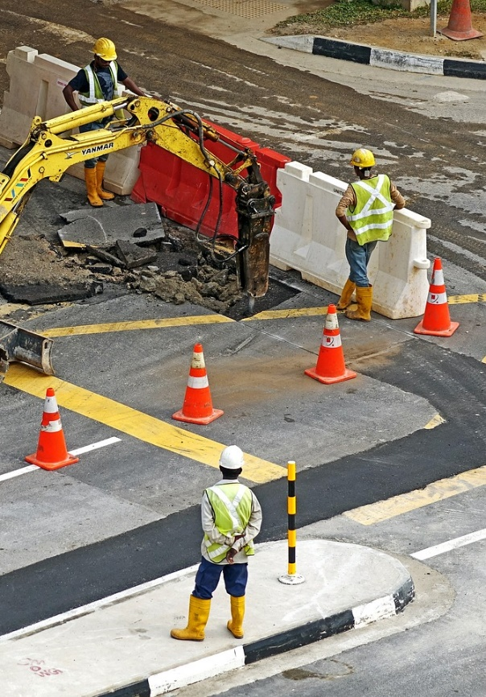
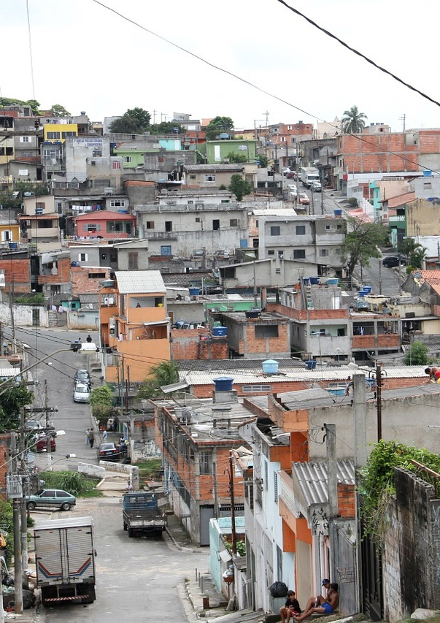
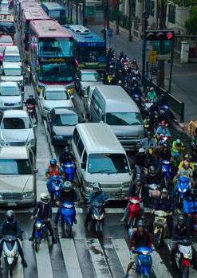
Stakeholders Exposed to Road Safety Risks
Project Workers
Local Communities
Road Users, especially VRU
Notes:
The GPN identified these three groups of people at risk of road safety issues, and interventions are designed to benefit each.
Project Workers who are the individuals and groups engaged in the project Implementation Phase such as direct workers, contracted workers, workers bring supplies and materials to the work site, and community workers.
Affected Communities who are the vulnerable individuals and groups directly exposed to project construction activities and ongoing exposure to operations once construction is completed; As noted in the ESF Guidance Note to Borrowers “Communities affected by traffic and road safety issues include those alongside, or bisected or fragmented by a road associated with the project. Shops, stalls, and residential properties may all be affected, along with people present on the road itself, whether nonmotorized (pedestrians and cyclists) or motorized (on motorcycles, or in cars, trucks, or buses).”
Road Users who are the public using the project road either during construction or operation phases. By far the majority of FSIs arise during the operational phase of a project once the road/facility is opened. For this reason, the GPN has a strong focus on interventions to reduce these risks.
Vulnerable users are also a focus. As shown earlier, well over 50% of deaths in LMICs are these three road user groups. It was also shown how at 30 km/h 15% of pedestrians would be fatalities in a collision, compared to 85% at 60 km/h.
Ideally, vulnerable users should be protected through segregation—such as through the provision of footpaths or dedicated cycle/motorcycle lanes. As segregation is impossible in many situations, the next option is speed management: vulnerable road users require a low speed environment to interact with traffic.
Vulnerable road users are pedestrians, cyclists, and motorcyclists, who are a key focus area in the GPN. As shown earlier, well over 50% of deaths in LMICs are these three road user groups—93% in Indonesia! These users are most at risk of an FSI in the event of a crash with a motor vehicle. We also showed that at 30 km/h 15% of pedestrians would be fatalities in a collision, compared to 85% at 60 km/h.
Ideally, vulnerable users should be protected through segregation—such as through the provision of footpaths or dedicated cycle/motorcycle lanes. As segregation is impossible in many situations, the next option is speed management: vulnerable road users require a low speed environment to interact with traffic.
Pedestrian Source: https://pixabay.com/photos/london-pedestrian-crossing-crossing-2286985/
Bicycle Source: https://pixabay.com/photos/cyclists-cycle-path-traffic-bike-1750975/
Motorcycle Source: https://www.nzherald.co.nz/nz/news/article.cfm?c_id=1&objectid=11594979
Workers Source: https://pixabay.com/photos/excavators-construction-machine-site-391143/
Community Source: https://pixabay.com/photos/brazilian-reality-brazil-641231/
Motorcycle Source: https://www.nzherald.co.nz/nz/news/article.cfm?c_id=1&objectid=11594979
At the identification stage of the project, Task Teams should identify the ‘Overall Project Traffic and Road Safety Risk’ (OPTRSR).

Slide 3
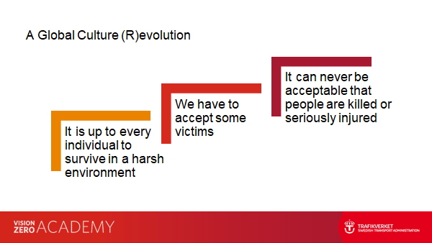
Safe System

Slide 4
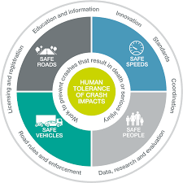
Safe System
Management process – monitoring,
Capacity building
Standards and guidelines
Traffic management plan – warning, delineation, speed
Separation from hazards
Facilities for vulnerable road users
Route selection
Reduced speed limit
Calming - Narrow road
Enforcement
Vehicle monitoring
Vehicle selection
Vehicle maintenance and checking
Vehicle monitoring
Road users
  Adequate warning, delineation, speed
Project workers
  Training, PPE
  Toolbox talks
  Monitoring / testing

Slide 5
Safe System
Management process – monitoring,
Capacity building
Standards and guidelines
Traffic management plan – warning, delineation, speed
Separation from hazards
Facilities for vulnerable road users
Route selection
Reduced speed limit
Calming - Narrow road
Enforcement
Vehicle monitoring
Vehicle selection
Vehicle maintenance and checking
Vehicle monitoring
Road users
  Adequate warning, delineation, speed
Project workers
  Training, PPE
  Toolbox talks
  Monitoring / testing

Slide 6
What is a traffic management plan (TMP)?
Traffic Management Plan
A comprehensive plan completed prior to commencement of works
Contains details on how risks associated with the works and vehicle/pedestrian traffic are managed at the worksite
Includes Traffic Guidance scheme
Existence of plan means nothing if this isn’t adopted, updated, integral to all activity
TMP
Notes:
Information on the proposed works (timelines, contact details for road operators, consultant and contractors) and inspection and enforcement program;
Implementation plan containing a method statement for implementing the traffic management arrangements including diversion routes, descriptions and drawings of operational procedures, and changeovers between concurrent traffic management arrangements for various project phases;
Inspection program defining the responsibility for specific reviews and inspections by the Safety Supervisor throughout the duration of the works;
Clearance plan containing a method statement for decommissioning at the end of the project;
Contingency plan for unplanned and emergency events (key contacts at DPWH and emergency services) particularly for large scale long-term projects;
Stakeholder management and communication plan detailing how stakeholders and the public will be informed throughout the work;
Traffic Guidance Scheme with layouts and details for all phases of the roadworks such as diversion route drawings, traffic management drawings and cross sections.

Slide 7
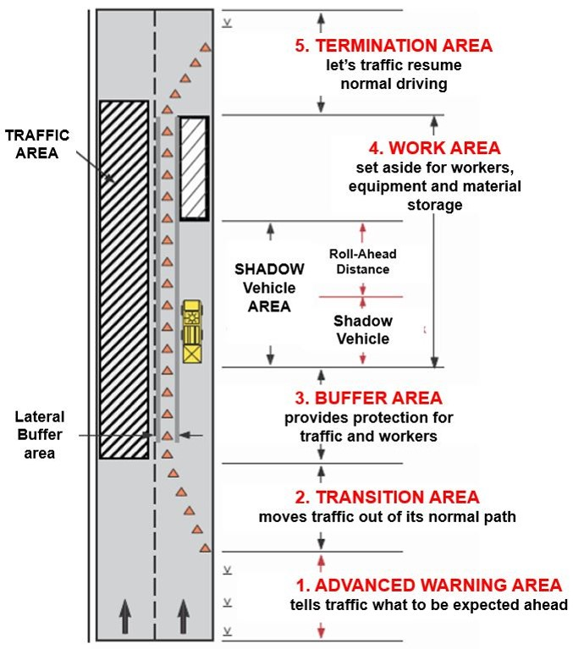
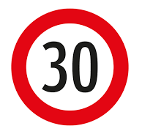
Work Zone Areas
Advance Warning Area
Transition Area
Buffer Area
Work Area
Termination Area
MAIN RULES:
Give drivers enough time to change their behavior.
Never surprise the
drivers.
Notes:
Work zone areas
Advance Warning Area: road users are informed about the oncoming roadworks and should adapt their behaviour to the new situation
Transition Area: road users are redirected (delineated) from their route (e.g., initial speed reduction, initial narrowing of the road, further speed reduction, final narrowing of the road)
Buffer Area: lateral and longitudinal area separating the traffic from the construction site, allows protection of workers from vehicles and protection of road users from workers and machinery
Work Area: construction works are performed, tools, excavated materials and equipment are stored, as well as the space needed for movement during the work
Transition Area: traffic returns to the original route

Slide 8
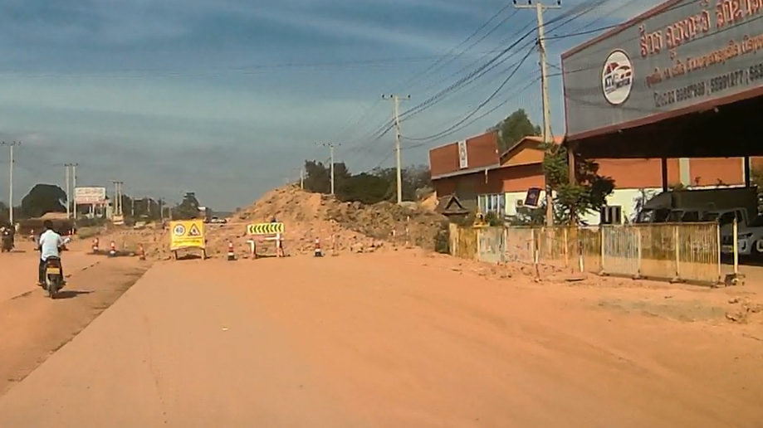

Advanced Warning
Advanced Warning
LATE NOTICE

Slide 9
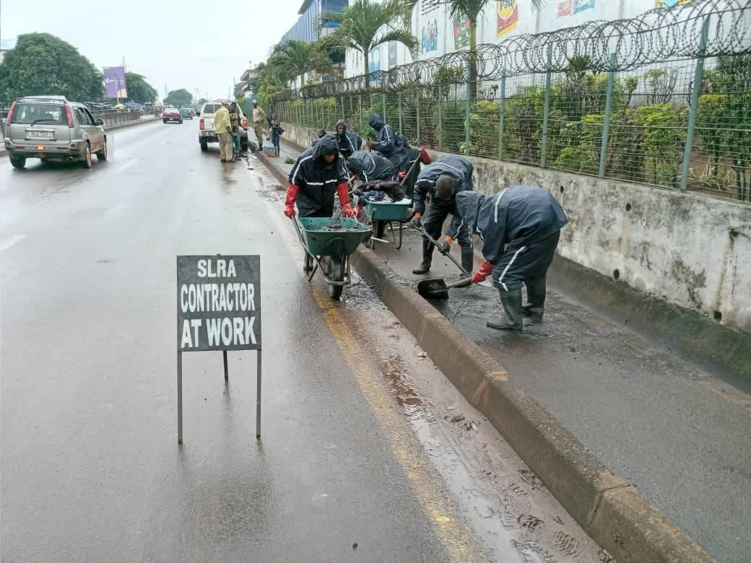




Separation
Separation

Slide 10
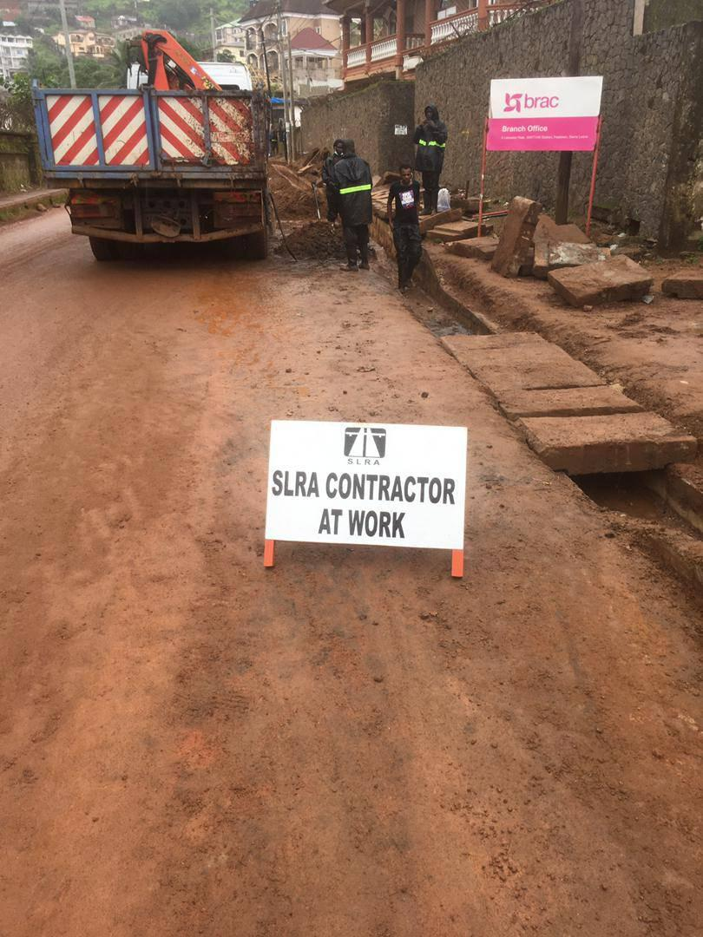
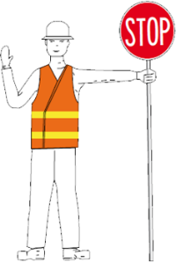
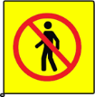


Clear Direction – Delineation
Notes:
if that driver is distracted for a moment, this situation (shown with yellow arrows) can easily arise.

Slide 11
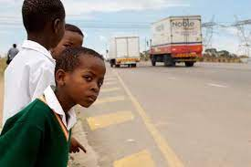
Route Selection
Moving materials on the safest route possible
May avoid certain locations or times of day
Vulnerable road users
Narrow roadways
Turning movements
Check detours carefully

Slide 12
Safe System
Management process – monitoring,
Capacity building
Standards and guidelines
Traffic management plan – warning, delineation, speed
Separation from hazards
Facilities for vulnerable road users
Route selection
Reduced speed limit
Calming - Narrow road
Enforcement
Vehicle monitoring
Vehicle selection
Vehicle maintenance and checking
Vehicle monitoring
Road users
  Adequate warning, delineation, speed
Project workers
  Training, PPE
  Toolbox talks
  Monitoring / testing

Slide 13
Speed Control
"A dump truck passed an irregularly parked vehicle on a corner, and ran over a 7 year old girl who was playing in the road. She sustained serious injuries to the right arm which needed to be amputated. Incident report noted improper speed of vehicle."
"Driver of dump truck was unfamiliar with vehicle, and lost control at high speed. Vehicle rolled over. Driver's leg was amputated due to injuries sustained."
"Third party truck was driving in opposite with a high speed and occupying two lanes. When the driver noticed the situation, he signaled (honked) and tried to pull over to avoid direct impact. However, due to the inertia of the vehicle, he failed and caused the vehicle to rush out of the road and roll over. The driver of another truck ran away."

Slide 14
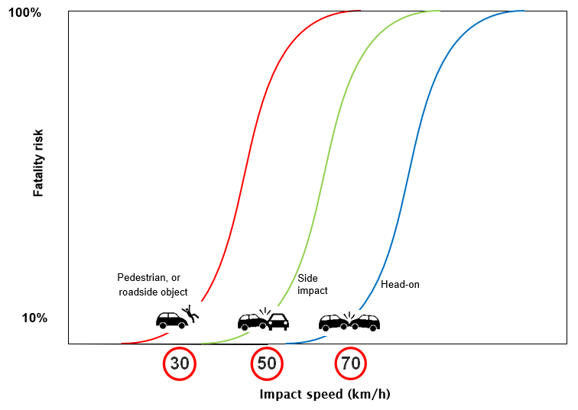
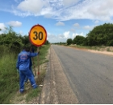
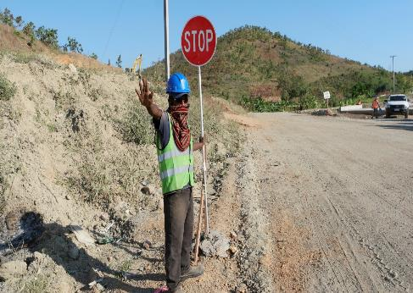
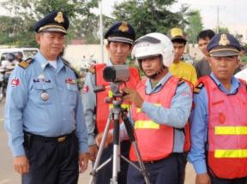
Speed Control
14

Slide 15
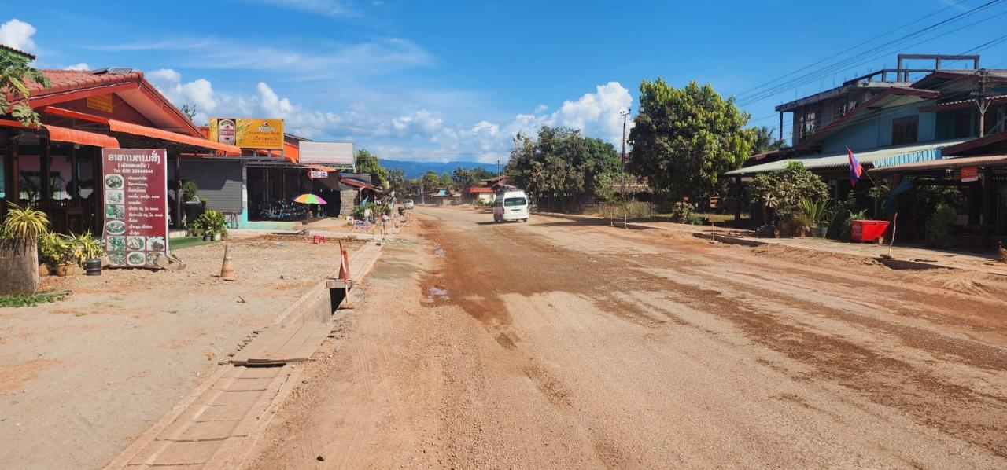




Speed Control

Slide 16
Safe System
Management process – monitoring,
Capacity building
Standards and guidelines
Traffic management plan – warning, delineation, speed
Separation from hazards
Facilities for vulnerable road users
Route selection
Reduced speed limit
Calming - Narrow road
Enforcement
Vehicle monitoring
Vehicle selection
Vehicle maintenance and checking
Vehicle monitoring
Road users
  Adequate warning, delineation, speed
Project workers
  Training, PPE
  Toolbox talks
  Monitoring / testing

Slide 17
Vehicle Selection / Inspection
Fatal incident: "Truck rolled backwards on steep hill crushing passenger of motorcycle that was following. It is alleged that the vehicle had some mechanical faults".

Slide 18
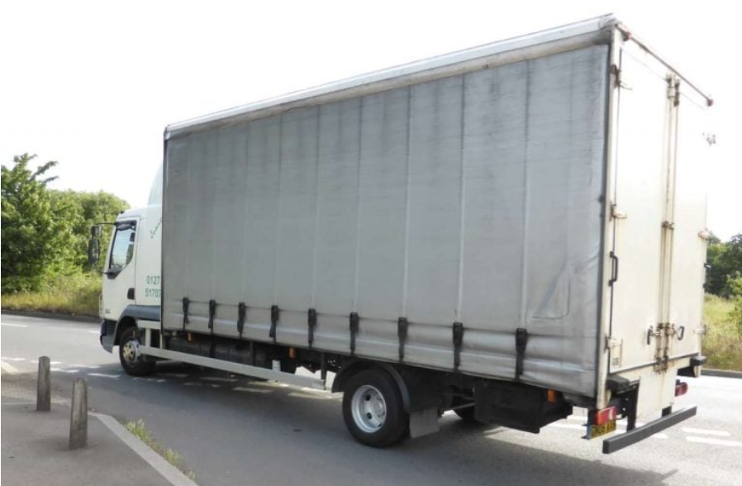
Vehicle Selection / Inspection
Select safe vehicles – can specify in contracts
Under-run protection
Seat belts and lights
Tyres
GPS tracking
Vehicles inspected regularly, and well maintained
      Daily checks (and recording of these)
      More substantial vehicle checks (e.g. brakes)
Avoid motorcycles for site inspection where possible. If you need to use, then make sure riders are well trained and protected

Slide 19
Safe System
Management process – monitoring,
Capacity building
Standards and guidelines
Traffic management plan – warning, delineation, speed
Separation from hazards
Facilities for vulnerable road users
Route selection
Reduced speed limit
Calming - Narrow road
Enforcement
Vehicle monitoring
Vehicle selection
Vehicle maintenance and checking
Vehicle monitoring
Road users
  Adequate warning, delineation, speed
Project workers
  Training, PPE
  Toolbox talks
  Monitoring / testing

Slide 20
Driver Training and Testing
Ensure drivers are well trained
Provide continual training and feedback
First aid training
Medical fitness to drive (e.g. eye sight)
Set clear limits on performance and check
      Alcohol and other drugs - testing
      Speed and speed monitoring devices
      Fatigue (adequate rest requirements)
"The driver was driving at high speed and under Alcohol effect (0.83g/l)".

Slide 21
Transport of Workers
Incidents where site workers have been injured or killed in transit
Ensure safe vehicles with seatbelts
Safe drivers
Safe location to pick up and drop off
"A worker was involved in an crash with the bus transporting the workers ….the bus was moving slowly with the doors closed and the worker was standing outside the bus. Some other workers were rushing to catch the bus and the worker fell over and connected with the bus".

Slide 22
Safe System
Management process – monitoring,
Capacity building
Standards and guidelines
Traffic management plan – warning, delineation, speed
Separation from hazards
Facilities for vulnerable road users
Route selection
Reduced speed limit
Calming - Narrow road
Enforcement
Vehicle monitoring
Vehicle selection
Vehicle maintenance and checking
Vehicle monitoring
Road users
  Adequate warning, delineation, speed
Project workers
  Training, PPE
  Toolbox talks
  Monitoring / testing

Slide 23
Monitoring and Reporting
Clear lines of responsibility
Recording of incidents, and acting on these
Checking for compliance (vehicles; site layout; driver testing etc)
Clear consequences for breaches
Checklist available

Slide 24

Capacity Building / Guidance Development
Consider training – contract managers and contractors
Production of guidance
      Country
      Regional / global

Slide 25
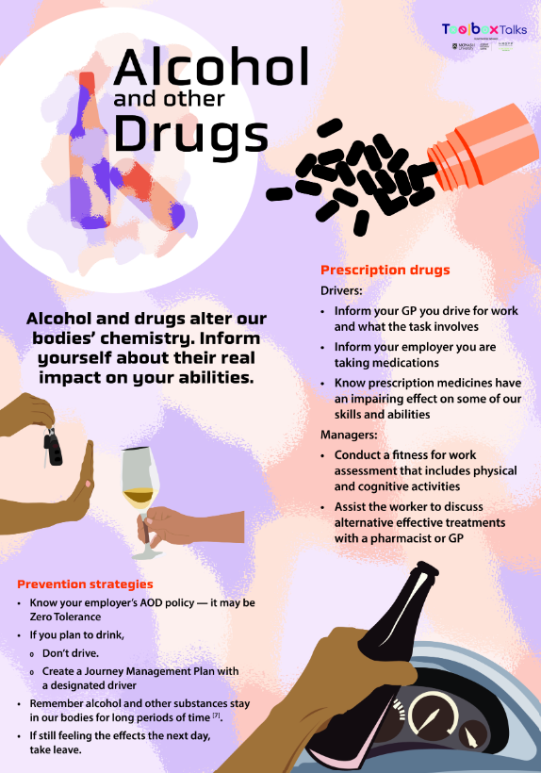

Tool Box Talks
Continual improvement process
Keep safety knowledge current
Keep it ‘front of mind’
Materials available for free
https://www.nrspp.org.au/

Slide 26
Key Points
This is a high risk on Bank projects
Should be aiming for zero deaths and serious injuries
Consider all who are at risk – public, workers (drivers, roadside workers); at site / offsite
Having a plan is not enough – need whole process
Training often required
Consider guidance review / development as part of project implementation

Slide 27
THANK YOU
www.roadsafetyfacility.org
WORLD BANK ACADEMY
Leaders in Road Safety Management

