Slide 1


WORLD BANK ACADEMY
Leaders in Road Safety Management
Session 9:
Managing Road Safety Data

Slide 2

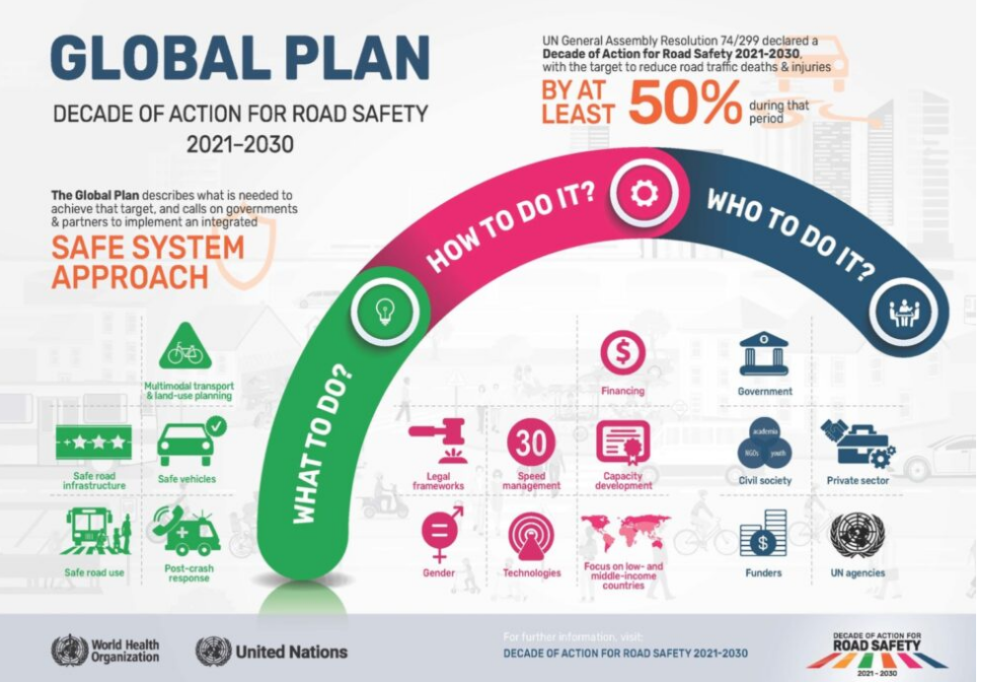
Challenges Ahead
The second Decade of Action for Road Safety 2021-2030
Reducing road traffic deaths and injuries by at least 50 percent
“The Global Plan goal foresees a further 13 million traffic deaths and 500 million injuries on the world's roads and streets over the coming decade, unless bold and decisive measures are taken.”

Slide 3
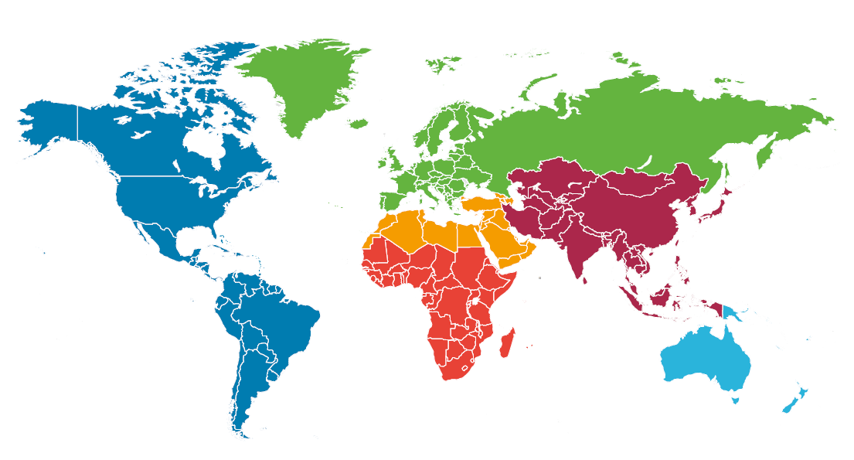
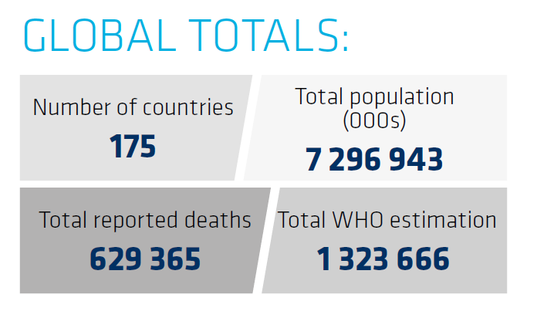
Data Challenges
Varying degrees of underreporting, completeness and lack of meaningful analysis for road safety interventions
Lack of standardization and integration of multiple datasets, definitions, and collection methods
Need for streamlining of processes, leveraging technology, bridging gaps in capacity and resources, and addressing barriers in notification of fatalities and injuries
Road safety indicators are not used (e.g. speed, drink-driving, safety equipment)

Slide 4
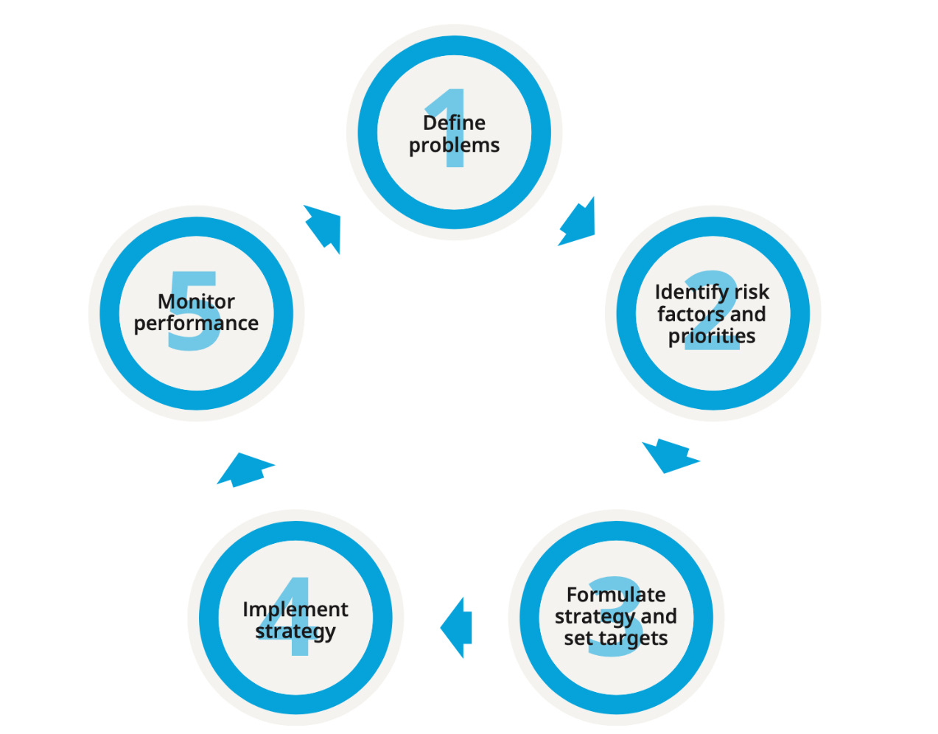
Importance of Reliable Data
Reliable safety and traffic data are essential to:
  Prioritize road safety vis a vis other public health issues
  Assess the full nature of the road safety problem (who is at risk ? When ? Why ? )
  Assess the real economic costs associated with road crashes
  If the problem is underreported, less likely to receive the right level of investment
  Design the most (cost) effective road safety interventions
  Monitor progress and adjust work plan
  Develop and implement a systematic approach to road safety
“What is not measured is unknown and what is unknown cannot be managed”

Slide 5
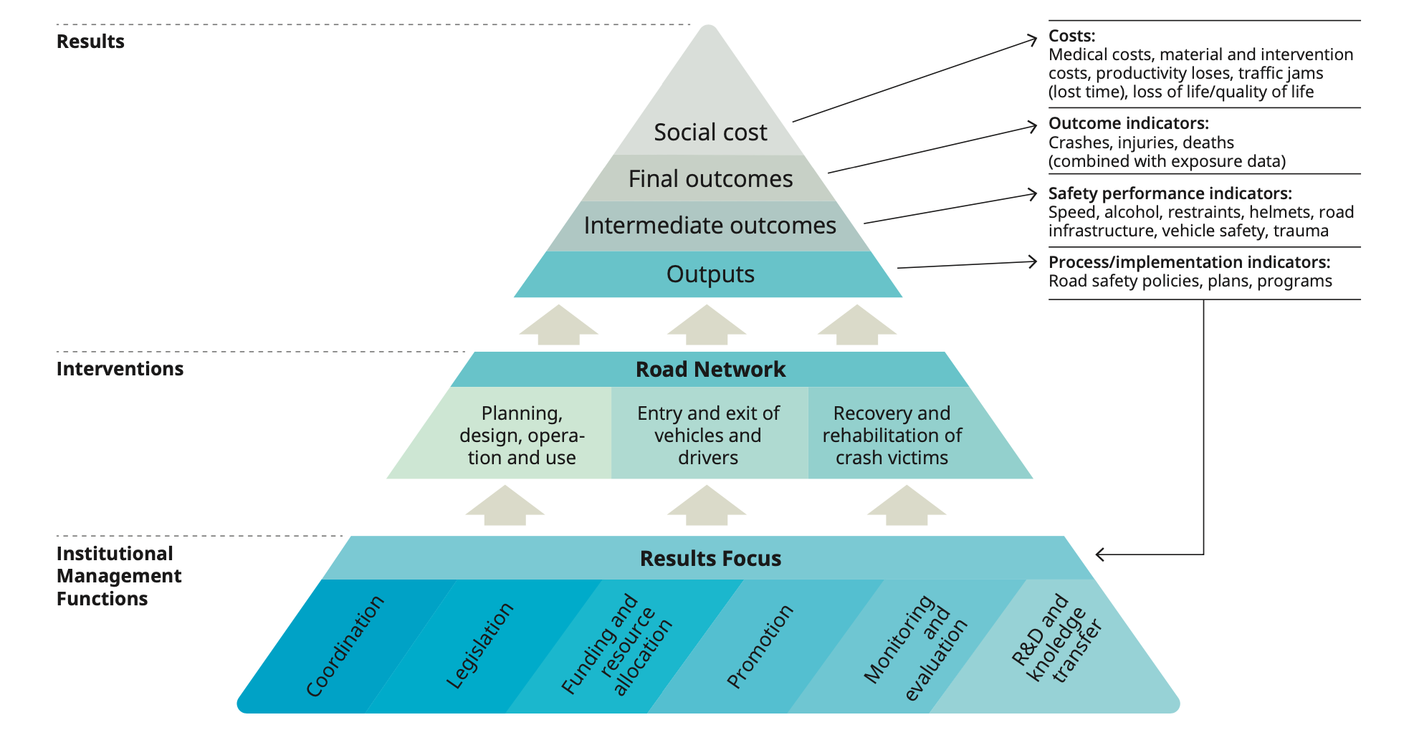
Road Safety Management and Data

Slide 6
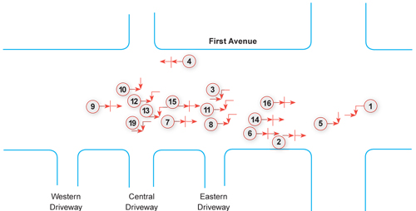
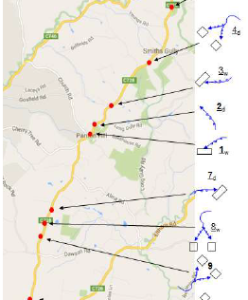
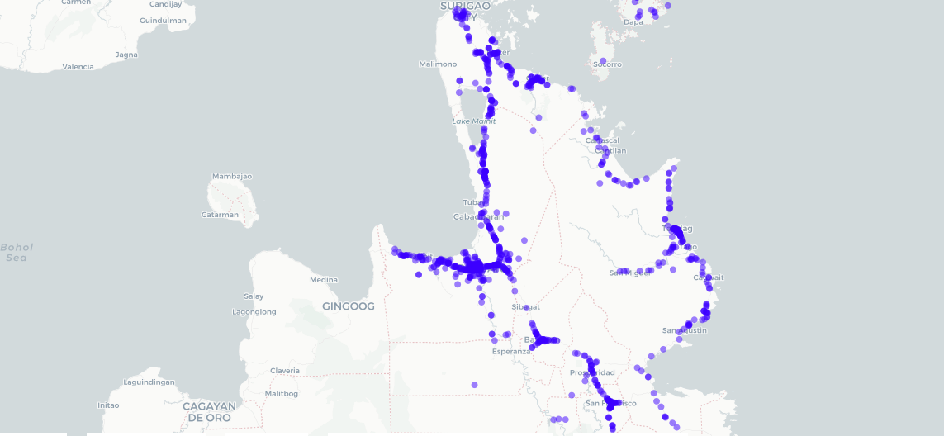
Crash and Casualty Data
  Should provide full picture of road risk, fatal and serious injury most important
  Completeness and notification
  Uniformity of definitions and collection
  Crash location
  Registration, transmission, and sharing
  Data storage
  Data querying, visualization, and analysis
  Leveraging other datasets, augmenting data

Slide 7
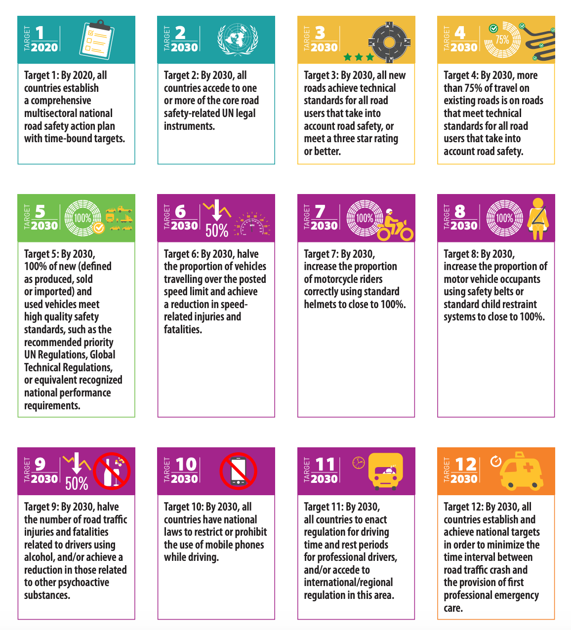
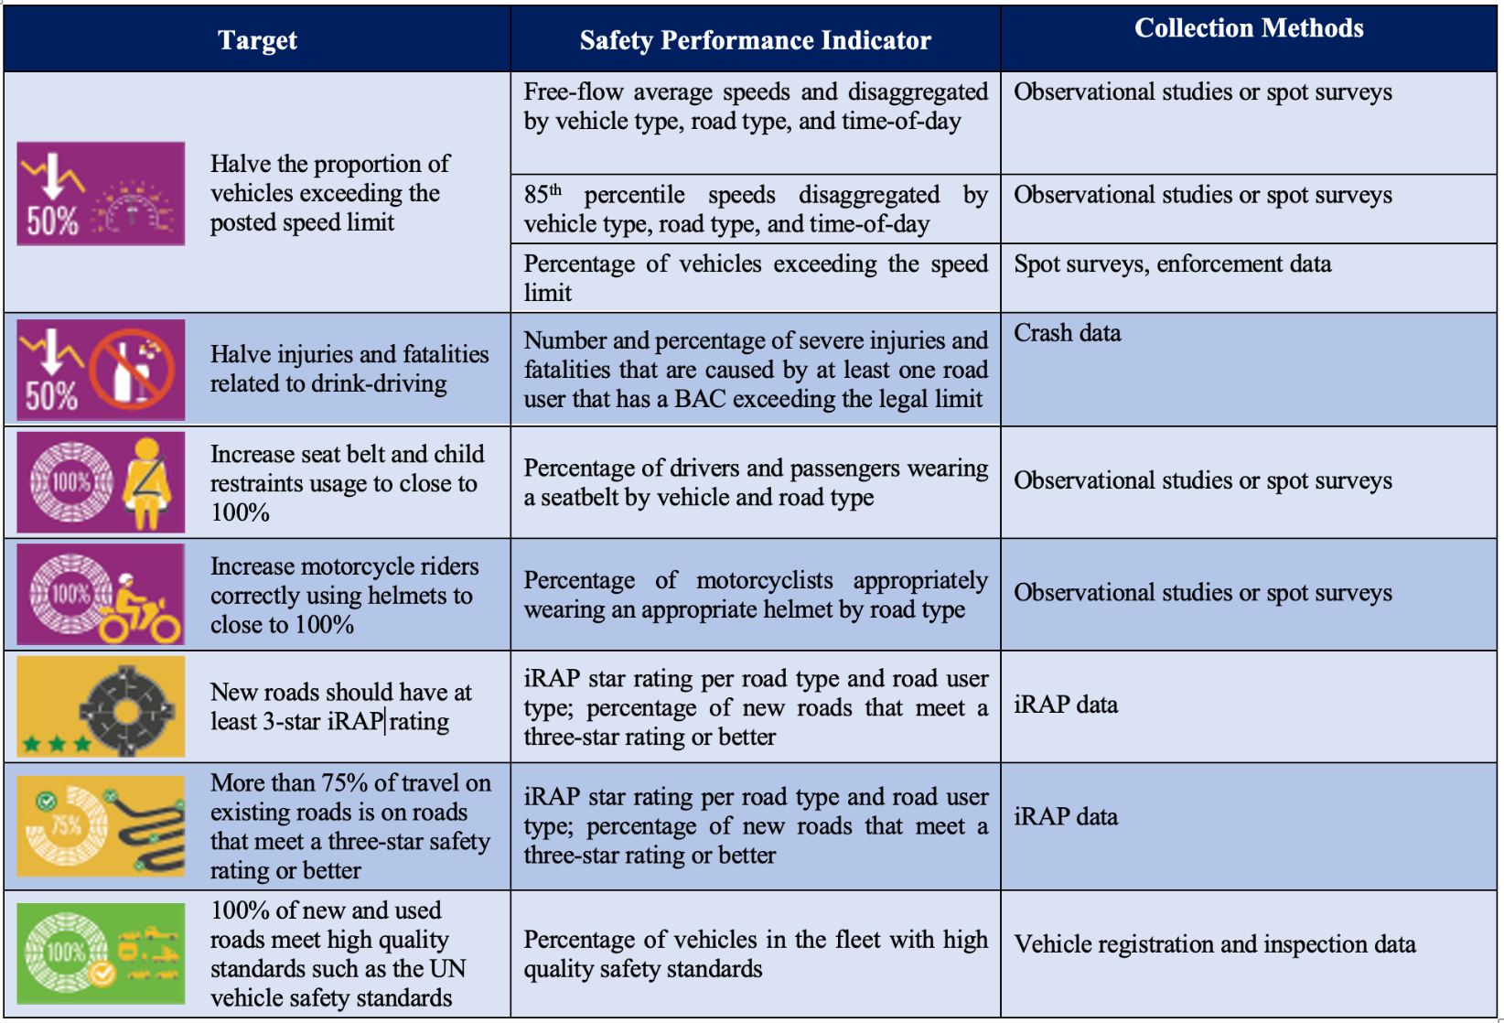
Safety Performance Indicators

Slide 8
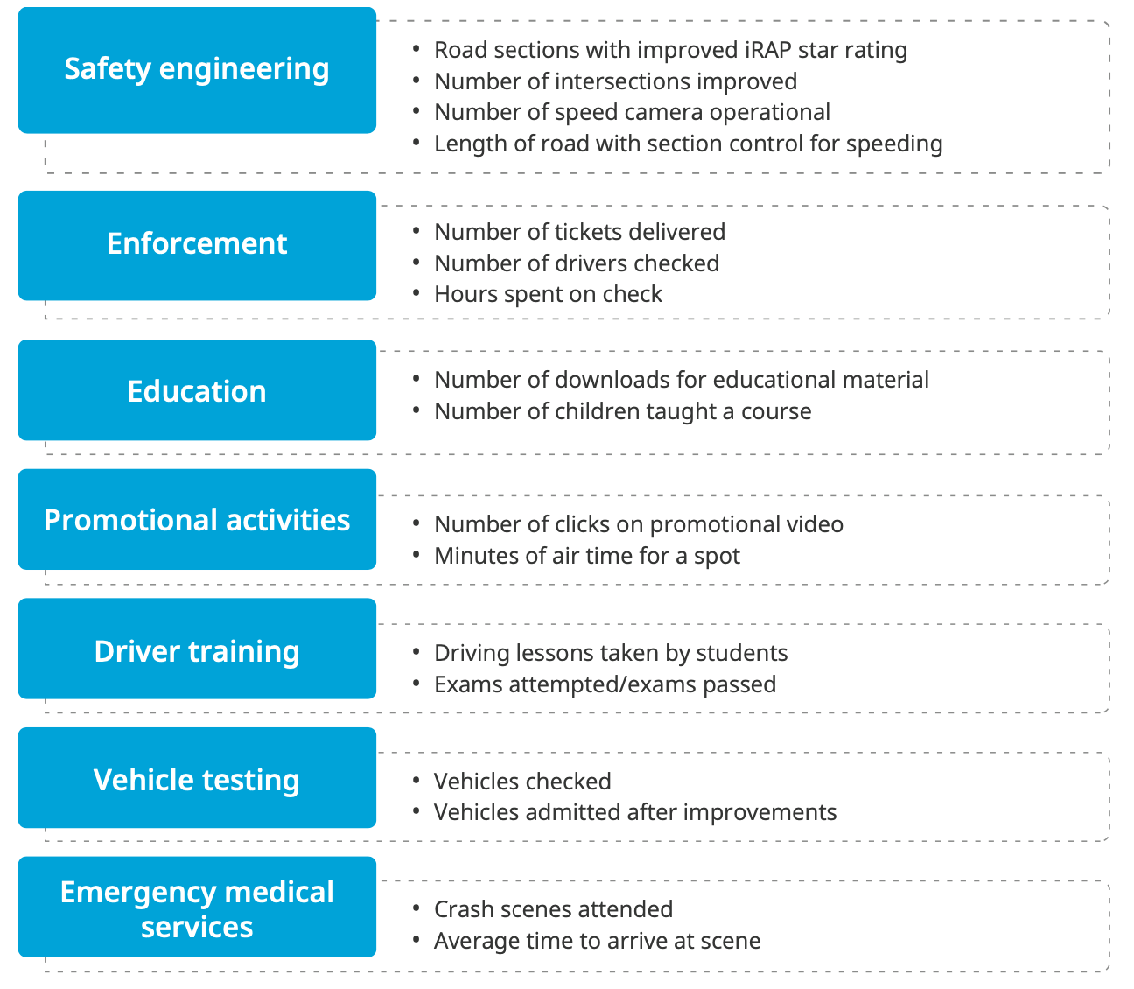
Other Data
Mobility Data
Road Safety Interventions
Reports from Regional Road Safety Observatories

Slide 9
Developing Data Systems
Developing comprehensive and effective data systems takes time. High performing countries have had decades of experience in this, across their transport and health sectors.
Crash fatality and injury data only become useful for the specification of a country Results Focus once sufficient years have been collected to reliably assess trends.
However, intermediate outcome surveys have immediate effectiveness in signaling likely final safety outcomes and guiding safety interventions until more comprehensive data systems are built.

Slide 10
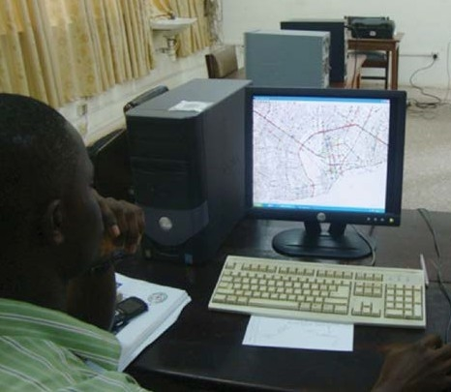
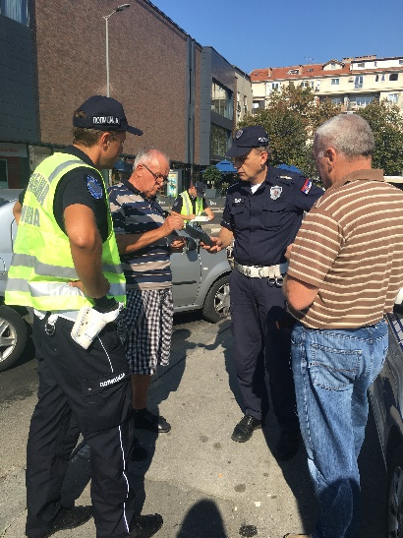
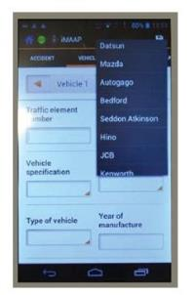
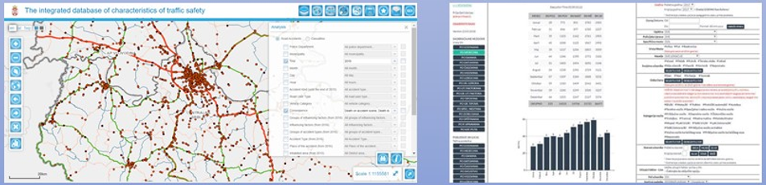
Road Safety Data Management Systems
  The World Bank is currently financing crash data systems in over 34 countries, through its lending operations.
  In addition to a strong road safety data management and coordination, some minimum requirements for the system include:
  Should provide full picture of road risk, fatal and serious injury most important
  Completeness and notification
  Uniformity of definitions and collection
  Crash location
  Registration, transmission, and sharing
  Data storage
  Data querying, visualization, and analysis
  Leveraging other datasets, augmenting data

Slide 11
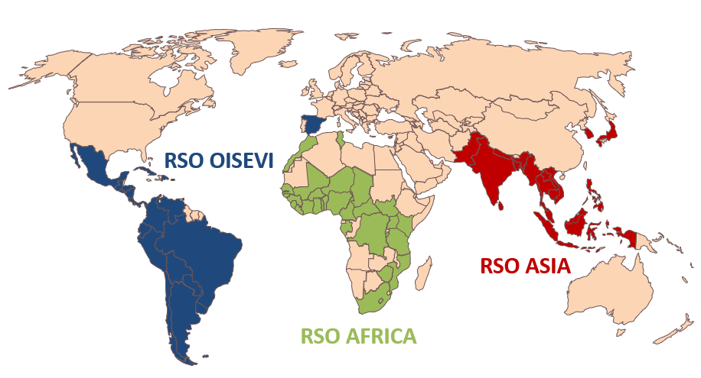

Road Safety Observatories
Objectives
  Accelerate country-level improvements in data collection, analyses and decision making,
  Stimulating harmonization between countries in the definition of variables and data collection procedures for better monitoring
  Fostering a positive emulation between countries to improve their crash data systems, raise road safety on the policy agenda and share data and information
  Offering a common space for data and information sharing, bringing around the table all key stakeholders.
  COLLABORATION - PARTNERSHIPS

Slide 12


Road Safety Data Review Guidelines
Objectives
  Support review teams in the assessment of road safety data collection (“detective work”)
  Harmonize assessments
  Identify needed preparations (stakeholders to consult, activities, documents to review)
  Identify international standards
  Self-evaluation tool for observatories
Scope
  Whole data collection process (crash investigations, reporting and registration, checking completeness and consistency, storage, analysis, use, and accessibility)
  Focus is on all types of road safety data
English
French
Spanish

Slide 13
Data Review Process
Objective of guidelines
    Support
    Harmonization
What?
    Preparations
    Stakeholders
    Interviews
    Reporting

Slide 14
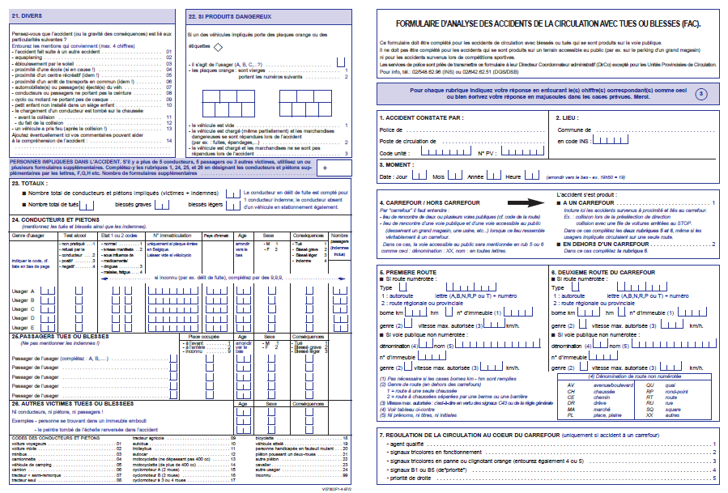
Preparations
Determine scope and objectives of review.
Obtain relevant data and documentation of your country
Identify key stakeholders
Undertake literature review of published studies and reports
Review existing documentation, forms and reports
Inspect crash data
Assess SPIs and mobility data
Develop preliminary assessment and insight

Slide 15
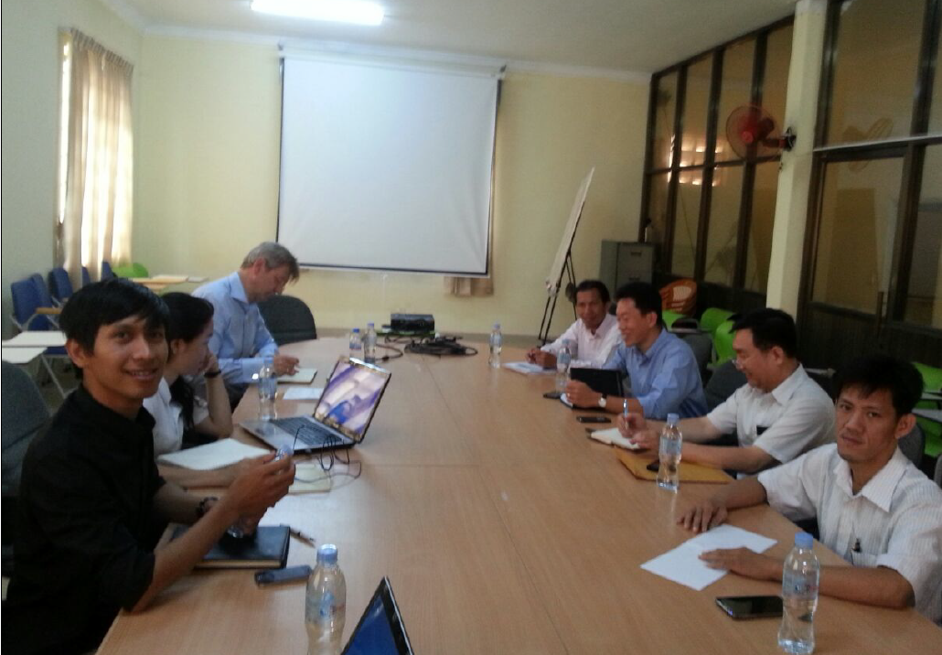
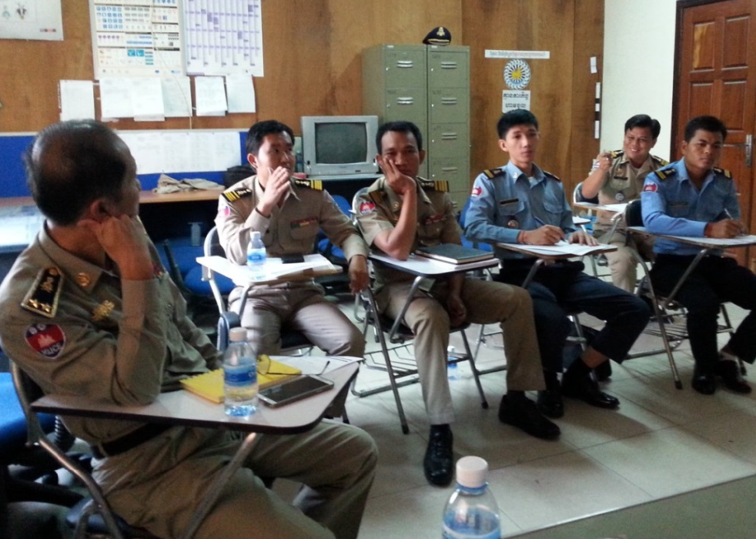
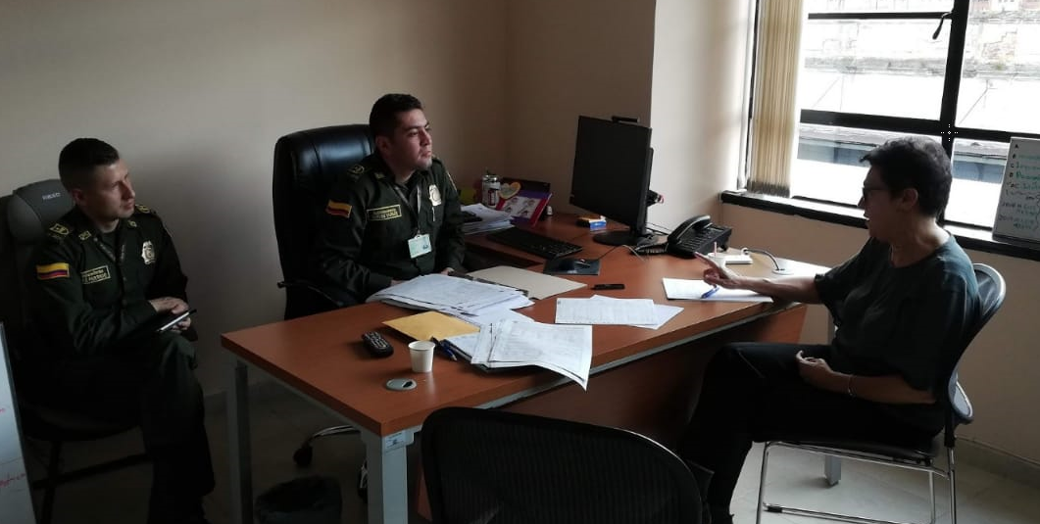
Stakeholders
Ministries and Government Departments
Police
Hospitals
Statistics Office
Coroners
Insurance Companies
Road Safety Advocacy Groups and Journalists
Research and Academia

Slide 16
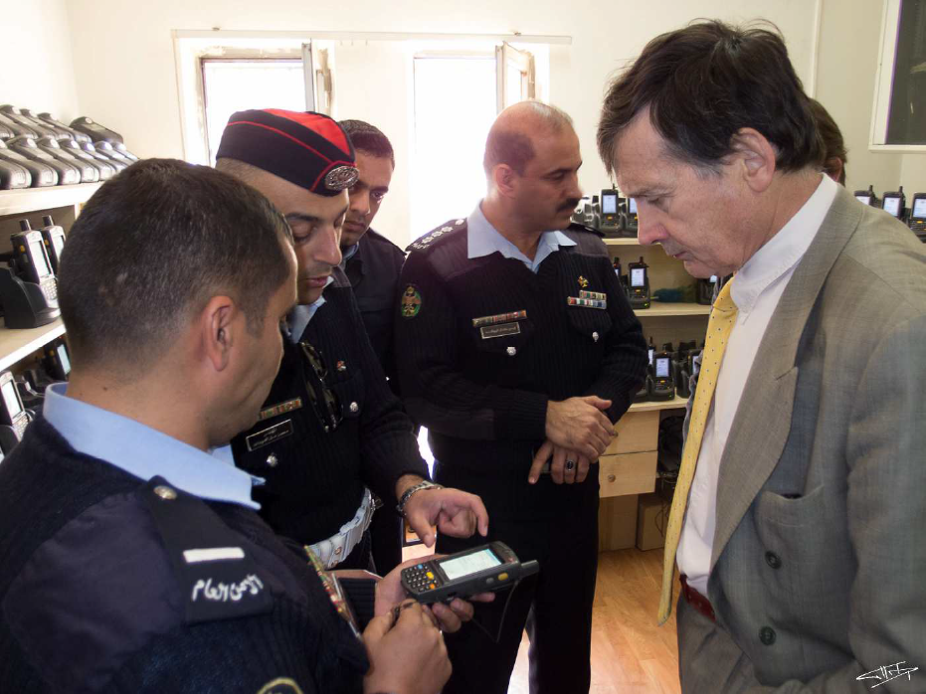
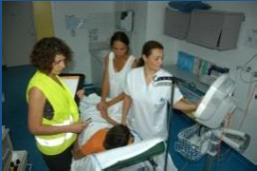
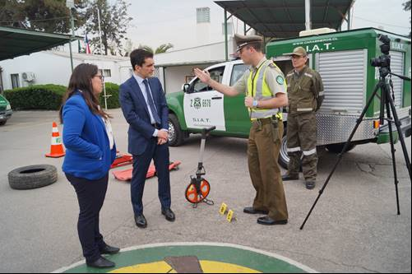
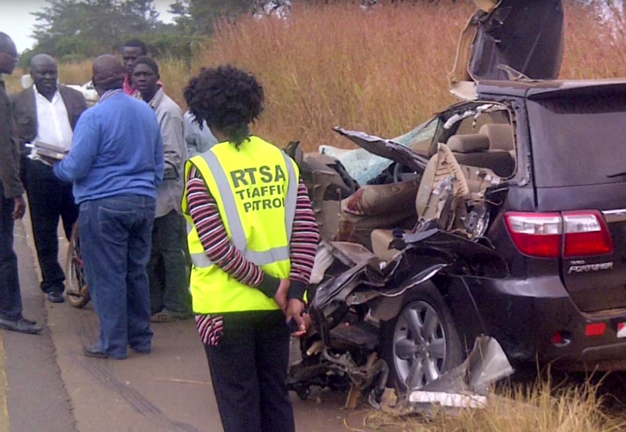
Interviews
What?
    Organization of data collection
    Resources
    Data storage and accessibility
    Data use
How?
    Trace the whole chain
    Look for tangible evidence
    Check for consistency

Slide 17
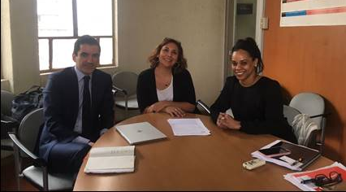
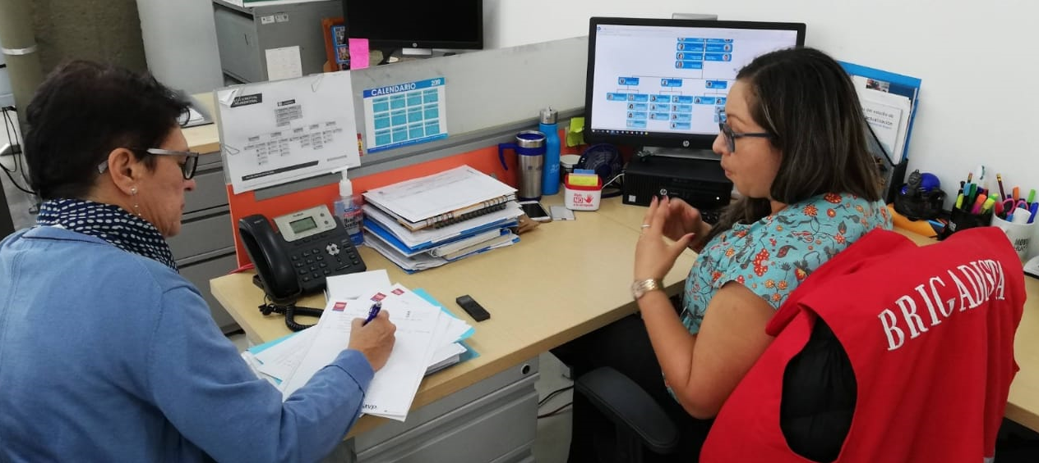
Reporting
Evaluation
    Completeness
    Quality
    Uniformity
  Recommendations
    Organization of data collection
    Use of road safety data
    Additional data to collect

Slide 18
Experience from Kenya- Methodology
Literature Review
      Previous studies, manuals, data received from ministries, past initiatives
Semi-structured interviews
      National Transport and Safety Authority, National Police Service, Hospitals, Kenya National Bureau of Statistics, Civil Registration, Insurance Companies, Relevant Advocacy Groups and Researchers
Observational Studies: Police station and hospital in urban and rural settings
Inter-ministerial meeting

Slide 19
Experience from Kenya-Observational Studies
Police
      Notification, recording of crashes, data elements collected, data transmissions, human resources, capacity building, equipment, legal framework
    Hospitals
      Organization of hospitals, data collected, injury severity, data transmission, human resources, capacity building legal framework
Other Offices
      Available data and indicators, data integration and sharing, accessibility, completeness and quality of data, barriers for citizens to report data (customs, costs), other road safety data

Slide 20
Experience from Kenya- Stakeholders Met
      Ministry of Roads and Transport (State department of Transport and State department of Roads)
      National Transport and Safety Authority (NTSA)
      Kenya National Highways Authority (KeNHA)
      Kenya Urban Roads Authority (KURA)
      Kenya Roads Board (KRB)
      Kenya Rural Roads Authority (KeRRA)
      Nairobi Metropolitan Area Transport Authority (NAMATA)
      Ministry of Health

Slide 21
Experience from Kenya- Stakeholders Met
      Kenyatta National Hospital
      Naivasha Sub-County Hospital
      National Police Service (NPS)
      National Traffic Police Service
      Nairobi Traffic Police HQ
      Embakasi Police Station
      Naivasha Police Station
      Civil Registration Services
      Kenya National Bureau of Statistics (KNBS)

Slide 22
Experience from Malawi: Findings
1 Governance
  There is no governance system to address spread of responsibility for road safety data across several major arms of government
  Goodwill across agencies is no substitute for:
  documented processes and procedures
  easy access to critical public safety information
  project governance disciplines to deliver reform
2 Systems
  A substantial upgrade or replacement is required to technology systems:
  Health – HMIS upgrade to similar capability as HIV and other public health issues
  DRTSS – MalTIS functionality upgrade required (to allow better analysis of drivers/vehicles for example)
  Traffic Police – a new crash data system which draws data from DRTSS, and provides data to centralised system
  Central road safety data management system needed

Slide 23
Experience from Malawi: Recommendation
1 Governance
  A road safety governance mechanism is formally established for national road safety effort, which can also oversee road safety data reform program
  Data governance arrangements are detailed in a signed inter-agency memorandum of understanding, including all management arrangements and data sharing
  DRTSS is nominated as the business owner of a central road safety data management system, developed and run by the Department of E-Government

Slide 24
Experience from Malawi: Recommendation
2 Program scope
  Establish a central road safety data management system to allow: data sharing; authorised stakeholder access; analytics; program design; monitoring and evaluation
  Revise MP176 crash report form against ARSO recommendations (only around 50% of fields currently covered)
  Introduce digital data collection and recording systems within Traffic Police and the Ministry of Health, and increase training and operational resources
  Replace the current MPS crash data system with a system designed to capture, share and analyse crash data, integrated with the central system
  Significantly upgrade the scope of the road traffic injury data set collected within the health sector against WHO recommendations
  Strengthen the DRTSS MalTIS system to full functionality and connection with the central road safety data management centre.
3 Central system
  An emergency response centre is established
  The central data system is integrated with the National Registration Bureau
  A modular software system is implemented based on microservices architecture to act as the central repository for management of road traffic crash data
  Significant start up and ongoing training through internalised train the trainer processes with special training provided in data analysis.

Slide 25
Experience from Malawi: Recommendation
Recommendations to Government
Establish governance mechanisms
Agree responsibilities for system ownership and delivery
Establish Project Implementation Team
Agree scope of data project
  A meeting of relevant government agency heads is convened
  Road safety governance mechanisms are established
  A Project Implementation Team is established within MPWT
  Project scope is confirmed: replacement of the MPS system; upgrade road traffic injury reporting within MoH systems; upgrade of MalTIS to full functionality, and establishment of a central system
  Ongoing responsibilities are agreed for “Business ownership” and delivery
  A project Terms of Reference is prepared, and a formal tender process initiated

Slide 26
THANK YOU
www.roadsafetyfacility.org
WORLD BANK ACADEMY
Leaders in Road Safety Management

